Slide 1
Communicating the Value of Immunization Information Systems (IIS)
A Template for Program Managers

Slide 2
Using this Slide Deck
The following slides are meant to be used as a template for you when talking or presenting about the IIS.
You are free to use and edit the content as you wish!
Additional information is contained within the slide notes for easy reference.
https://www.izsummitpartners.org/content/uploads/IIS_brochure_clinicians_template-2-10-2022.pdf

Slide 3
Agenda
Overview of IIS
IIS Data
Value Proposition
Sustainability

Slide 4
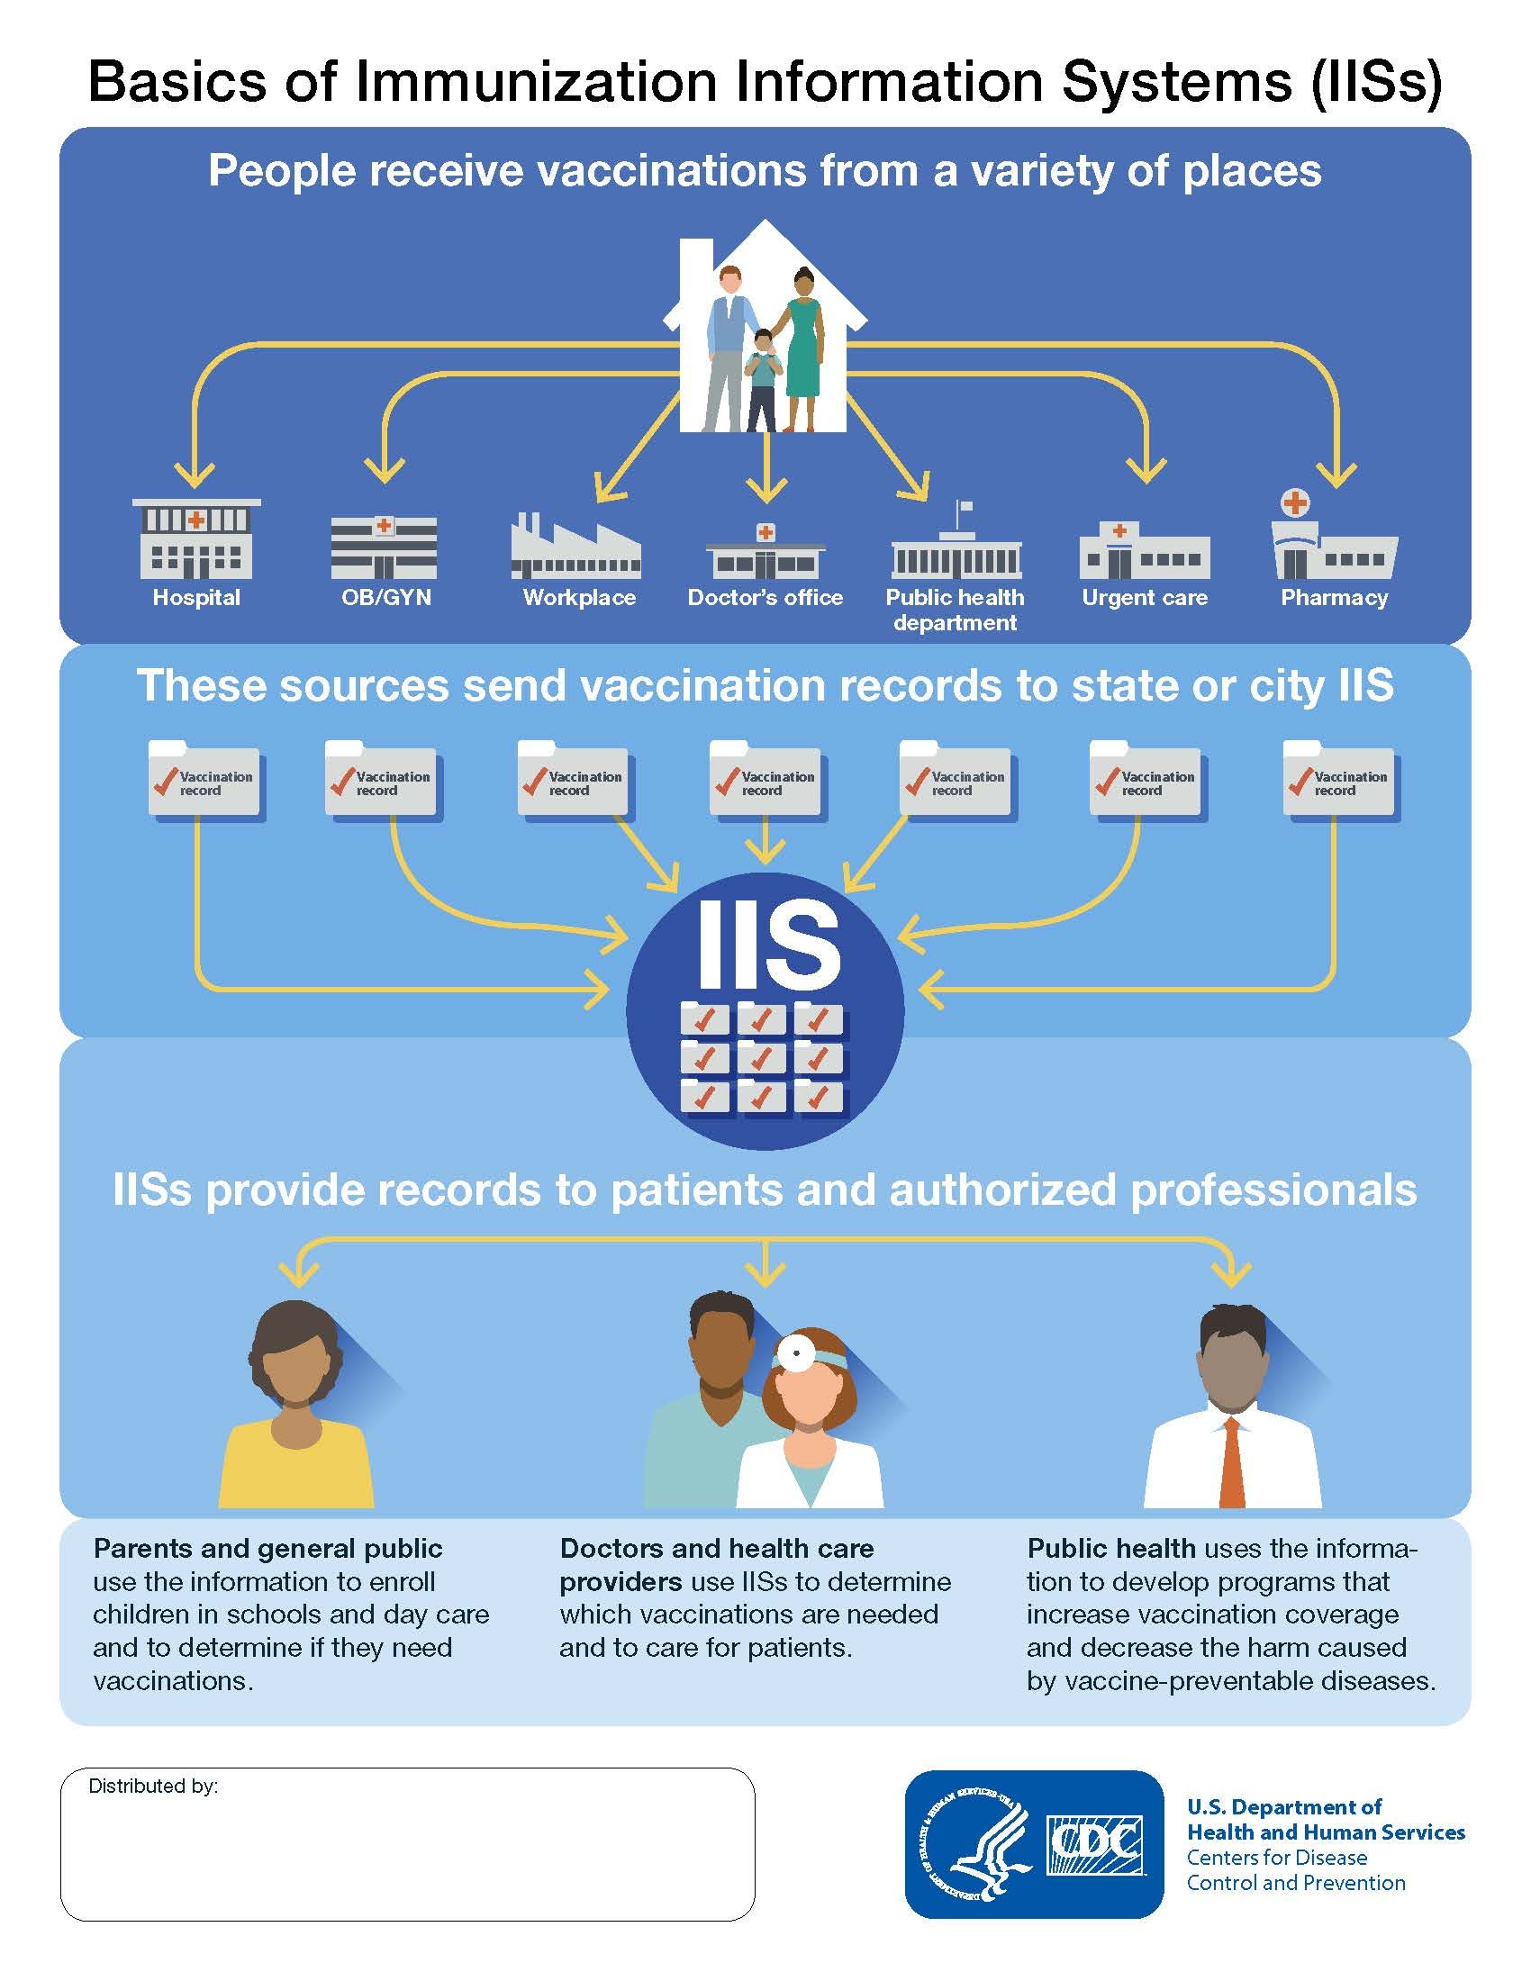
Overview of IIS
Confidential, population-based, computerized database
Records all immunization doses administered by participating providers to persons residing within a given area
Creates a consolidated record of an individual’s immunization history
Exchanges data with multiple authorized providers and partners, including across jurisdictions
https://www.cdc.gov/vaccines/programs/iis/about.html

Slide 5
Benefits of IIS
Access
Access to complete, accurate immunization records and forecasts
Identify
Identify vaccines patients are missing
Remind
Remind individuals of needed vaccines
Prevent
Prevent unnecessary duplicate vaccination and costly vaccine waste
Support
Support collaboration, coordination, communication, and documentation
Notes:
Access:
IIS are used by medical home clinicians, pharmacists, specialty care providers, and others throughout the medical community who need access to complete, accurate immunization records and forecasts of needed vaccines for people of all ages.
Identify
At least three out of every four adults are missing one or more recommended vaccines. IIS can help identify which vaccines patients are missing.
Remind
IIS support high quality care of both children and adults for routine vaccines, as well as those recommended during public health emergencies. Help ensure that you have access to the most accurate and complete immunization information to protect your adult Medicaid population from vaccine preventable diseases.
Access
Accessing a patient’s consolidated record and forecast of vaccines due is not only increasingly the standard of care, but also helps ensure your Medicaid population will receive the right vaccine at the right time.
Prevent
Using IIS data to supplement other immunization histories can prevent costly vaccine waste and claims payments by avoiding unnecessary immunizations.
Support
IIS support collaboration, coordination, communication, and documentation among members of the immunization neighborhood and care delivery teams.

Slide 6
[Name of IIS] Data
# Immunizations
# Individuals
# Connections
X Total
X Total
X Total
X Medicaid
X Medicaid
X Bi-directional
Notes:
The [jurisdiction IIS] contains:
X # of unique immunizations
X # of unique individuals
Total # active connections to the IIS
# of connections with a one-way exchange (either reporting to or receiving data from the IIS but not both)
# of connections with a bi-directional exchange (reports to and receives immunization histories from the IIS)
Consent Policy [example from Alabama CDC IIS Dashboard]
Adult consent: Adult Medicaid recipients are included in the IIS with no possibility to opt out. All other adults are included in the IIS unless they choose to opt out.
Child consent: Child Medicaid recipients are included in the IIS with no possibility for their parent(s)/guardian(s) to opt them out. All other children are included in the IIS unless their parent(s)/guardian(s) choose to opt them out.
Medicaid-specific Information
# of individuals in the IIS with a patient-level eligibility of “Medicaid-eligible”
# of immunizations administered with a dose-level eligibility of “Medicaid-eligible”

Slide 7
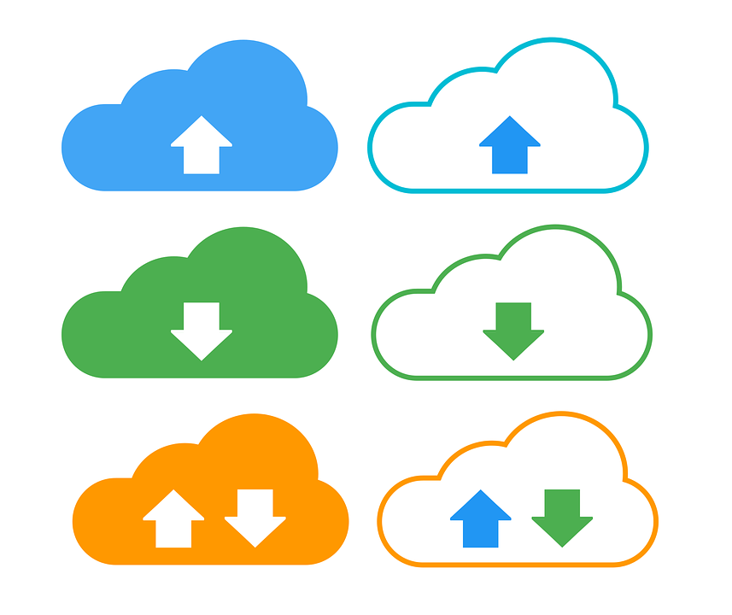
[Name of IIS] Data
Opt-out vs. opt-in
Consent
All ages, < 18, etc.
Inclusion
Reporting mandates?
Reporting
Notes:
EDIT THIS SLIDE BASED ON YOUR JURISDICTION

Slide 8
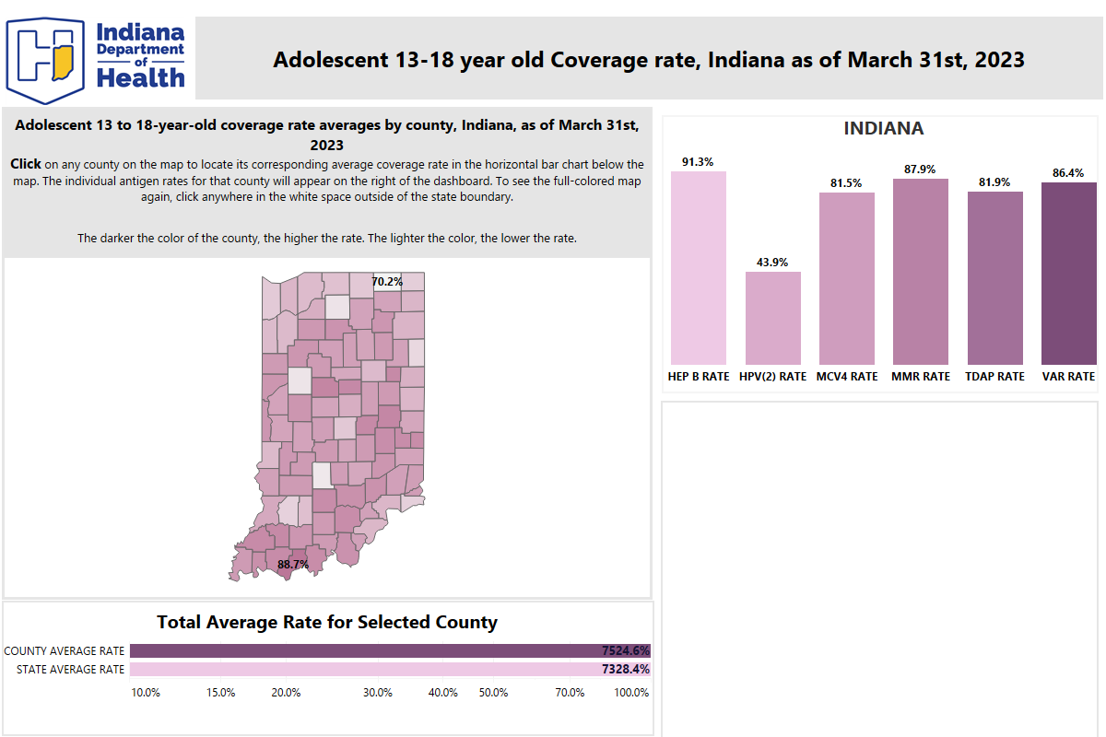
[Name of IIS] Coverage Rates
Notes:
Visualizing data, especially by age, race, sex, or other demographic or geographic characteristics is incredibly impactful when showing the value of the IIS and the data it contains

Slide 9
Value Proposition
Enhanced reporting
accurate coverage rates
Improved data quality & completeness
data visualization and analytics
Notes:
Value Proposition of IIS-Medicaid Partnership and Data Exchange
Enhanced public health reporting when the data sets are combined, you get a better understanding of disparities based on geography/location, social determinants of health, race or ethnicity, and others. By having an accurate and more complete depiction of this information, public health and community leaders can make better informed decisions and develop targeted outreach to underserved and under vaccinated communities and populations.
More accurate coverage rate assessments public health vs medical claims data contains different amounts of patient-level data completeness. By marrying the data, there are opportunities to improve the patient-level data quality and completeness in both systems that immunization programs, other public health programs, and Medicaid agencies can benefit from, particularly to generate more accurate immunization coverage rates for the population.
Improved data quality and completeness IIS to IIS data exchange across jurisdictions has grown significantly since the beginning of the pandemic. More and more IIS are also connected to the CDC’s Immunization Gateway (IZ Gateway) which includes federal partners such as the Veterans Health Administration and the Department of Defense as well as large health systems that span multiple states and jurisdictions.
Enhanced data visualization and analytics to support response to current and future health threats COVID-19 highlighted the interest and need for public-facing data reports and dashboards to show the overall health and protection within communities and specific populations such as Medicaid. When data sets are combined and used to report this information in a clear and consistent manner, it builds trust in the data and immunization programs.

Slide 10
Sustainability
Shared workforce
Less training
Data resiliency
Contingency planning
Notes:
IIS-Medicaid Data Sharing Sustainability
Workforce and Training
When it comes to data and informatics, finding skilled people who are willing to stick around long-term is extremely hard. Public health is often not able to compete with private sector positions and can find it difficult to recruit and retain staff with the skills necessary to maintain and operate public health data systems.
When data sets are combined and the relationship between IPs and Medicaid is strong, there can be an opportunity to share data and informatics workforce to analyze, cleanse, and improve the data in both systems. Data analytics and reporting can also act as a shared service between IPs and Medicaid creating dashboards for the public that are all housed within one location and not siloed as traditionally has been the case.
Data resiliency and contingency planning
Data contingency planning is critical. Capturing and storing data in more than one system can alleviate the loss of data or reduce the amount of system downtime necessary for data retrieval and system re-population.
The COVID-19 pandemic pushed the public health data infrastructure and information systems to their limits.
Strengthening and expanding partnerships between IIS and Medicaid can be a solution to address the increased demand on IISs and Medicaid systems and provide data contingencies.

Slide 11
Financial Benefits
Performance-based payments
HEDIS reporting
Evidence-based strategies
Quality measures
Notes:
Financial Benefits of IIS-Medicaid Data Sharing
Performance-Based Payments: Actively collaborating with IIS to obtain accurate and timely immunization data can help Quality Improvement Organizations (QIOs) receive performance-based payments based on their ability to achieve specific quality improvement targets related to immunization. These targets may include increasing immunization rates, reducing vaccine-preventable diseases, enhancing data accuracy and completeness, and improving overall immunization outcomes. QIOs that demonstrate exceptional performance in these areas can earn financial incentives tied to their success.
HEDIS reporting: Most managed care plans must report immunization-related HEDIS metrics to the state Medicaid agency. One often-used metric is immunization status. MCOs often obtain data from the IIS to supplement or validate their patient panel immunization status. Connecting the IIS to the main Medicaid data and technology ecosystem can make the sharing of this data easier.
Evidence-based strategies for improving vaccine coverage can help alleviate the costly burden of disease that could otherwise be prevented through timely immunizations.
Quality measures used for monitoring for performance in key activities, allows for comparison across health plans, with aim towards better patient care and lower cost.

Slide 12
Reducing the Burden of Disease
Vaccination Reminder & Recall Systems
Proactive outreach strategies
Reduce the likelihood of outbreaks and minimize the burden of vaccine-preventable diseases
Targeted Public Health Interventions
Identify high-risk populations and areas with low immunization rates
Identify high-risk communities or groups
Improve immunization rates in vulnerable communities
Notes:
Reducing the Burden of Disease
Enhanced Vaccination Reminders and Recall Systems
Data sharing between Medicaid and IIS enables the development of robust vaccination reminder and recall systems. These systems can automatically generate reminders to healthcare providers and patients about upcoming or overdue vaccinations.
By leveraging the comprehensive data available through IIS, Medicaid programs can implement proactive outreach strategies, sending reminders via mail, phone calls, text messages, or electronic notifications. This helps to ensure that individuals stay on schedule with their immunizations, thereby reducing the likelihood of outbreaks and minimizing the burden of vaccine-preventable diseases.
Targeted Public Health Interventions
Data sharing also facilitates the identification of high-risk populations and geographic areas with low immunization rates. By analyzing the shared data, public health agencies and Medicaid programs can identify communities or groups that may be at a higher risk of vaccine-preventable diseases.
This information allows for targeted interventions, such as educational campaigns, immunization clinics, and outreach programs, specifically tailored to address the needs of these populations. By focusing resources where they are most needed, data sharing can help mitigate the burden of disease by improving immunization rates in vulnerable communities.

Slide 13
Thank you!
Questions?
[enter contact information]

