Slide 1
Vaccine Ingredients & Vaccine
Safety
REACH organization’s
logo here
(then remove green frame)
May 24, 2021
This webinar is supported by the Centers for Disease Control and Prevention of the U.S. Department of Health and Human Services (HHS) as part of a Cooperative Agreement. The contents are those of the author(s) and do not necessarily represent the official views of, nor an endorsement, by CDC/HHS, or the U.S. Government.

Slide 2
Learning Objectives
At the end of the webinar, participants will be able to:
List some of the ingredients found in vaccines
Describe the U.S. vaccine safety system
Notes:
Good afternoon everyone, we developed the following learning objectives listed here.
[For presenter] Questions to consider asking participants to kick off the presentation:
What is vaccine hesitancy? (multiple choice):
Refusal or reluctance to vaccinate against contagious diseases despite availability of vaccination services
Moving away from the needle when getting a vaccine
Refusing to go to a doctor’s office because of fear of needles.
I believe vaccines are dangerous. Yes/No
I trust vaccines, they are safe and prevent disease. Yes/No
Did you get the flu vaccine at least once in the past 3 years? Yes/No
Do you plan on getting the flu vaccine this year? Yes/No
If no, why not? (multiple choice)
I never get the flu vaccine
I don’t think the flu vaccine works.
I do not trust the vaccine.
d. Other reasons. Answer in the chat box.

Slide 3
Vaccine Ingredients

Slide 4
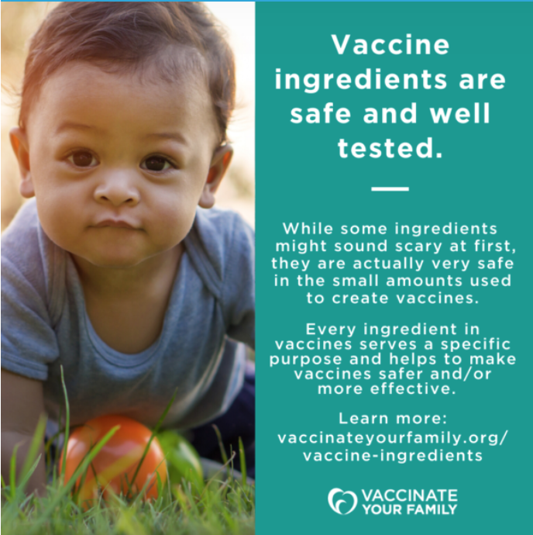
Today’s Vaccines Use Only Ingredients They Need to be as Safe and Effective as Possible.
Each ingredient serves a specific, necessary purpose:
  To facilitate production of the vaccine
  To provide immunity (protection) against the actual disease
  To prevent contamination and keep the vaccine safe and long lasting
Notes:
Each vaccine ingredient serves a specific, necessary purpose:
To facilitate production of the vaccine
To provide immunity (protection) against the actual disease
To prevent contamination and keep the vaccine safe and long lasting

Slide 5
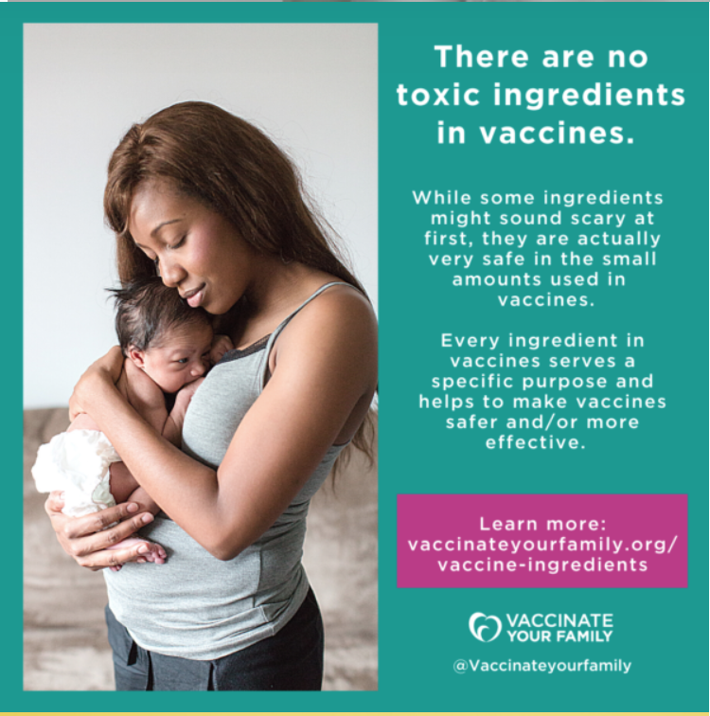
Vaccine Ingredients
Adjuvants help boost the body’s response to vaccine. (Also found in antacids, buffered aspirin, antiperspirants, etc.)
Stabilizers help keep vaccines effective after manufactured (Also found in foods such as
Jell-O® and resides in the body naturally)
Preservatives to prevent contamination

Slide 6
Manufacturing By-products (Residuals)
Because vaccines are often made from viruses and bacteria, some chemicals and cell
by-products used during vaccine production may remain in the final preparation in minute quantities. Some examples include antibiotics, egg proteins, formaldehyde.
Residual cell culture materials to help in production — make enough vaccine (e.g., eggs)
Residual inactivating ingredients to kill viruses or inactive toxins during the manufacturing process (formaldehyde)
Residual antibiotics to prevent contamination by bacteria during the manufacturing process
Notes:
Because vaccines are often made from viruses and bacteria, some chemicals and cell
by-products used during vaccine production may remain in the final preparation in minute quantities. Some examples include antibiotics, egg proteins, formaldehyde.
Residual cell culture materials to help in production — make enough vaccine (e.g., eggs)
Residual inactivating ingredients to kill viruses or inactive toxins during the manufacturing process (formaldehyde)
Residual antibiotics to prevent contamination by bacteria during the manufacturing process

Slide 7
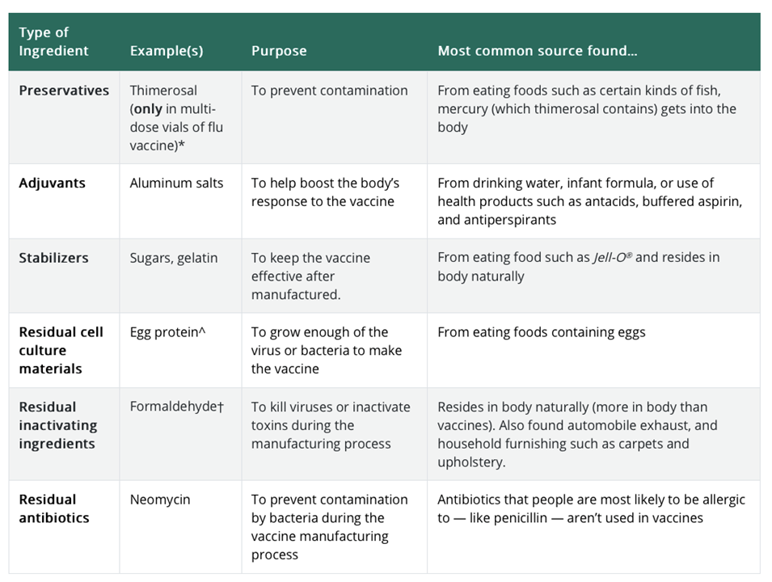
Source
Notes:
This is available on the CDC website.

Slide 8
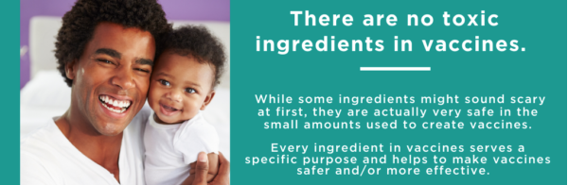
Thimerosal
Prevents the growth of bacteria in vaccines
Has a different form of mercury (ethylmercury) than the kind that causes mercury poisoning (methylmercury).
The human body eliminates thimerosal easily
Has been shown to be safe when used in vaccines
Scientific research does not show a connection between thimerosal and autism.
Was taken out of childhood vaccines in the U.S. in 2001.
Side effects in vaccines are minor (e.g., redness/swelling at injection site)
Notes:
Thimerosal has a different form of mercury (ethylmercury) than the kind that causes mercury poisoning (methylmercury). It’s safe to use ethylmercury in vaccines because it’s processed differently in the body and it’s less likely to build up in the body — and because it’s used in tiny amounts.
Mercury is a naturally occurring element found in the earth’s crust, air, soil, and water. Two types of mercury to which people may be exposed — methylmercury and ethylmercury — are very different.
Methylmercury is the type of mercury found in certain kinds of fish. At high exposure levels methylmercury can be toxic to people. In the United States, federal guidelines keep as much methylmercury as possible out of the environment and food, but over a lifetime, everyone is exposed to some methylmercury.
Thimerosal contains ethylmercury, which is cleared from the human body more quickly than methylmercury, and is therefore less likely to cause any harm.
Thimerosal is no longer an ingredient in any vaccine except multi-dose vials of the flu vaccine. Single dose vials of the flu vaccine are available as an alternative. No reputable scientific studies have found an association between thimerosal in vac­cines and autism.
Although rare, some people may be allergic to thimerosal.
Ingredients available at FDA website: https://www.fda.gov/vaccines-blood-biologics/safety-availability-biologics/thimerosal-and-vaccines
List of ingredients in all vaccines available at CDC website: https://www.cdc.gov/vaccines/pubs/pinkbook/downloads/appendices/B/excipient-table-2.pdf
https://www.chop.edu/centers-programs/vaccine-education-center/vaccine-ingredients/thimerosal

Slide 9
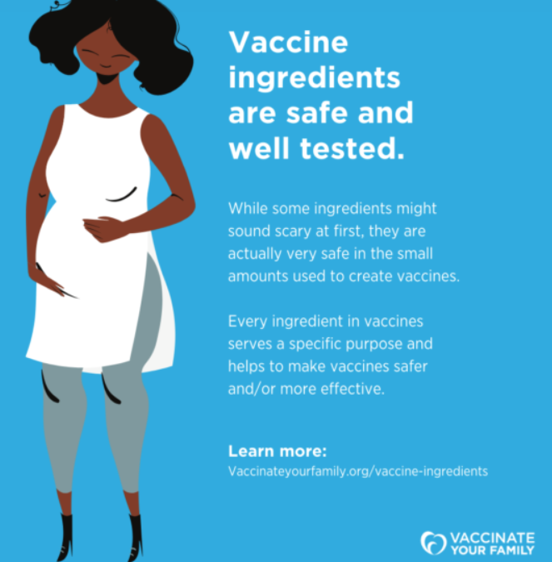
Formaldehyde
Formaldehyde is diluted during the vaccine manufacturing process, but residual (left over) amounts of formaldehyde may be found in some current vaccines.
The amount of
formaldehyde present
in some vaccines is so
small compared to what
occurs naturally in the
body that it does not
pose a safety concern.
Notes:
Why is formaldehyde used at all? To kill viruses or inactivate the bacteria during the manufacturing process of the vaccine. We do not want the live germ in the vaccine, we have to weaken or kill it first.
Other ingredients
https://www.chop.edu/centers-programs/vaccine-education-center/vaccine-ingredients/formaldehyde

Slide 10
What are Adjuvants?
Boosters that make the immune response stronger and the vaccine
work better.
They allow scientists to use less of the killed germ to make the vaccine.
All vaccines, including those that contain adjuvants, are tested for safety and effectiveness in clinical trials before licensed for use in the U.S. and continuously monitored by CDC and FDA once approved.
More information is at Vaccinate Your Family: https://www.vaccinateyourfamily.org/questions-about-vaccines/vaccine-ingredients/
Notes:
An adjuvant is an ingredient used in some vaccines that helps create a stronger immune response in people receiving the vaccine. In other words, adjuvants help vaccines work better. Some vaccines that are made from weakened or killed germs contain naturally occurring adjuvants and help the body produce a strong protective immune response. However, most vaccines developed today include just small components of germs, such as their proteins, rather than the entire virus or bacteria. Adjuvants help the body to produce an immune response strong enough to protect the person from the disease he or she is being vaccinated against.
Example: aluminum. Aluminum is found in health products including antacids, buffered aspirin, antiperspirants and some vaccines.
The aluminum contained in vaccines is similar to that found in a liter (about 1 quart or 32 fluid ounces) of infant formula. While infants receive about 4.4 milligrams* of aluminum in the first six months of life from vaccines, they receive more than that in their diet. Breast-fed infants ingest about 7 milligrams, formula-fed infants ingest about 38 milligrams, and infants who are fed soy formula ingest almost 117 milligrams of aluminum during the first six months of life.
*Note: One milligram is one-thousandth of a gram. One gram is the weight of one-fifth of a teaspoon of water.
Adjuvanted vaccines can cause more local reactions (such as redness, swelling, and pain at the injection site) and more systemic reactions (such as fever, chills and body aches) than non-adjuvanted vaccines.
In all cases, vaccines containing adjuvants are tested for safety and effectiveness in clinical trials before they are licensed for use in the United States, and they are continuously monitored by CDC and FDA once they are approved.
https://www.vaccinateyourfamily.org/questions-about-vaccines/vaccine-ingredients/

Slide 11
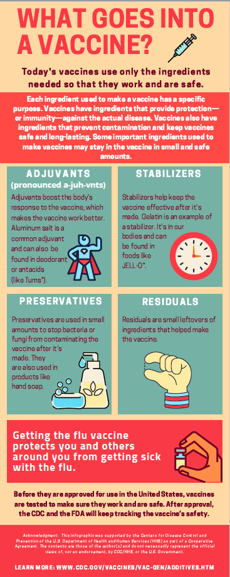
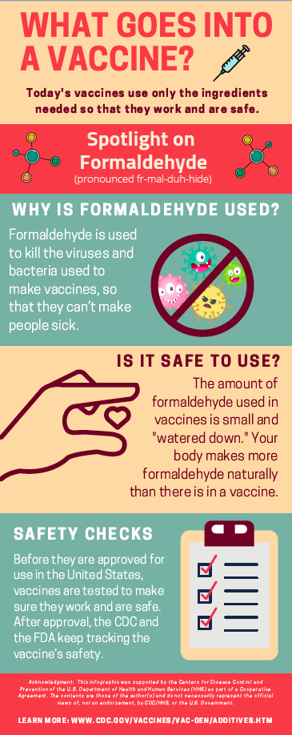
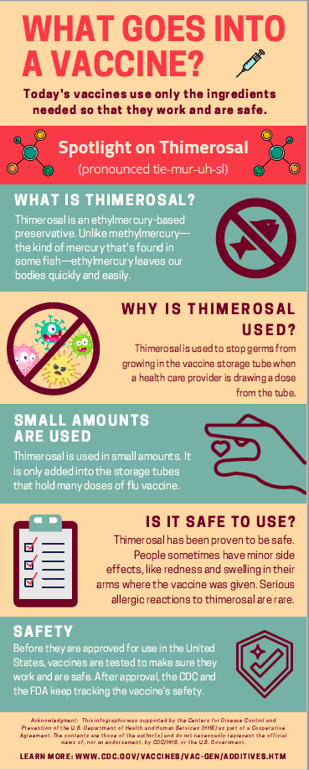
Vaccine Infographics

Slide 12
Vaccine Safety
Vaccines are safe!

Slide 13
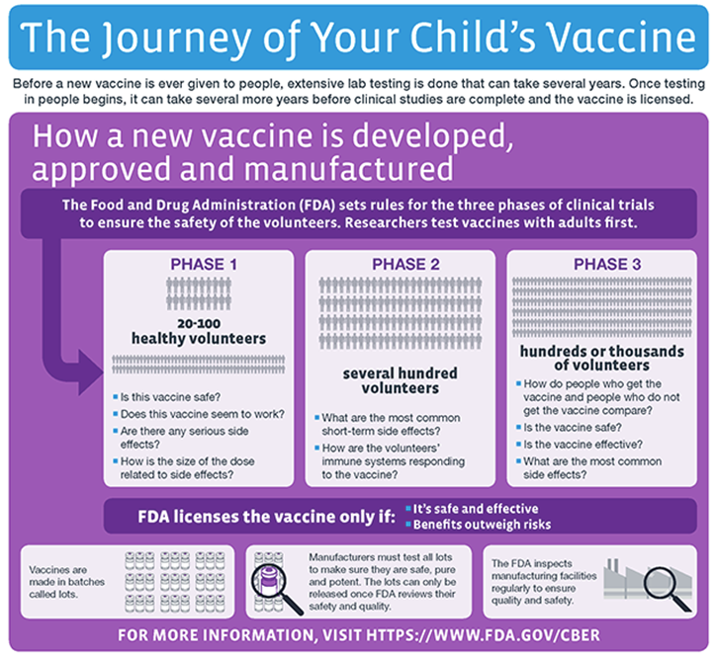
Notes:
The general stages of the development cycle of a vaccine are:
Exploratory stage
Pre-clinical stage (animal or lab studies)
Clinical development
Regulatory review and approval
Manufacturing
Quality control
Clinical development is a three-phase process. During Phase I, small groups of people receive the trial vaccine. In Phase II, the clinical study is expanded and vaccine is given to people who have characteristics (such as age and physical health) similar to those for whom the new vaccine is intended. In Phase III, the vaccine is given to thousands of people and tested for efficacy and safety.
Many vaccines undergo Phase IV formal, ongoing studies after the vaccine is approved and licensed.
Source: https://www.cdc.gov/vaccines/basics/test-approve.html

Slide 14
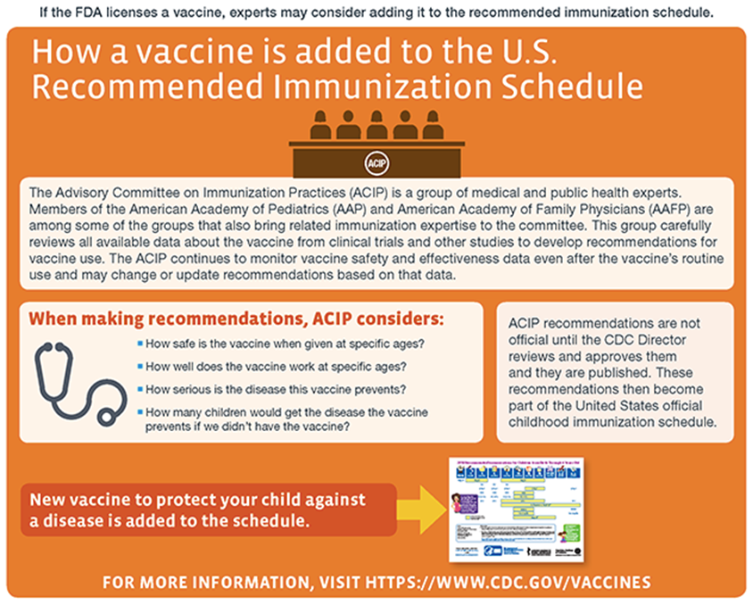
Notes:
The Advisory Council on Immunization Practices (ACIP) is a group of medical and public health experts. NON-governmental body. 15 Experts in their field appointed by the Secretary of Health and Human services. They may be professors, researchers, etc.
Members of the American Academy of Pediatrics (AAP) and American Academy of Family Physicians (AAFP) are among some of the groups that also bring related immunization expertise to the committee. This group carefully reviews all available data about the vaccine from clinical trials and other studies to develop recommendations for vaccine use. The ACIP continues to monitor vaccine safety and effectiveness data even after the vaccine’s routine use and may change or update recommendations based on that data.
When making recommendations, ACIP considers:
How safe is the vaccine when given at specific ages?
How well does the vaccine work at specific ages?
How serious is the disease this vaccine prevents?
How many children would get the disease the vaccine prevents if we didn’t have the vaccine?
ACIP recommendations are not official until the CDC Director reviews and approves them and they are published. These recommendations then become part of the United States official childhood immunization schedule.
New vaccine to protect your child against a disease is added to the schedule.
For more information, visit https://www.cdc.gov/vaccines
After being added to the U.S. Recommended Immunization Schedule, health experts continue to monitor the vaccine’s safety and effectiveness.
https://www.cdc.gov/vaccines/parents/infographics/journey-of-child-vaccine.html?CDC_AA_refVal=https%3A%2F%2Fwww.cdc.gov%2Fvaccines%2Fparents%2Finfographics%2Fjourney-of-child-vaccine-text.html

Slide 15
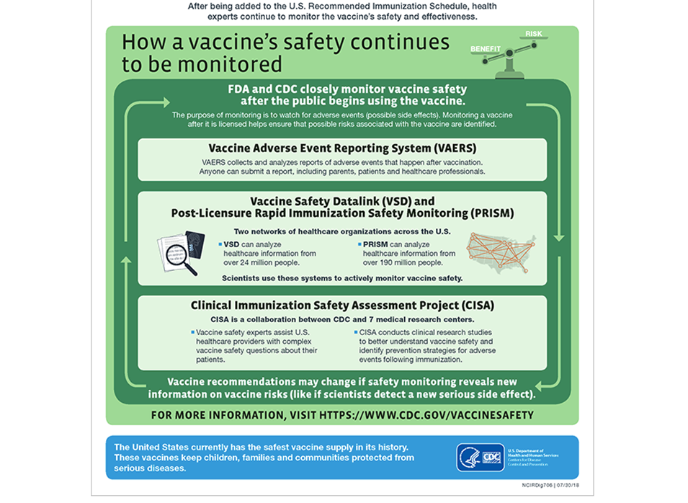
Notes:
The U.S. Food and Drug Administration’s (FDA’s) Center for Biologics Evaluation and Researchexternal icon (CBER) is responsible for regulating vaccines in the United States.
The sponsor of a new vaccine product follows a multi-step approval process, which typically includes
An Investigational New Drug application
Pre-licensure vaccine clinical trials
A Biologics License Application (BLA)
Inspection of the manufacturing facility
Presentation of findings to FDA’s Vaccines and Related Biological Products Advisory Committeeexternal icon (VRBPAC)
Usability testing of product labeling
After approving a vaccine, FDA continues to oversee its production to ensure continuing safety. Monitoring of the vaccine and of production activities, including periodic facility inspections, must continue as long as the manufacturer holds a license for the vaccine product.
FDA can require a manufacturer submit the results of their own tests for potency, safety, and purity for each vaccine lot. FDA can require each manufacturer submit samples of each vaccine lot for testing.
To learn about FDA’s role in the vaccine approval process, consult FDA’s Vaccine Product Approval Processexternal icon web page.
Tracking Side Effects Once a Vaccine is Administered
The Vaccine Adverse Event Reporting System (VAERS) is a national vaccine safety surveillance program co-sponsored by the Food and Drug Administration (FDA) and the CDC.
VAERS collects and analyzes information from reports of adverse events (side effects) that occur after the administration of US licensed vaccines. Reports are welcome from all concerned individuals: patients, parents, healthcare providers, pharmacists, and vaccine manufacturers. To submit a report, use VAERS’ reporting pageexternal icon. However, not every event that occurs after a vaccine means that the vaccine caused the event. Hence there are other entities that review the information further, for example VSD and CISA.
https://www.cdc.gov/vaccines/basics/test-approve.html

Slide 16
Adverse Events
True reactions to the vaccine:
Common, known side effects
Serious reactions, like allergic reactions (extremely rare)
Adverse events
Side effects
A side effect is any health problem shown by studies to be caused by a vaccine. Like any medication, vaccines can cause side effects. Usually they are minor (for example, a sore arm where a shot was given or a low-grade fever) and go away on their own within a few days.
Unrelated health problems
These are experiences that would have occurred even if the person had not been vaccinated. They happen after vaccination but are not caused by the vaccine.
Health problems that cannot be related directly to the vaccine
The cause of these events is unknown, and there is not enough evidence to say whether they are caused by
a vaccine
Notes:
True reactions,
An “adverse event” is any health problem that happens after a shot or other vaccine. An adverse event might be truly caused by a vaccine, or it might be pure coincidence.

Slide 17
Do Vaccines Cause Autism?
NO. There is no link between vaccines and autism
Where did this false theory come from?
Notes:
What is autism? Autism spectrum disorder (ASD)is a developmental disability that can cause significant social, communication, and behavioral challenges. Recent estimates from CDC’s Autism and Developmental Disabilities Monitoring Network found that about 1 in 54 children have been identified with ASD in communities across the United States. CDC is committed to providing essential data on ASD, searching for causes of and factors that increase the risk for ASD, and developing resources that help identify children with ASD as early as possible.
Some people have had concerns that Autism might be linked to the vaccines children receive, but studies have shown that there is no link between receiving vaccines and developing ASD.
Discuss Andrew Wakefield. His studies were deemed fraudulent and data misrepresented.
In 2011, an Institute of Medicine (IOM) reportexternal icon on eight vaccines given to children and adults found that with rare exceptions, these vaccines are very safe.
A 2013 CDC study [PDF – 7 pages]external icon added to the research showing that vaccines do not cause ASD. The study looked at the number of antigens (substances in vaccines that cause the body’s immune system to produce disease-fighting antibodies) from vaccines during the first two years of life. The results showed that the total amount of antigen from vaccines received was the same between children with ASD and those that did not have ASD.
Vaccine ingredients do not cause autism. One vaccine ingredient that has been studied specifically is thimerosal, a mercury-based preservative used to prevent contamination of multidose vials of vaccines. Research shows that thimerosal does not cause ASD. In fact, a 2004 scientific reviewexternal icon by the IOM concluded that “the evidence favors rejection of a causal relationship between thimerosal–containing vaccines and autism.” Since 2003, there have been nine CDC-funded or conducted studies pdf icon[PDF – 2 pages] that have found no link between thimerosal-containing vaccines and ASD, as well as no link between the measles, mumps, and rubella (MMR) vaccine and ASD in children. Besides thimerosal, some people have had concerns about other vaccine ingredients in relation to ASD as well. However, no links have been found between any vaccine ingredients and ASD.
Vaccines are not the cause. Researchers continue to look at other causes.
Source

Slide 18
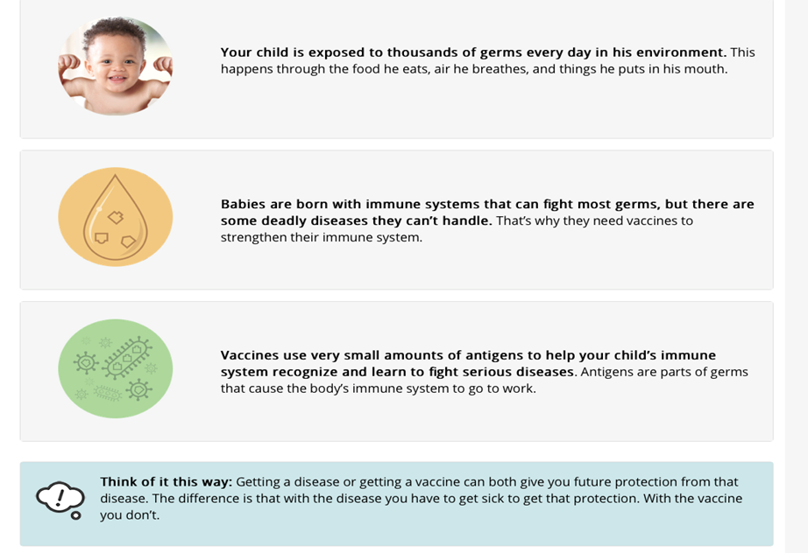
Do Vaccines Overwhelm the Immune System?
How do vaccines stimulate the immune system?
Let’s look at a newborn baby
Notes:
Vaccines contain weakened or killed versions of the germs that cause a disease. These elements of vaccines, and other molecules and micro-organisms that stimulate the immune system, are called “antigens.”
Question… can a baby handle all these antigens?
Babies are exposed to thousands of germs and other antigens in the environment from the time they are born. When a baby is born, his or her immune system is ready to respond to the many antigens in the environment and the selected antigens in vaccines
Getting multiple vaccines at the same time has been shown to be safe.
Scientific data show that getting several vaccines at the same time does not cause any chronic health problems. A number of studies have been done to look at the effects of giving various combinations of vaccines, and when every new vaccine is licensed, it has been tested along with the vaccines already recommended for a particular aged child. The recommended vaccines have been shown to be as effective in combination as they are individually. Sometimes, certain combinations of vaccines given together can cause fever, and occasionally febrile seizures; these are temporary and do not cause any lasting damage. Based on this information, both the Advisory Committee on Immunization Practices and the American Academy of Pediatrics recommend getting all routine childhood vaccines on time.
CDC’s recommended childhood vaccine schedule ensures children get the best protection during the many different stages in growth and development.
From the moment babies are born, they are exposed to numerous bacteria and viruses on a daily basis. Eating food introduces new bacteria into the body; numerous bacteria live in the mouth and nose; and an infant places his or her hands or other objects in his or her mouth hundreds of times every hour, exposing the immune system to still more germs. When a child has a cold, he or she is exposed to up to 10 antigens, and exposure to “strep throat” is about 25 to 50 antigens. Each vaccine in the childhood vaccination schedule has between 1-69 antigens. A child who receives all the recommended vaccines in the 2018 childhood immunization schedule may be exposed to up to 320 antigens through vaccination by the age of 2. Crawling on the floor at the airport for example gives a child more germs than could ever come from the vaccines a child receives.
In fact, a 1994 report from the Institute of Medicine, Adverse Events Associated with Childhood Vaccinesexternal icon, states: “In the face of these normal events, it seems unlikely that the number of separate antigens contained in childhood vaccines …would represent an appreciable added burden on the immune system that would be immunosuppressive.”
Source 1 AND Source 2

Slide 19
Vaccine Safety Graphics
Notes:
Resources: Vaccine ingredients from CHOP:
https://www.chop.edu/centers-programs/vaccine-education-center/vaccine-ingredients
https://www.vaccinateyourfamily.org/vyf-vaccinegraphics/

Slide 20
Resources
Vaccine Safety: Answers to Parents’ Top Questions
Top Doctors Address Vaccine Safety video
Are Vaccines Safe? video
Notes:
This slide includes lots of resources around vaccine hesitancy and building trust in vaccines.

Slide 21
Thank You!

