Slide 1
Kidney Disease + Vaccines
LIVE WEBINAR: FRIDAY, MARCH 25, AT 12 P.M. ET
Building sustainable, community-centered health equity by applying pandemic lessons to vaccines and total health with a focus on kidney disease.

Slide 2
Moderator
Kristen Hobbs, MPH, CPH
Senior Project Manager, Quality Improvement and Equity
NMQF - SHC

Slide 3
Microsite Devo
Example:
Basis for infographics, social media graphics, flyers, etc.
Culturally responsive and linguistically appropriate for ALL audiences
Important to individuals living with chronic kidney disease

Slide 4
Housekeeping
All attendees are in listen-only mode and videos are turned off
Place all questions in Q&A box
Respectful communication in chat box is welcome
Transcription should appear at the bottom of your screen
This webinar will be interactive!
Transparent feedback

Slide 5
Agenda
NMQF - SHC
Chronic Kidney Disease in POC
Vax Data
ACIP Recommendations
Panel Discussion
Microsite Outline Feedback

Slide 6
NMQF

Slide 7
Center for Sustainable Health Care Quality and Equity (SHC)
Sustainable, healthy communities in every zip code
Communities of color are prioritized
Quality Improvement and clinical education through the lens of health equity
Laura Lee Hall, PhD
President, SHC
Kristen Hobbs, MPH, CPH
Senior Project Manager, Quality Improvement & Equity
Chinonso "Chinnie" Ukachukwu, MPH
Quality Improvement and Equity Project Manager

Slide 8
Chronic Kidney Disease (CKD)
What is it?:
The kidneys are damaged and can’t filter blood the way they should.
The main risk factors for developing kidney disease are diabetes, high blood pressure, heart disease, and a family history of kidney failure.
How can one manage CKD?:
Controlling diabetes and blood pressure.
Engaging in healthy habits
Receiving all adult and routine vaccinations
Source: National Institute of Diabetes and Digestive and Kidney Diseases

Slide 9
Kidney Disease + Race & Ethnicity
Who is at higher risk for complications?
African Americans, Hispanics, and American Indians are at high risk for developing kidney failure
Increased prevalence of diabetes and high blood pressure in communities of color
By the numbers...
Black patients are 4x more likely to develop kidney failure
Hispanic patients are 1.3x more likely to develop kidney failure
Indigenous Americans are 1.2x more likely to develop kidney failure
Source: National Institute of Diabetes and Digestive and Kidney Diseases

Slide 10
Infectious Disease Implications
COVID-19
Patients living with kidney disease are at higher risk for complications - hospitalization and/or mortality
Patients on dialysis may have weakened immune systems, making it harder to fight infections
People with kidney transplants also have weakened immune systems due to anti-rejection meds
COVID-19 patients at risk of acute kidney injury (AKI) or acute renal failure (ARF)
COVID-19 vaccines and boosters are best defense + risk mitigation measures
Source: National Kidney Foundation & NKF of Michigan

Slide 11
Infectious Disease Implications
Flu
Patients living with kidney disease are at higher risk for complications - hospitalization and/or mortality
Patients on dialysis may have weakened immune systems, making it harder to fight infections
People with kidney transplants also have weakened immune systems due to anti-rejection meds
Flu vaccine shown to reduce risk of getting sick with flu or having complications
Source: Centers for Disease Control and Prevention

Slide 12
Panelist
Iyabode Beysolow, MD, MPH
COVID and Flu Immunization Expert
AIM and iREACH Program for CDC

Slide 13
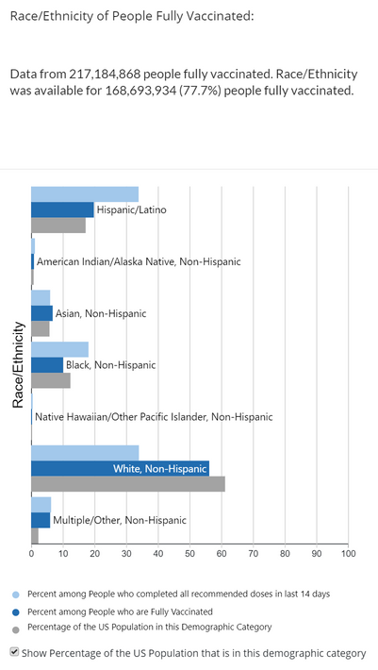
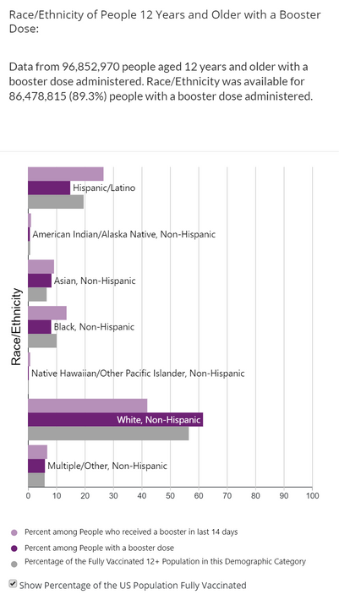
Data: COVID-19 Vax by Race & Ethnicity
As of March 23, 2022
Source: Centers for Disease Control and Prevention

Slide 14
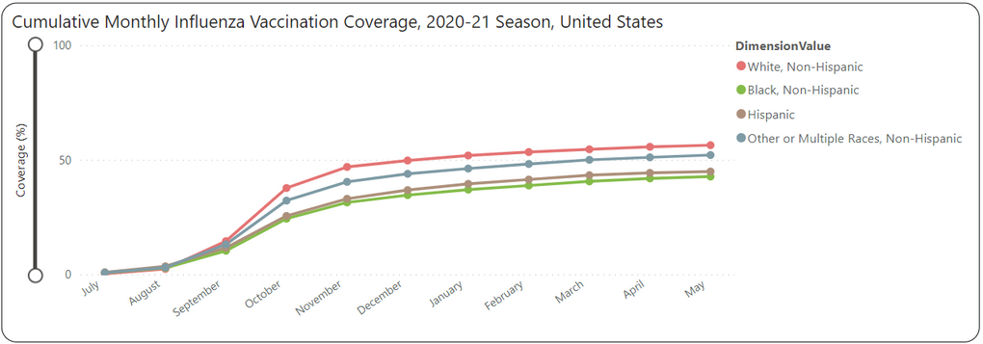
Data: Flu Vax by Race & Ethnicity
Source: Centers for Disease Control and Prevention

Slide 15
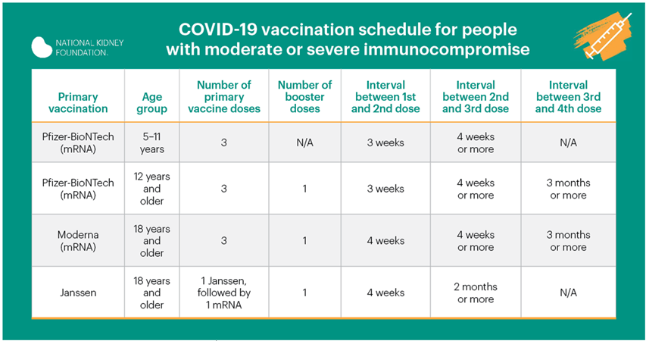
Data: COVID-19 Vax in Patients

Slide 16
Data: Flu Vax in Patients
CDC Recommendations
Flu vaccine is the best protection against the flu
The nasal spray is contraindicated in people who are immunocompromised
Among people with CKD, flu vaccination has been associated with reduced hospitalizations
Pneumococcal pneumonia is an example of a serious flu-related complication that can cause death.
Get a pneumococcal vaccine
Source: Centers for Disease Control and Prevention

Slide 17
ACIP Recommendations
Advisory Committee on Immunization Practices
A routine annual flu vaccination is recommended for all individuals aged 6 months+ who do not have contraindications.
Speak with your doctor if you have questions
Source: Centers for Disease Control and Prevention

Slide 18
Panelist
Cynthia Nichols-Jackson
Patient and Program Coordinator
National Kidney Foundation of Michigan

Slide 19
Panelist
Silas Norman, MD, MPH
Associate Professor, Nephrology
University of Michigan

