Slide 1
Nuts and Bolts of a Flu and COVID-19 Family Vaccination Clinic
Anna Rutins, Program Manager Associate, Community Health
Jessica Jones, MSN, RN Clinical Practice Specialist
Notes:
Thank you to Lisa and Dr. Yabo for this invitation to share our experience with all of you. Also to Olber at Urban Strategies and Trevor at AIM for their assistance. We are excited to talk about our recent experience designing and actual implementation of combination FLU and COVID-19 vaccine clinics.
Here with me today is my colleague Jessica Jones who has been instrumental in the effective development of medical and technical systems for Presbyterian's COVID-19 testing and vaccination operations. I have had the privilege of working side-by-side with Jessica since April, and I'm grateful she can join us today as co-presenter.

Slide 2
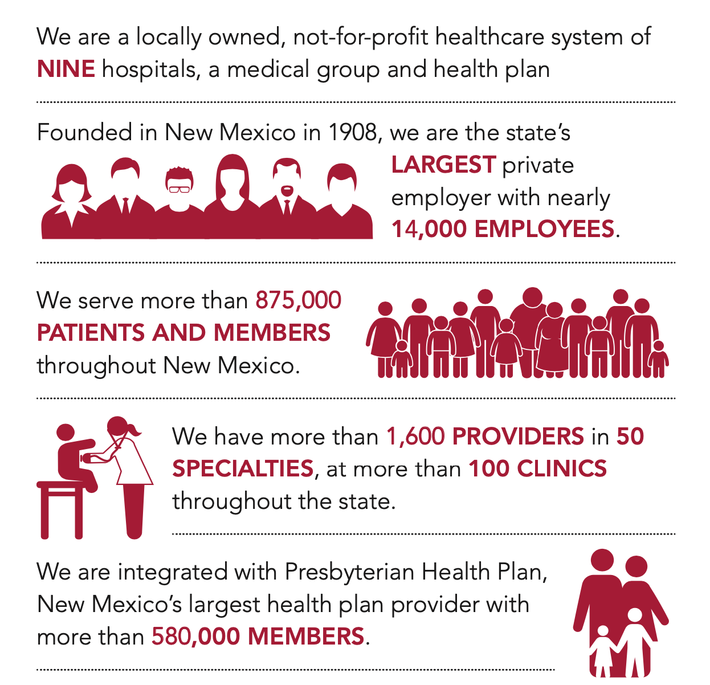
Notes:
I'm aware of the fact that this group here today represents a vast variety of organizations and institutions. For that reason, I feel it is important to provide context for how we – as REACH recipients – are able to do our vaccine equity work.
Presbyterian Healthcare systems is the largest employer in New Mexico, which has a population of 2.1 million. Our health plan supports approx. ¼ of our state. We have facilities throughout the state including a vast network of partners.
Being part of a large organization like PHS also comes with significant benefits such as infrastructure for services such as graphic design, PR and media communications, and other internal support areas. I ask that you keep this in mind during today's presentation, and I also acknowledge that your situation organizational framework might be very different. We certainly welcome questions of all kinds during the Q & A. Thank you.

Slide 3
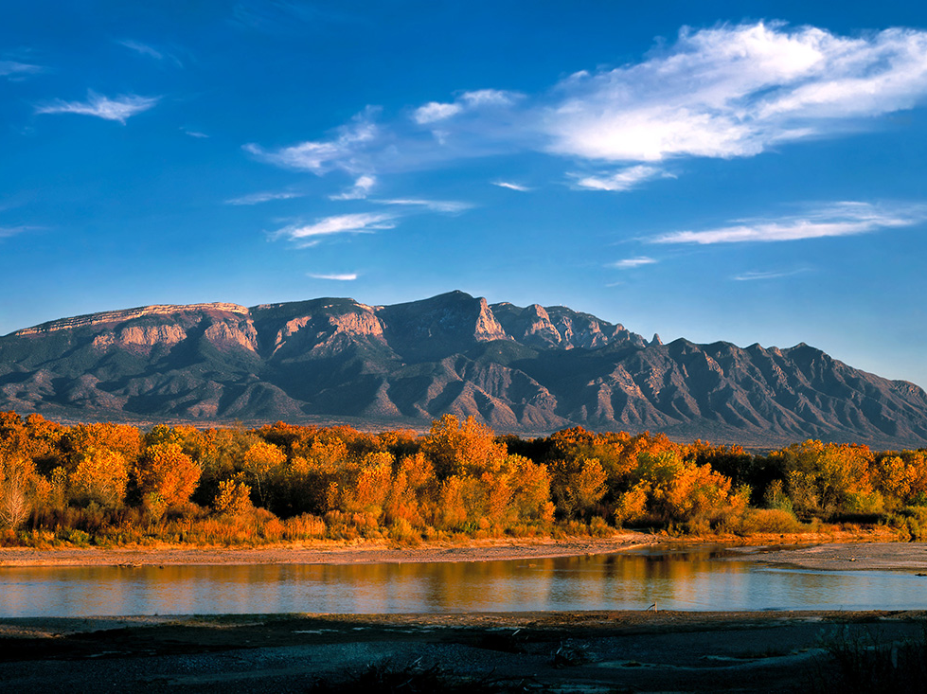
Our purpose is to improve the health of the patients, members and communities we serve.
Notes:
A photograph of the Sandia Mountains, which provide a natural border for the eastern side of Albuquerque. The body of water in the forefront is the Rio Grande River.
And, our Presbyterian Healthcare Services mission:

Slide 4
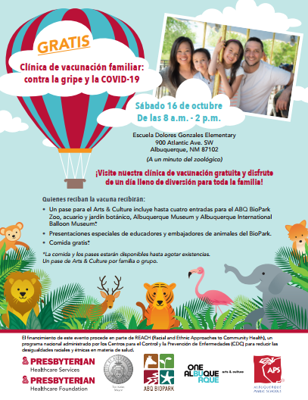
Family Vaccine Clinics, Oct 16 & Nov 6
COVID-19 Pfizer for
ages 12+
Flu for ages 8+
In partnership with Albuquerque Public Schools and
ABQ Dept.of Arts & Culture / Zoo BioPark
Total vaccines administered at both events:
1217 Flu / 381 COVID-19
FLU: (432) adults / (286) youth = 718 total COVID: (18) 1st doses, (8) 2nd doses, (121) 3rd / booster doses = 147 total
FLU: (274) adults / (225) youth = 499 total COVID: (19) 1st doses, (24) 2nd doses, (191) 3rd / booster doses = 234 total
Notes:
A high level snap shot of the clinics we are here to talk about today – the first on Oct 16th and the second on Nov 6th. These flyers reflect the branded look we created to entice families to participate. The graphics also represent our partnership with Albuquerque Public Schools and Dolores Gonzales ES, as well as the ABQ Dept of Arts and Culture, specifically the Zoo BioPark.
You can see the numbers we reached below by event. Our total vaccination numbers from both events combined are: 1217 for FLU and 381 for COVID-19, including 1st, 2nd and booster doses. In terms of numbers of people who walked through the events – with or without getting vaccinated – we estimated approx. 2,250 on Oct 6th and approx. 1,800 on Nov 6th.

Slide 5
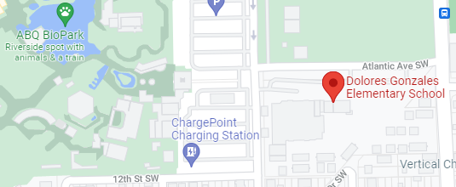
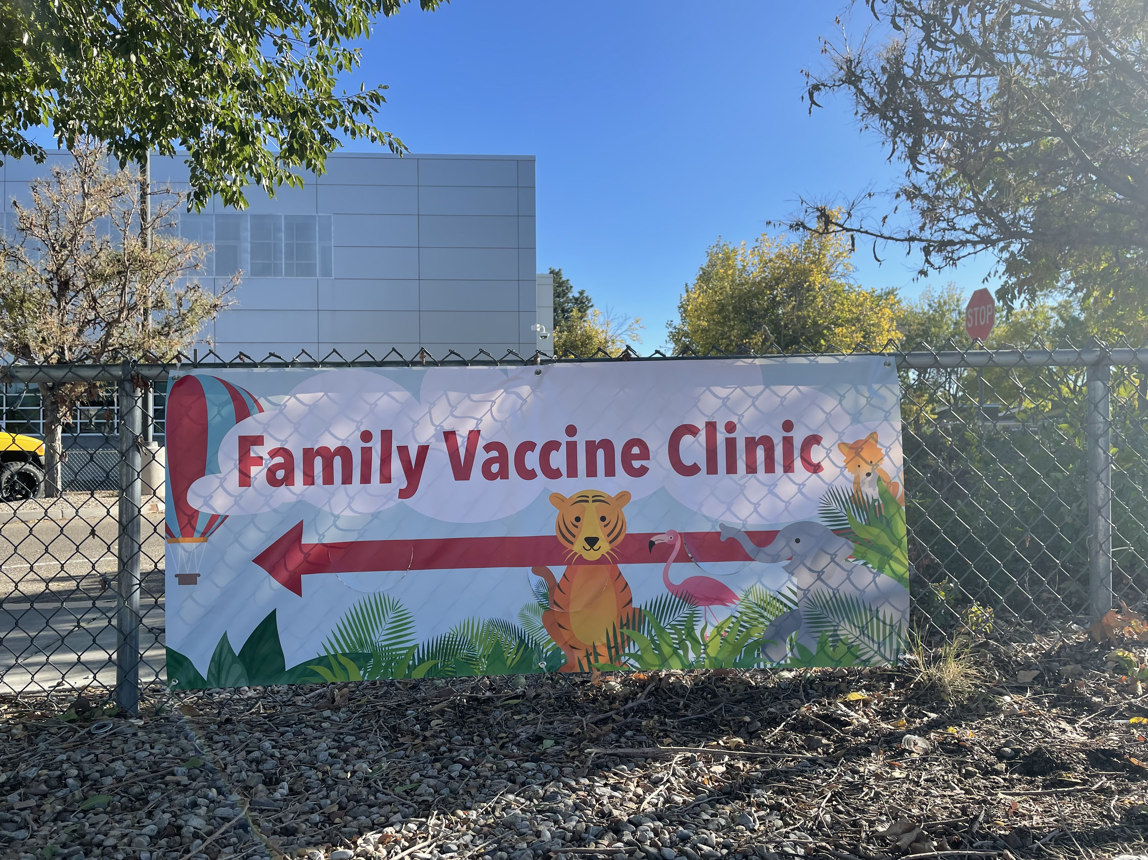
Convenience of Partner Locations
Notes:
This maps shows us the proximity of the two partner sites, which made our creative programming incentives easy to deliver.
Approx. 200 yards from door to door.
The sign you see in this image was adhered to the schools fence in advance and in between the two events, so every parent, care-giver, zoo-goer was reminded of the opportunities. Sandwich boards with directional arrows were placed at the blue dots on day of event.
Due to the location of the two sites, we were able to capture the attention of vast variety of community members.

Slide 6
General Project Planning Timeline
July
Initial exploratory meetings
1st site visit @Zoo
Seek approval from all partner parties
Follow-up meetings to secure partnerships
August
Worked closely with Marketing
Branding (in-house)
Hired advertising firm
Video production started at Zoo
Site shifted to DGES
2x monthly partner meetings
September
Order vaccines
Craft final media messaging
Working closely with Communications (PR)
Site visit #1: walk/talk-through clinic flow, signage, use of space
Secure equipment rentals (tents, tables, chairs)
October
Final press (radio & TV interviews)
APS volunteer sign-up
Flyer translations
Promotions: flyers, Zoo video, outreach to partners, APS families
TV, radio spots, social media campaigns launched
Confirmation of all staff (nurses, interpreters, etc.)
Confirmation of vaccine supplies
Oct 5 – receive rental equipment, set-up
Oct 6 – EVENT
November
2x monthly partner meetings
2nd site visit (pivot to indoors)
Repurposed flyers w/new date & distribution
Confirmation of all staff
2nd media campaign
New rental order
Media campaign push
Pre-event set-up
Weekly partner meetings
Nov 6th event
Event debrief
Integrate recommended improvements from 1st event
Food ordering
Order food
Notes:
This Project Planning Timeline provides a lot of detail, which I won't cover today. However, I hope it's helpful to understand the general flow of our work.
The partnership collaboration stretched over five months from start to finish. We had regularly scheduled partner meetings to ensure all progress was being shared and all issues were being heard. Perhaps important would be to highlight the graphic design, branding, and media/advertising efforts, which started in August. That required a lot of attention, and our events had both internal and hired external support.
From the first to second event, we decided to shift the registration from outside to inside. Jessica will tell you more about those operations. I bring it up as we did not simply replicate the first model, but made modifications to bring registration inside from the colder November weather.

Slide 7
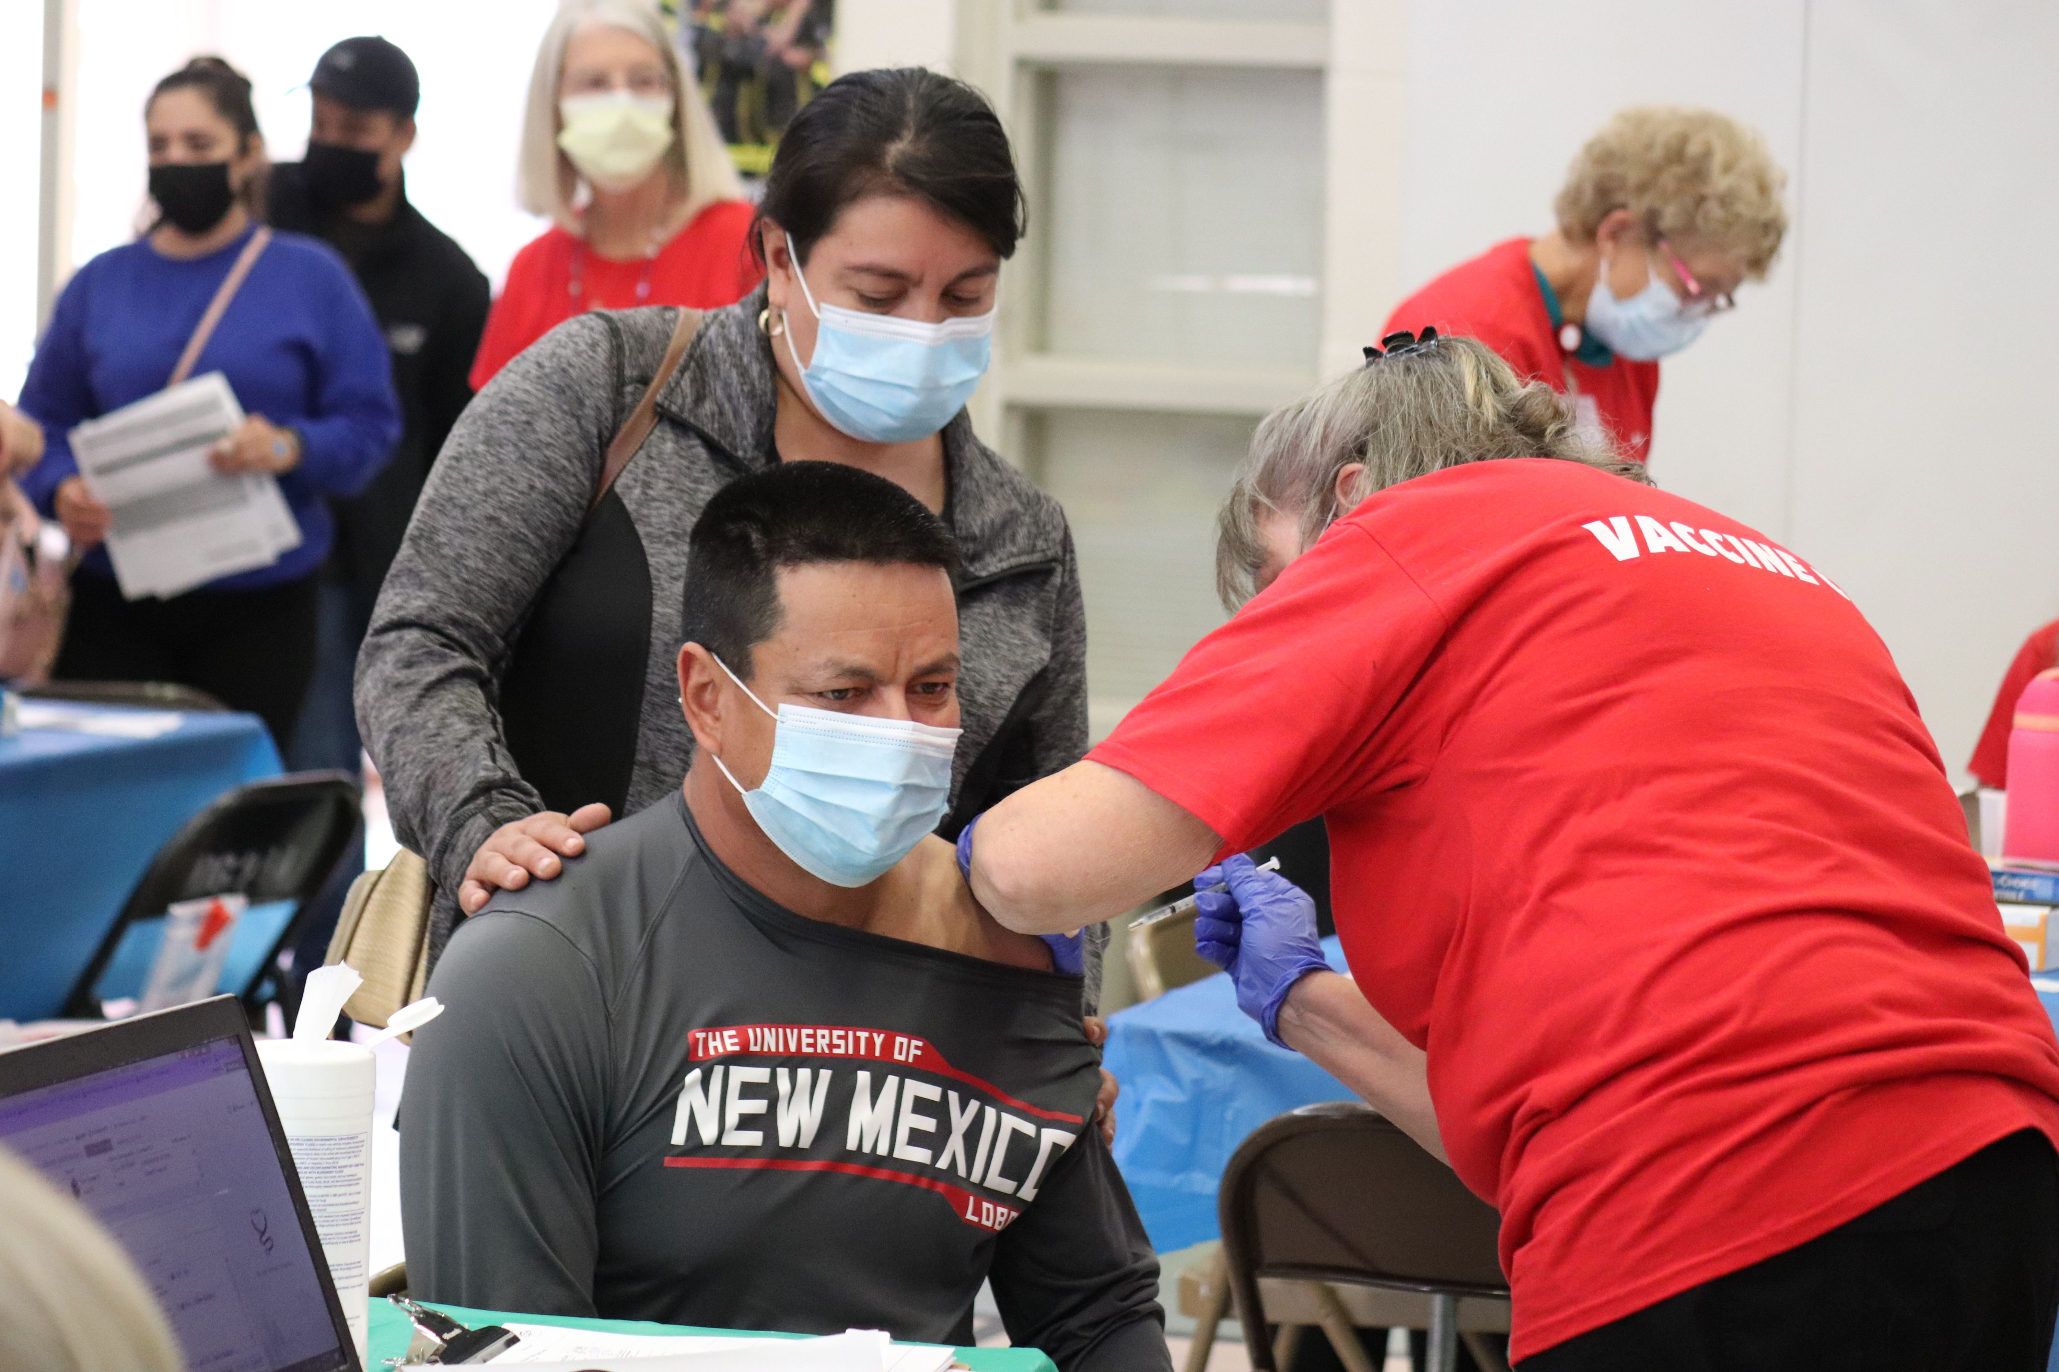
Target Audiences & Promotion
Hispanic/Latinx
Black/African American
Urban Native
Refugees & Immigrants
APS: email blast to over 79,000 active email addresses in student households
APS: Refugee & Newcomer Supports Program (special outreach to Arabic, Dari & Swahili-speaking student families)
Notes:
Aligned with our REACH grant parameters. Relied on all partner networks for sharing of flyers, word of mouth, our PHS Community Healthcare Workers
One of many benefits from partnering with a school district is the use of their communications systems.
Office of Refugee and Immigrant Support - provided special outreach to refugee families using flyers translated into Swahili, Arabic, and Dari.

Slide 8
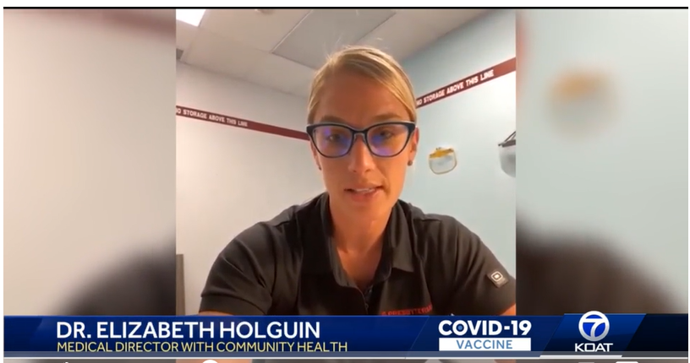
Radio, TV, and Social Media Promotion
Communications / PR
ABQ Journal article
KOAT interview (TV)
NM Living on KOAT (TV)
Donnie Chase radio show, WKML 95.7 (Country music)
Radio & TV
Traditional Spanish FM radio
TV spots
Notes:
We used approx. $11,000.00 of our communications budget to hire an advertising agency to support the Oct 6th event. They created 20 and 30 second TV spots which were aired during morning and afternoon programming on local commercial TV stations.
As part of our REACH COVID grant work, my colleague Nancy Pope has been organizing Listening Sessions with our priority populations. We learned from two sessions that Hispanic/Latinx men rely on traditional FM radio for their news and information. This fact has been integrated into all of our outreach work. FOr this reason, we invested in radio ad time on Spanish radio.
According to the advertising company, the estimate regarding exposure via listenership and viewership was 1,268,00 for purchased media.
Our internal Prebyterian Communications/PR department also stepped in. Thanks to their work, we landed a few prime media opportunities, which consisted of PSA or educational messaging. Elizabeth Holguin, our Comm Health Medical Director, participated in two radio interviews and two TV interviews. She used that time to promote the events, as well as to talk about the impact getting sick with the flu can have on a family system.

Slide 9
Facebook Campaign Post
Notes:
Purchased FB campaigns with targeted zip codes aligned with our target audiences. Resulted in 4538 Click-throughs, opening and presumably reading the ad content. 132 shares/reposts of the same campaign. $300.00 well-spent. The same FB ad was used by the previously mentioned Don Chase radio show as follow-up to Elizabeth Holguin's radio interview.

Slide 10
ABQ Zoo / BioPark
Albuquerque Dept. of Arts and Culture
Outreach
See how animals are trained to be active participants in their own healthcare. Then join us for Presbyterian Healthcare's Flu and COVID-19 Family Vaccination Clinic on Oct 16^{th.}
Notes:
When we started exploring the possibility of partnering with the Zoo, we discovered they too were actively interested in outreach to the same priority populations. They recognized issues re: financial and physical / transportation access which are obstacles to enjoying this wonderful city facility. This shared mission provided great motivation and momentum for our collaboration.
Initially, the clinic was going to happen at the zoo, but we became worried about adequate space for a proper clinic-set-up. The idea to invite Dolores Gonzales into the partnership for use of their facility was born from that moment. This didn't stop our Zoo partners from showing up with remarkably creative programming. They set-up a table with pelts, skulls, bones, teeth and other animal goodies. The tables were staff Zoo ambassadors who are educational specialists to talk about the artifacts. This was a great hit!
The Zoo also provided the FAMILY passports – given to each family group. Four tickets to each of the four following city facilities:
This incentive certainly drew many people to the clinic. Some walked in asking for the Family Passport first.

Slide 11
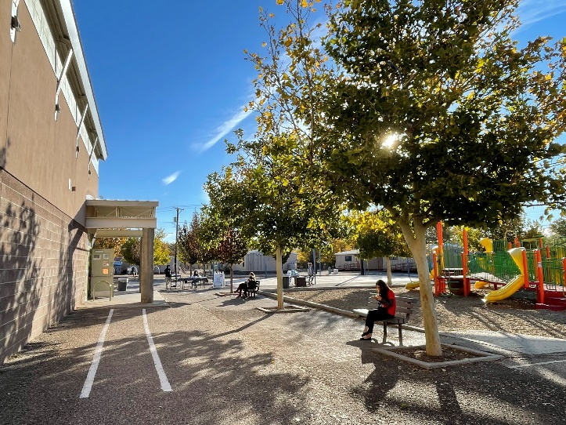
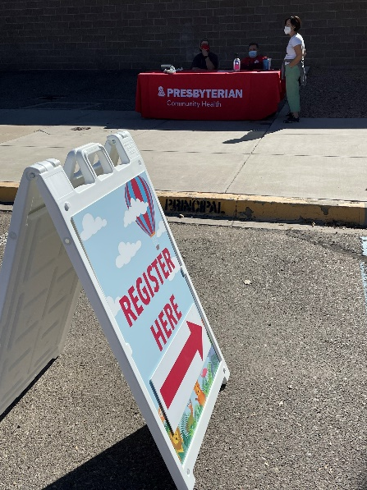
APS - Dolores Gonzales Elementary School
Facilities (indoor & outdoor), Volunteers, Engagement
Notes:
We hadn't imagined what a wonderful space Dolores Gonzales would be! An elementary school with playground equipment, a gym, well-layed out space for traffic flow, adequate parking, etc. And, a remarkably supportive and beloved principal, Lori Stuit, who has worked in this particular corner of Albuquerque community for decades.

Slide 12
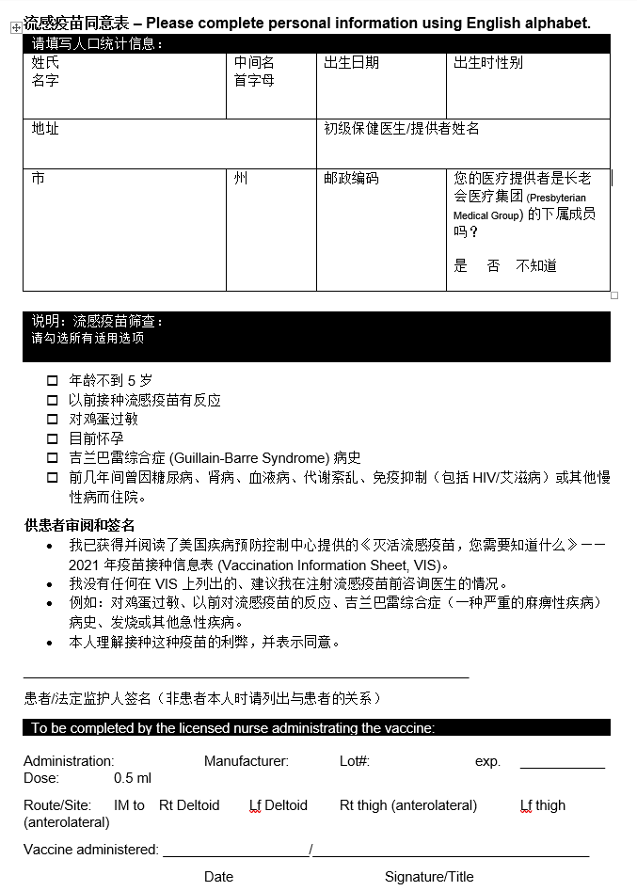
Albuquerque Public Schools (APS) Translation Services
Spanish, Arabic, Vietnamese, Chinese, Dari, Swahili
Notes:
An added benefit to shifting the clinic from the zoo to the school was access to more in-kind services.

Slide 13
APS Interpreters
Spanish, Arabic, Vietnamese, Chinese, Dari, Swahili
Notes:
Also, another added benefit – an in-kind service/

Slide 14
A warm meal for community members
Centering equity and grass-roots economic development with every decision
Street Food Institute served single portions of warm quiche and posole
Mujeres en Accion served generous bean and cheese burritos
Funding for food was provided by PHS Community Health special projects budget.
Notes:
What Is The Street Food Institute?
SFI is a non-profit organization of food service and business professionals dedicated to shaping a healthy, sustainable and creative food future across New Mexico. Their work is guided in the belief that street food has an amazing capacity to connect people and enrich our community by creating jobs, developing local business opportunities and inspiring the culinary leaders of tomorrow.
The Street Food Institute curriculum was developed in partnership with the Central New Mexico Community College (CNM) – an outstanding culinary program offering state-of-the art facilities for training future chefs (link to CNM program). The classroom training and internships provide real-world business experience and are available through CNM or directly to community members interested in starting their own small food business.
Mujeres en Accion – at the border of downtown and the South Valley, a lower-economic income quadrant of our city, Mujeres started as a non—profit committed to creating opportunities for skills development and good jobs for Hispanic/Latinx immigrant and refugee women who have escaped domestic violence. Mujeres en Accion recently shifted from non-profit to for profit using a social entrepreneurship model to serve as an economic engine for this particular population. The continue providing work and life skills, supporting those looking to build a better life for themselves and their families. And, in my humble opinion, they make the best holiday tamales in town!

Slide 15
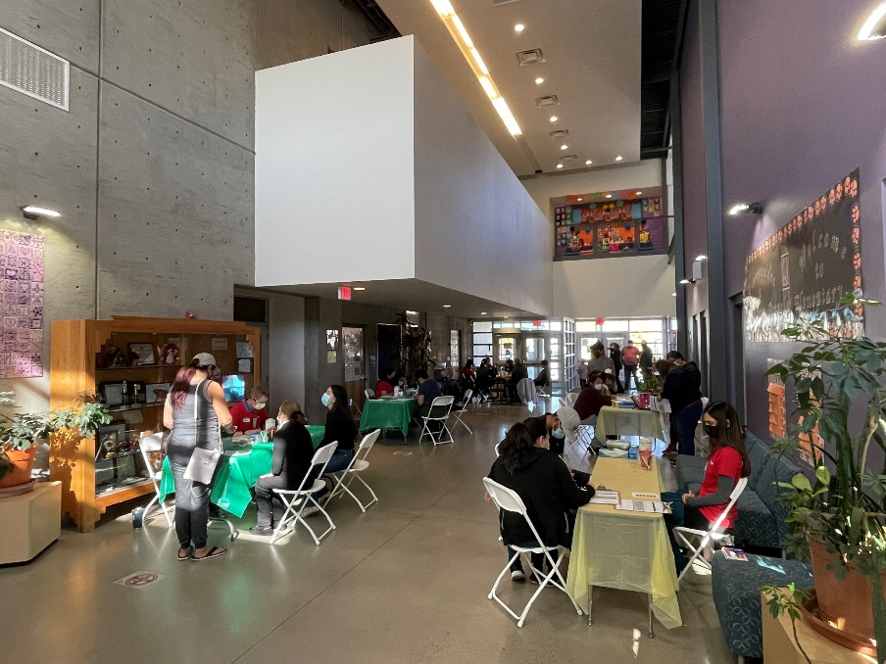
Clinic Logistics
Walk-in (no app’t necessary)
FREE, No ID, No Insurance
Securing nurse vaccinators, registrar and pharmacy staff
IT Support
Consent Forms
Reminder cards for follow-up COVID-19 vaccines
Further info for other clinic options
What to Expect COVID-19 fact sheets
Flu info cards
Adjustment for weather
Event #1 / October 16th
Event #2 / November 6th
Notes:
In the spirit of community health and removing obstacles, all of the clinics we have done, including these two, have been hassle free.
The two pictures above represent both events. The 1st registration was 100% outdoors and the 2nd was indoors. We moved indoors based on the cooler temperature changes from October to November to keep both patients and staff as warm as we could.
Also saved money by not renting as many tents moving indoors

Slide 16
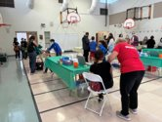
Vaccine Procurement
For COVID-19 vaccines: Close communication with Pharmacist and Tech prior to event
Pfizer vaccine offered for ages 12+
Order placement one to two weeks in advance
Safe preparation space and storage for pharmacy staff
For Flu vaccines: Clarify what is available from medical partners
Vaccines for Children (VCF)
Other possible sources
Safe preparation space for RN to prep and distribute
Notes:
Operating under pandemic circumstances

Slide 17
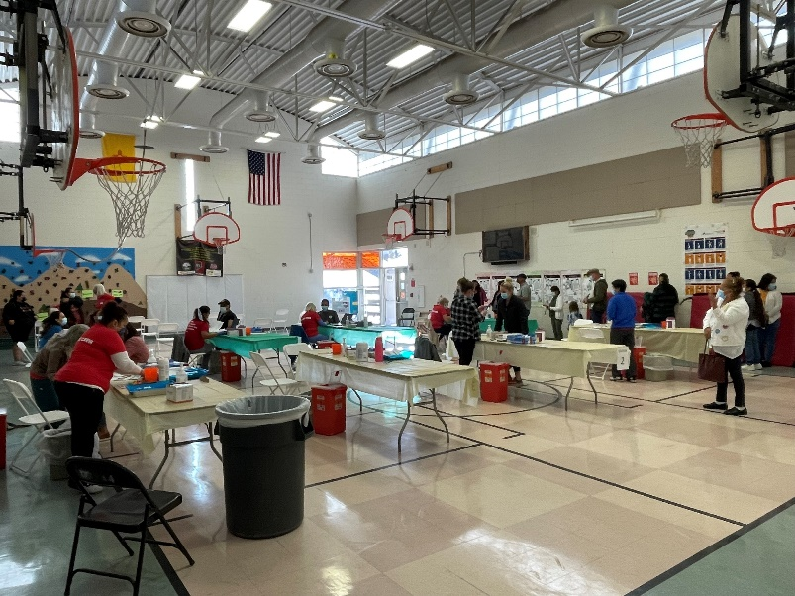
Clinic Flow
Greeters, guides, volunteers placed at strategic spots
Color Coded Dots at Registration
Color Coded Table Coverings
Separate Consent Forms
Pharmacy in PE Office (dedicated vaccine runner)
Notes:
I would encourage you to walk through these details with your medical partner. If you have further questions, I am glad to chat offline

Slide 18
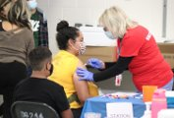
Clinic Operations
Importance of segregating vaccines and stations
How to handle patient who is receiving both COVID-19 and Flu vaccines (red sticker)
Triage/observation area

Slide 19
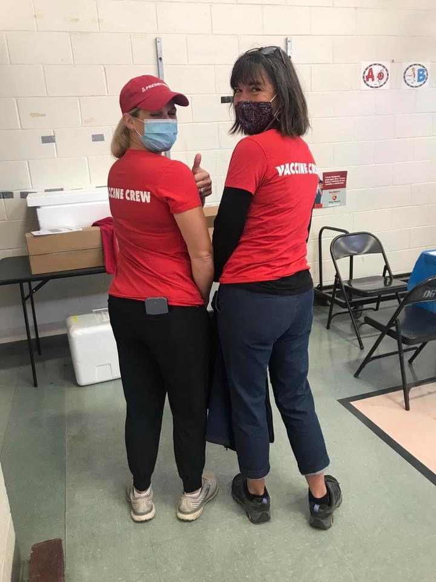
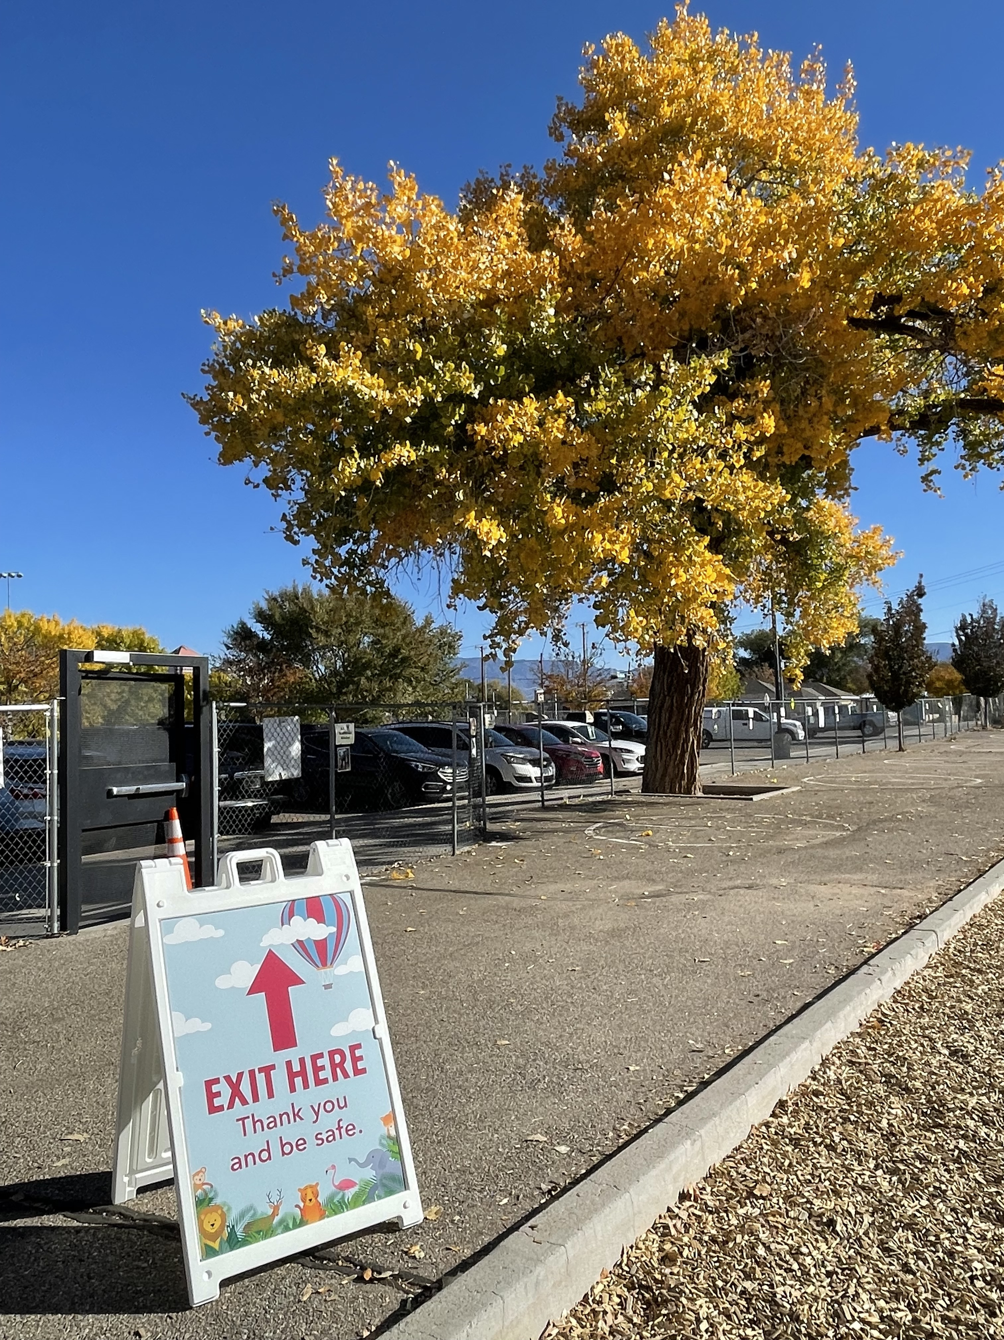
Reflection & Lessons Learned
REFLECTIONS
Positive feedback re: warmth of experience (name-tags, volunteers)
Regular communication with partners
Elementary school: great space for family event
Unidirectional clinic flow to allow social distancing
Pre-event huddle with all staff
Post-event debrief with partners
Creative leveraging of partner resources
LESSONS LEARNED
Start flu vaccine procurement process earlier
Emphasis on 1st event, more needed on 2nd
Photograph artifacts

Slide 20
Unique Promotion
https://www.youtube.com/watch?v=-XT3faEQguY
See how animals are trained to be active participants in their own healthcare. Then join us for Presbyterian Healthcare's Flu and COVID-19 Family Vaccination Clinic on Oct 16th (and Nov 6th).

Slide 21
Thank you!
arutins@phs.org jjones@phs.org

