Slide 1
Aim, Reach, and P4vE Presents: “Health equity: methods to support communities”
community-based organizations/grass-roots response, challenges, sustainability, and the path forward (covid19 & beyond)
“dr. dan”
Daniel B. Fagbuyi, M.D.
ER physician, Fmr biodefense & public health appointee
@docdanmd IG/twitter

Slide 2
Disclosure
I am speaking today as a consultant to AIM/P4VE on health/vaccine equity
I will NOT be discussing any particular drug or pharmaceutical
This discussion is for informational purposes only

Slide 3
objectiveS
Define
Define Health Disparity and Health Equity
Discuss
Discuss how to create pragmatic and informed message development for a target audience/end-user
Identify
Identify ways to foster culturally competent and digestible communications
Identify
Identify characteristics of a successful program/initiative
Discuss
Discuss ways to “bridge the gap” from acute response phase to sustainability (long term).

Slide 4
historical context/background
Violations of trust among communities of color by US public health service, healthcare institutions, and medical community in general
Lack of access to quality healthcare
Racial and ethnic disparities in the quality of healthcare received and outcomes

Slide 5
What is Health disparity?
Difference in outcomes and causes among groups
Characterized by differences in where they live, play, work, learn, etc.
The experience results in greater burden of disease/adverse health outcome

Slide 6
Adopted from Kaiser Family Foundation

Slide 7
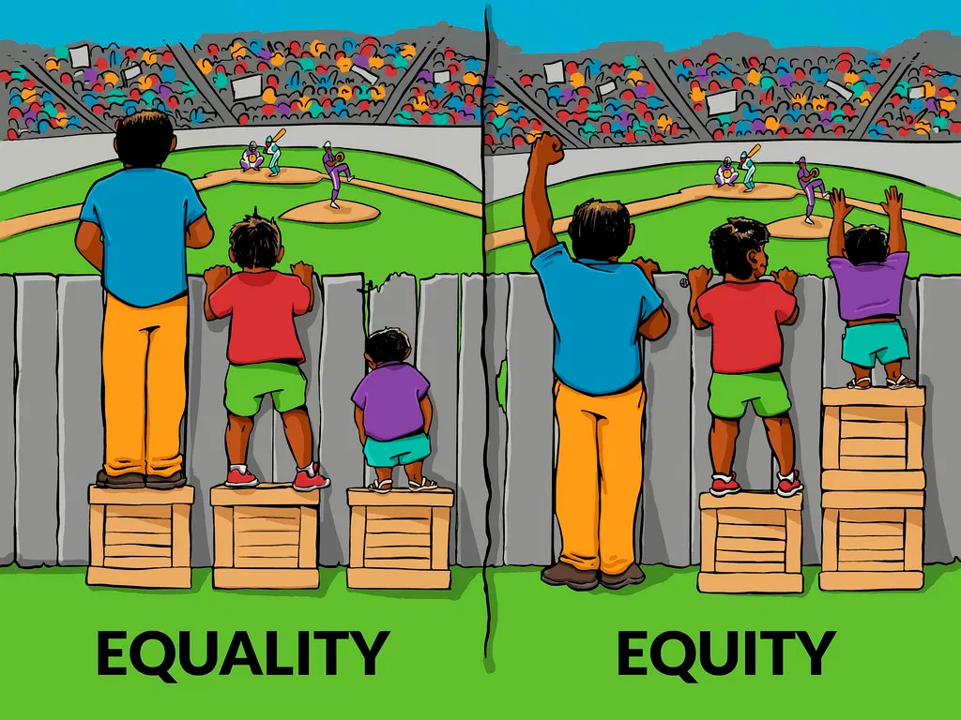
What is Health equity?
Adopted from John Hopkins Alliance for a Healthier World
Artist: Angus Maguire

Slide 9
Covid19 –The great magnifier
Public Health Security threatened
Need for rapid Medical Countermeasures (MCMs), e.g. vaccines, therapeutics, PPE, etc.
Fear, distrust, and rampant misinformation/disinformation
Health disparities magnified!!! We couldn’t Ignore it!!!

Slide 10
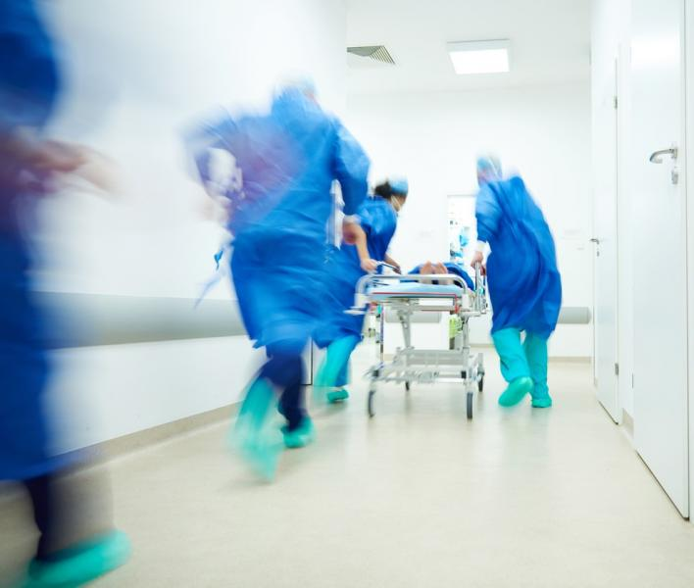
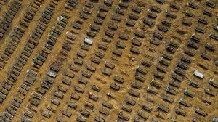
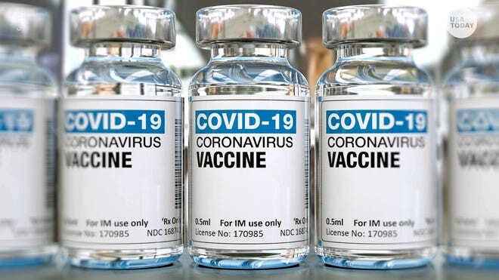

Slide 11
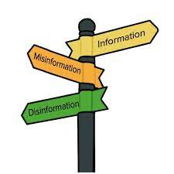
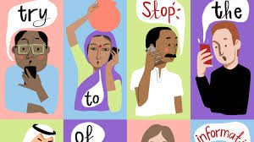

Slide 12
Culturally Competent communications: Pragmatic approach to messaging
Who is the target audience? Where do they congregate? Meet them where they are?
E.g barbershop, place of worship, hiphop music/event
Who is the messenger? Looks like or is from the target community?
How does the messenger relate to the intended receiver?
Are there other cultural nuances that need to be considered?
Who are you consulting to give you feedback and critique on how to implement and engage various communities?

Slide 13
Meet people where they are!

Slide 14
Can I get a witness?

Slide 15
What does success look like for you?
Short term vs Long term
Acute phase of the Pandemic vs After the pandemic resolves or virus becomes endemic
Sustaining initiative and passing it on to community leaders with decision-making power; capabilities and infrastructure
Avoiding the “valley of death”. Providing funding and support programs and initiative during and after covid. E.g. Sustaining healthy communities by building trust and supporting non-covid initiatives that are associated covid co-morbidities.

Slide 16
Characteristics of a successful Program
Available Funding to maintain and upgrade infrastructure
The Community is in the “driver seat”.
Community leaders with decision-making capability are at the table at all levels of planning, etc.
Data driven
Culturally competent communications with novel approaches welcome
Engaged with community before, during, and after public health emergencies
Shares lesson-learned and best practices to improve health outcomes in diverse communities

Slide 17
Community engagement & the charge forward
Beauty of the Public-Private-Partnership
Leverage the “trusted messenger” to attain racial and ethnic group vaccine equity
Community connections and relationships are best nurtured before a disaster/pandemic
Break silos and barriers by communicating and sharing resources and strategies among one another based on personal experiences and lessons-learned
Racism is public health issue. Do your part to help us address this!

Slide 18
Community engagement & the charge forward
What are you doing to sustain the programs you are currently funded for and what’s the plan long term?
How are you handing over your program?
Burn-out is real! Take a break from those vaccine clinics.

Slide 19
Questions???

