Slide 1
COVID-19 Vaccines: Vaccine Safety FAQs Dispelling Vaccine Myths
REACH organization’s logo here (then remove green frame)
June 4, 2021
This publication is supported by the Centers for Disease Control and Prevention of the U.S. Department of Health and Human Services (HHS) as part of a Cooperative Agreement.
The contents are those of the author(s) and do not necessarily represent the official views of, nor an endorsement, by CDC/HHS, or the U.S. Government.

Slide 2
Are The Vaccines Safe?
The three authorized vaccines were developed in a faster than usual process, but all were extensively tested for both safety and efficacy and met FDA safety standards
They will be carefully monitored to detect any problems or side effects
Millions of people in the U.S. (and in other countries) have already received COVID-19 vaccines
Notes:
Read slide

Slide 3
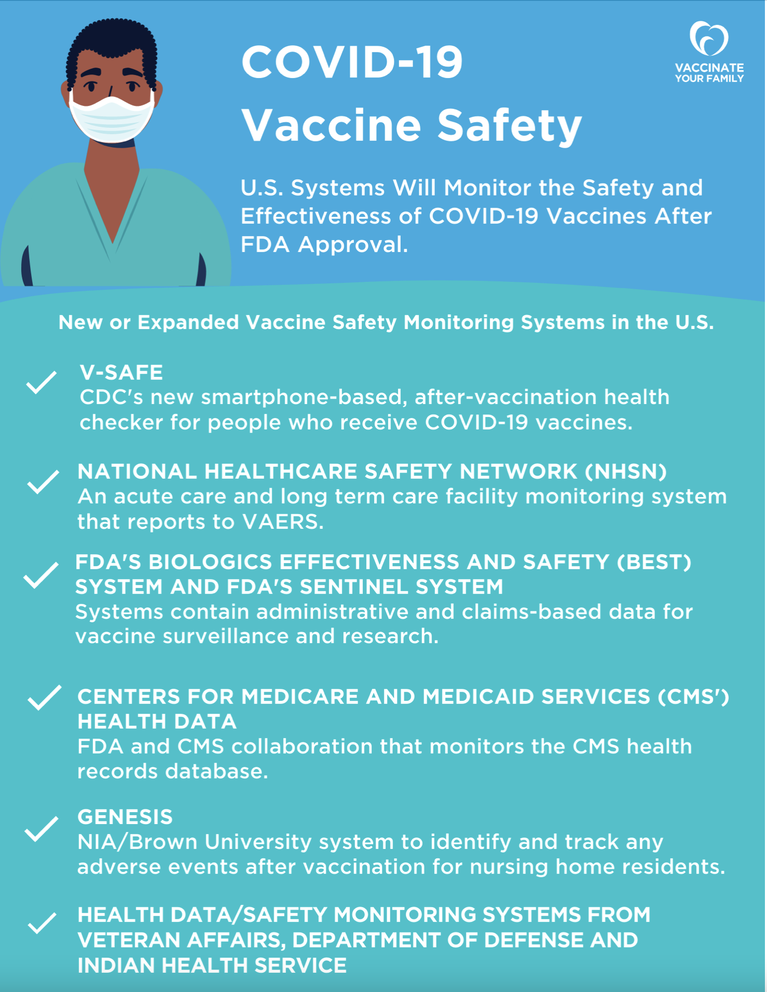
Vaccine Safety Monitoring
After a vaccine is authorized or approved for use, many vaccine safety monitoring systems watch for adverse events (possible side effects)
This monitoring can pick up adverse events that may not have been seen in the clinical trials
If an unexpected adverse event is seen, experts quickly study it further to assess whether it is a true safety concern, and then decide whether changes are needed in U.S. vaccine recommendations
Notes:
After a vaccine is authorized or approved for use in the US there are many vaccine safety monitoring systems in place to watch for possible side effects. This monitoring can pick up adverse events that may not have been seen during clinical trials. If an unexpected adverse event is found, experts will quickly study it to see if it is a true safety concern and then decide the actions to take and if changes to the vaccine recommendations are needed.
On the right is an infographic on COVID-19 vaccine safety developed by Vaccinate Your Family which reviews the various safety monitoring systems in the U.S.

Slide 4
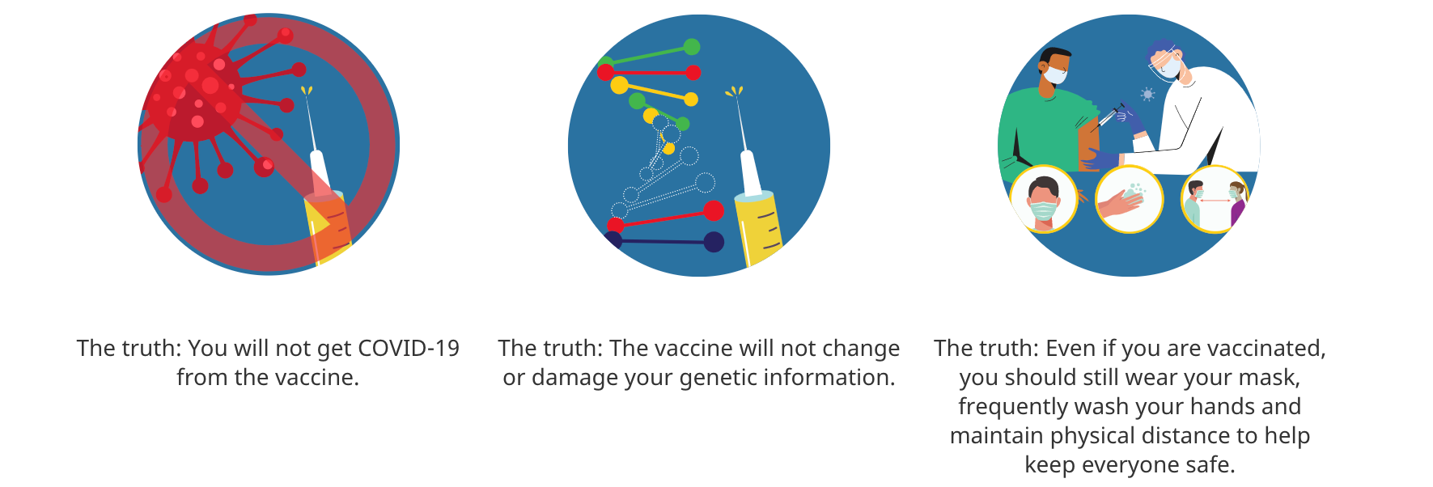
Dispelling Common Myths About the Vaccine
Source
Notes:
Let’s turn our attention to some of the myths we hear about the vaccine.
1 AND 2. The vaccine for COVID-19 cannot and will not give you COVID-19. The two authorized mRNA vaccines instruct your cells to reproduce a protein that is part of the SARS-CoV-2 coronavirus, which helps your body recognize and fight the virus, if it comes along. The COVID-19 vaccine does not contain the SARS-Co-2 virus, so you cannot get COVID-19 from the vaccine. The protein that helps your immune system recognize and fight the virus does not cause infection of any sort. mRNA vaccines use lab-created mRNA encapsulated within nanoparticles. Translation of the mRNA results in the development of a protein antigen that triggers an immune response (Schlake, 2012). mRNA vaccines deliver mRNA directly to the cytoplasm, where it is transcribed by ribosomes. The mRNA does not enter the nucleus and therefore cannot be incorporated into the genome. Its presence in the cell is transient, and it is quickly metabolized and eliminated via cellular processing mechanisms (Walsh, 2020). mRNA vaccines do not utilize any element of an organism. First, some things that the new vaccines are not and cannot do: • They aren’t viruses. • They aren’t “natural” – they’re synthesized. • They can’t enter a nucleus of a human cell and mutate our DNA. Even if they did, they’d encode the viral spike protein – as a vaccine does. • They aren’t derived from human embryos or fetuses. https://dnascience.plos.org/2020/12/17/the-first-covid-19-vaccines-whats-mrna-got-to-do-with-it/
https://www.health.harvard.edu/diseases-and-conditions/preventing-the-spread-of-the-coronavirus
The two COVID-19 vaccines available to us are designed to help your body’s immune system fight the coronavirus. The messenger RNA from two of the first types of COVID-19 vaccines does enter cells, but not the nucleus of the cells where DNA resides. The mRNA does its job to cause the cell to make protein to stimulate the immune system, and then it quickly breaks down — without affecting your DNA.
3. Individuals who get the COVID-19 vaccination still need to practice infection prevention precautions. Keep your mask on and continue staying at least 6 feet from people outside your household, until further notice. Vaccines do not stop the coronavirus from entering your body; they only prevent you from developing moderate to severe COVID-19. It’s not yet clear if people vaccinated for COVID-19 can still carry and transmit the virus, even when they themselves don’t get sick.
https://www.hopkinsmedicine.org/coronavirus/covid-19-vaccine/for-patients.html#mythbusters

Slide 5



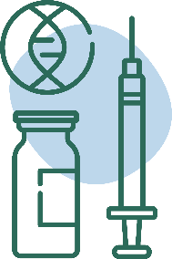
COVID-19 Vaccine: The Facts
Key Facts About COVID-19 Vaccination
Getting vaccinated can help prevent getting sick with COVID-19
People who have already gotten sick with COVID-19 may still benefit from getting vaccinated
COVID-19 vaccines will not cause you to test positive on COVID-19 viral tests*
COVID-19 vaccines cannot give you COVID-19
Notes:
COVID-19 vaccines will not give you COVID-19
People who have gotten sick with COVID-19 may still benefit from getting vaccinated
Getting vaccinated can help prevent getting sick with COVID-19
COVID-19 vaccines will not cause you to test positive on COVID-19 viral tests*
Please visit: https://www.cdc.gov/coronavirus/2019-ncov/vaccines/about-vaccines/vaccine-myths.html to read more about these vaccine myths and the facts about COVID-19 vaccine from CDC.
NOTE: While COVID-19 vaccination will not cause a positive result on viral tests, there is a possibility that it could cause a positive result on a serologic (antibody) test.
Neither the recently authorized and recommended vaccines nor the other COVID-19 vaccines currently in clinical trials in the United States can cause you to test positive on viral tests, which are used to see if you have a current infection.​ Molecular and antigen tests. Molecular tests detect the SARS-CoV2 virus. The antigen tests detect specific proteins made by the virus.
If your body develops an immune response—the goal of vaccination—there is a possibility you may test positive on some antibody tests. Antibody tests indicate you had a previous infection and that you may have some level of protection against the virus.
Current Antibody tests – test for antibodies against spike protein fighting cells, so remember the whole point of getting vaccinated was to develop fighting cells that would sit, ready primed, ready to fight off the actual disease. So as a result, you may test positive on an antibody test after you get vaccinated. There is another antibody test called the nucleocapsid protein test – this one should be used instead.

Slide 6

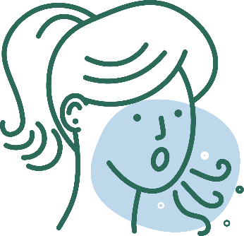
COVID-19 Vaccine: The Facts
COVID-19 Vaccination will Help Protect You from COVID-19
Getting a COVID-19 vaccine...
Will help create an immune response in your body against the virus
May help keep you from getting severely ill, even if you do get COVID-19
Notes:
COVID-19 vaccination will help keep you from getting COVID-19. Getting a COVID-19 vaccine will help create an immune response in your body against the virus without your having to experience illness. Based on what is known about vaccines for other diseases, experts believe that getting a COVID-19 vaccine may help keep you from getting seriously ill even if you do get COVID-19.
1. COVID-19 vaccination will help keep you from getting COVID-19. Getting a COVID-19 vaccine will help create an immune response in your body against the virus without your having to experience illness. Remember our discussion on vaccine induced versus natural immunity. I think, most of us can agree that the risk of getting COVID-19 disease and getting immunity that way is too great a risk to take. Not everyone does well with the disease. We have over 450K deaths now from this disease, in people of all ages, all races, those with and those without medical conditions.
2. Experts also believe that getting a COVID-19 vaccine may help keep you from getting seriously ill even if you do get COVID-19.
That was the one of the main goals of vaccine manufacturers. We know that so many people are asymptomatic with COVID-19. One of the goals is that the vaccine does not only prevent mild or asymptomatic infection but more importantly that even if you get a mild disease after vaccination, you will not end up hospitalized or dying from the disease.
Similar to the flu vaccine. The flu vaccine decreases your chances of hospitalizations and deaths from the flu.

Slide 7
Frequently Asked Questions
If I had COVID-19, do I need the vaccine?
Yes. People who had COVID-19 are recommended to get the vaccine after they have recovered.
Can a person spread the virus after they are vaccinated against COVID-19?
The COVID-19 vaccines have been shown to be highly effective at preventing disease, but they might not prevent infection without symptoms. What this means is that if a vaccinated person can still be infected, even without symptoms, they could spread the virus.
Studies will soon be completed to determine whether this is possible. However, given this uncertainty, vaccinated people should still use masks and practice social distancing measures.
Notes:
If I had COVID-19, do I need the vaccine?
Yes. People who had COVID-19 are recommended to get the vaccine after they have recovered.
Can a person spread the virus after they are vaccinated against COVID-19?
The COVID-19 vaccines have been shown to be highly effective at preventing disease, but they might not prevent infection without symptoms. What this means is that if a vaccinated person can still be infected, even without symptoms, they could spread the virus.
Studies will soon be completed to determine whether this is possible. However, given this uncertainty, vaccinated people should still use masks and practice social distancing measures.
https://www.cdc.gov/coronavirus/2019-ncov/vaccines/faq.html

Slide 8
Frequently Asked Questions
What if I have a pre-existing condition, like asthma or diabetes can I get the vaccine?
Adults of any age with certain underlying medical conditions are at increased risk for severe illness from the virus that causes COVID-19
COVID-19 vaccines may be administered to people with underlying medical conditions provided they have not had a severe or immediate allergic reaction to any ingredients in the vaccine
How long does immunity last from the vaccine?
We won’t know how long immunity produced by vaccination lasts until we have more data on how well the vaccines work
Notes:
Underlying medical conditions include asthma, diabetes, lung, heart disease etc.
These people are also at increased risk of severe disease if they contract COVID-19, being hospitalized, going to the ICU or dying.
Length of immunity: studies began mid summer 2020.. So at most 5 months of data so far (as of Feb 2021). We need to wait on more data.
https://www.cdc.gov/coronavirus/2019-ncov/vaccines/recommendations/underlying-conditions.html

Slide 9
Frequently Asked Questions
What If I have an autoimmune disorder, can I get the vaccine?
People with autoimmune conditions may receive the authorized COVID-19 vaccines
However, they should be aware that no data are currently available on the safety of the COVID-19 vaccines for them.
Individuals from this group were eligible for enrollment in clinical trials
What if I have a weakened immune system?
People with weakened immune systems due to other illnesses or medication might be at increased risk for severe COVID-19. They may receive a COVID-19 vaccine but be aware of the limited safety data:
Information about COVID-19 vaccine safety for people with weakened immune systems is not yet available
People with weakened immune systems should also be aware of the potential for reduced immune responses to the vaccine, as well as the need to continue following all current guidance to protect themselves against COVID-19
Speak to your health care provider!
Notes:
What If I have an autoimmune disorder, can I get the vaccine?
People with autoimmune conditions may receive the authorized COVID-19 vaccines. However, they should be aware that no data are currently available on the safety of the COVID-19 vaccines for them. Individuals from this group were eligible for enrollment in clinical trials.
What if I have a weakened immune system?
People with weakened immune systems due to other illnesses or medication might be at increased risk for severe COVID-19. They may receive a COVID-19 vaccine. However, they should be aware of the limited safety data:
Information about the safety of COVID-19 vaccines for people who have weakened immune systems in this group is not yet available.
People with weakened immune systems should also be aware of the potential for reduced immune responses to the vaccine, as well as the need to continue following all current guidance to protect themselves against COVID-19.
Speak to your health care provider!!
https://www.cdc.gov/coronavirus/2019-ncov/vaccines/recommendations/underlying-conditions.html

Slide 10
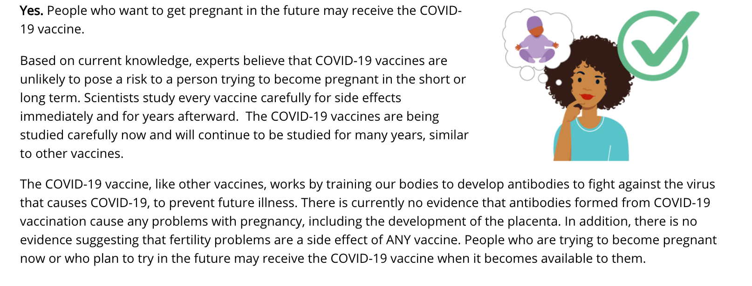
Is it safe for me to get a COVID-19 vaccine if I would like to have a baby one day?
Notes:
How the rumor started that COVID-19 vaccines may affect fertility:
https://www.webmd.com/vaccines/covid-19-vaccine/news/20210112/why-covid-vaccines-are-falsely-linked-to-infertility
In early December, a German doctor and epidemiologist named Wolfgang Wodarg, who has been skeptical about the need for vaccines in other pandemics, teamed up with a former Pfizer employee to ask the European Medicines Agency (the European Union counterpart to the FDA) to delay the study and approval of the Pfizer/BioNTech vaccine. One of their concerns was a protein called syncytin-1, which shares similar genetic instructions with part of the spike of the new coronavirus. That same protein is an important component of the placenta in mammals. If the vaccine causes the body to make antibodies against syncytin-1, they argued, it might also cause the body to attack and reject the protein in the human placenta, making women infertile.
Their petition was picked up by anti-vaccination blogs and websites and posted to social media. Facebook eventually removed posts about the petition from its site for spreading misinformation.
The idea that vaccines could be deployed for population control was also woven into the plot of a recent, fictional miniseries on Amazon Prime Video called Utopia. In that show -- spoiler alert -- a drugmaker obsessed with population control creates the illusion of a flu pandemic to convince people to take its vaccine, which doesn’t prevent infection, but human reproduction.
A spokesperson for Amazon Studios says the series is pure fiction.
“Utopia premiered on Amazon Prime Video on Sept. 25, 2020,” the spokesperson said in a statement to WebMD. “It was written 7 years ago, and was filmed prior to the COVID-19 pandemic. The series is based off of the original U.K. version, which premiered in 2013, and shares much of the same plot, including the vaccine storyline.”
While the show is the stuff of creative writing minds, could something like that happen in real life?
The biological basis for this idea is really shaky, Foster says.
The coronavirus’s spike protein and syncytin-1 share small stretches of the same genetic code, but not enough to make them a match. She says it would be like two people having phone numbers that both contain the number 7. You couldn’t dial one number to reach the other person, even though their phone numbers shared a digit.
“What we know is that they are similar on such a tiny level,” Foster says.
Even Wodarg, in his petition, writes “there is no indication whether antibodies against spike proteins of SARS viruses would also act like anti-Syncytin-1 antibodies.”
Indeed, data from the human studies of the Pfizer vaccine don’t bear out this theory. In the Pfizer trial, which included more than 37,000 people, women were given pregnancy tests before they were accepted to the study. They were excluded if they were already pregnant. During the trial, 23 women conceived, likely by accident. Twelve of these pregnancies happened in the vaccine group, and 11 in the placebo group. They continued to be followed as part of the study. Same with Moderna study!
Paul Offit, MD, director of the Vaccine Education Center at Children’s Hospital of Philadelphia, says this idea really crumbles when you consider that more than 22 million people in the United States have been infected by SARS-CoV-2, the virus that causes COVID-19. In fact, experts believe that number is much higher because 22 million is just the number who have been tested and found. Most think the real number is at least 3 times that high.
Offit says to consider that 70 million Americans have been infected, or about 20% of the population. If the infertility theory was true, he says, you’d expect that the body making antibodies against the natural infection would show up in our fertility statistics. It hasn’t.
“There's no evidence that this pandemic has changed fertility patterns,” Offit says.
He says there are cases where vaccines have caused biological effects linked to a disease. Take measles, for example. After a measles vaccine, you can get little broken blood vessels, called petechiae, as a result of a problem with blood clotting. It’s rare, but it can happen. The vaccine causes that phenomenon, he says, because measles, the disease, can also cause it.
“If natural infection doesn't alter fertility, why would a vaccine do it?” says Offit, who has been reviewing clinical trials behind the vaccines as an adviser to the FDA.
Offit admits that we don’t have all the long-term safety data we’d like on the vaccines. That’s being gathered furiously right now, as the vaccines roll out to millions of people, and reported by the CDC.
But so far, he says the major issues seem to be a severe allergic reaction that appears to happen very rarely -- in about 11 people for every million doses given. If it’s going to happen, he says, people generally know right away, when they are still under observation by nurses and doctors. Offit says the reaction, while serious, is treatable. It’s one reason why the CDC has advised people who have allergies to any part of the vaccine, including PEG or a related compound called polysorbate, to avoid these first shots.
.
Offit says what people should know is that they might feel pretty crummy after their shots. He says he had about 12 hours of fatigue and fever after his recent vaccine. That’s not a side effect, but the body generating a protective shield against the virus.
“It was a hit,” he says, “but again, a small price to pay to avoid this virus.”
Graphic source: https://www.cdc.gov/coronavirus/2019-ncov/vaccines/facts.html

Slide 11
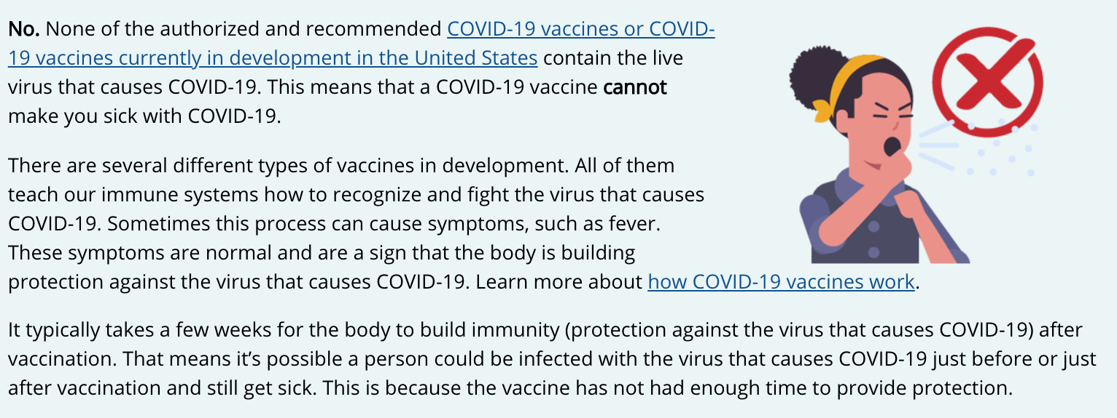
Can a COVID-19 vaccine make me sick with COVID-19?
Notes:
READ SLIDE
https://www.cdc.gov/coronavirus/2019-ncov/vaccines/facts.html

