Slide 1
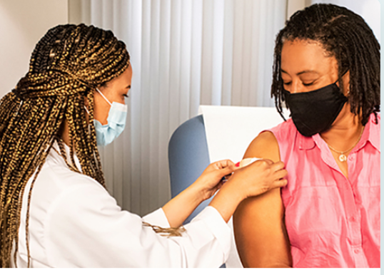
Overview: COVID-19 Disease
REACH organization’s logo here (then remove green frame)
February 10, 2021; updated March 4, 2022
This publication is supported by the Centers for Disease Control and Prevention of the U.S. Department of Health and Human Services (HHS) as part of a Cooperative Agreement.
The contents are those of the author(s) and do not necessarily represent the official views of, nor an endorsement, by CDC/HHS, or the U.S. Government.
Notes:
Good day. Today we will be providing an overview of COVID-19 disease

Slide 2
Objectives
At the end of this session, the learner will be able to describe:
Signs and symptoms of COVID-19 disease
When to seek emergency medical attention
Groups at high risk for severe COVID-19 disease
How to protect yourself and others from COVID-19
Treatments for COVID-19
COVID-19 variants
Notes:
At the end of this session, the learner will be able to describe:
The currently available COVID-19 vaccines, how they work, their effectiveness, and ingredients
Recommendations for use of the vaccines. and what to expect post-vaccination

Slide 3
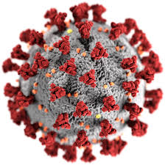
SARS-CoV-2 virus (COVID-19 disease)
SARS-CoV-2, the virus that causes COVID-19 disease affects the respiratory system primarily, but other organ systems may also be impacted
Transmission is through droplet and respiratory spread but may also include indirect contact with contaminated objects
People closer than 6 feet from the infected person are most likely to get infected
Notes:
Overall mortality increases with age
Mortality highest in persons 85 yrs. and older
Disease risk increases with the number of co-morbidities
Cancer HIV infections
Chronic kidney disease Immunocompromised state
Chronic lung diseases (inc. COPD, asthma, Cystic fibrosis) Liver disease
Dementia or other neurological conditions Overweight and Obesity
Diabetes (type 1 or 2) Pregnancy
Downs syndrome Sickle cell disease or thalessemia
Heart conditions Solid organ or blood stem cell transplant
Substance use disorders
Pregnant people are also at increased risk for severe illness from COVID-19
Increased risk for severe disease is also seen in certain racial/ethnic minority groups. African American, Hispanic/Latino and AI/AN people are 3 x more likely to be hospitalized and 2 x more likely to die from COVID-19 than their white counterparts. Race and ethnicity are risk markers for other underlying conditions that affect health including socioeconomic status, access to health care, and exposure to the virus related to occupation, e.g., frontline, essential, and critical infrastructure workers.
Resources:
https://www.cdc.gov/coronavirus/2019-ncov/your-health/index.html
https://www.cdc.gov/coronavirus/2019-ncov/hcp/clinical-care/underlyingconditions.html
https://www.cdc.gov/vaccines/acip/meetings/downloads/slides-2020-12/slides-12-20/02-COVID-Dooling.pdf
Source: https://www.cdc.gov/coronavirus/2019-ncov/prevent-getting-sick/how-covid-spreads.html

Slide 4
COVID-19 disease symptoms: can be mild to severe and develop 2-14 days after exposure
Fever or chills
Cough
Shortness of breath or difficulty breathing
Fatigue
Muscle or body aches
Headache
Loss of taste or smell
Sore throat
GI symptoms (nausea, vomiting, diarrhea)
Congestion or runny nose

Slide 5
When to seek emergency medical attention
Look for emergency warning signs* for COVID-19. If someone is showing any of these signs, seek emergency care immediately:
Trouble breathing
Persistent pain or pressure in the chest
New confusion
Inability to wake or stay awake
Pale, gray, or blue-colored skin, lips, or nail beds, depending on skin tone
*This list is not all possible symptoms. Please call your medical provider for any other symptoms that are severe or concerning to you.
Notes:
Source: https://www.cdc.gov/coronavirus/2019-ncov/symptoms-testing/symptoms.html

Slide 6
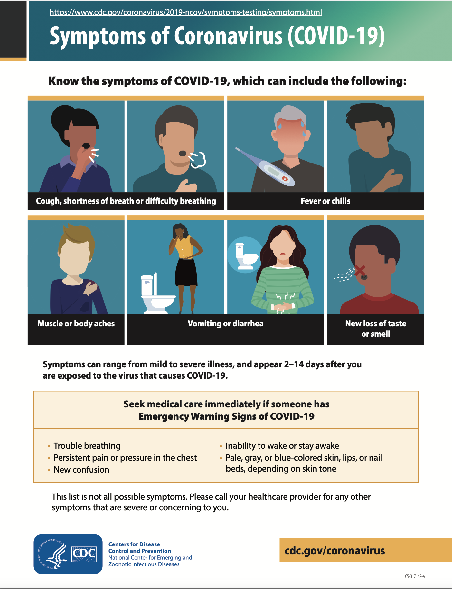

Slide 7
 | Flu | Similarities between Flu & COVID-19 | COVID-19
Caused by | Influenza virus |  | SARS-CoV-2
Spread by |  | Tiny droplets from coughing, sneezing, and/or talking Touching a surface or object that has the virus and then touching your mouth, nose, or eyes
Symptoms | Not everyone has a fever Most people show symptoms in 1 to 4 days | Fever/chills Cough Sore throat Runny/stuffy nose Muscle/body aches Headache Fatigue Vomiting/diarrhea Shortness of breath | Loss of smell/taste COVID toes Can take longer for someone to show symptoms (up to 5 days; range 2 to 14 days)
Spread and duration of illness | Can last 7-10 days Contagious from 1 day prior to 7 days after testing positive |  | Duration of illness varies More contagious than flu Contagious from 2 days prior to 10 days after testing positive

Slide 8
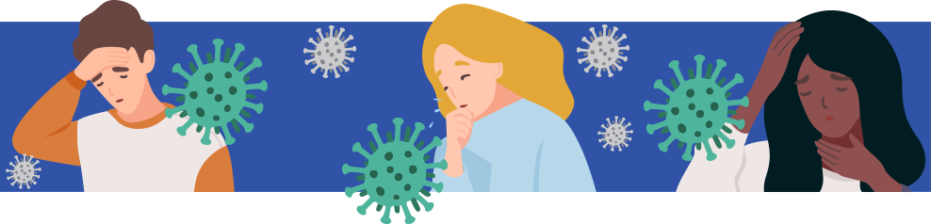
 | Flu | Similarities between Flu & COVID-19 | COVID-19
Complications | Ear infections Sinus infections Pneumonia | Negatively impacts pre-existing chronic conditions like asthma, heart disease, and diabetes May require hospitalization Can be deadly | Blood clots Complications with major organs MISC Post COVID symptoms (fatigue, etc.)
Who is at high risk for complications? | 65+ Young children Individuals with chronic illnesses | Everyone | Individuals with: Chronic illnesses Obesity Immunosuppression
Is there a vaccine? | YES |  | YES
Notes:
5. Complications of the flu can include bacterial pneumonia, ear infections, sinus infections and worsening of chronic medical conditions, such as congestive heart failure, asthma, or diabetes.​
Complications of COVID-19 can include the above like pneumonia, worsening of chronic medical conditions, but also many patients with COVID-19 have developed blood clots. The virus affects major organs like the liver, kidney, lungs; It can cause MISC, multi system inflammatory syndrome in children, and a new concern: Post COVID symptoms (Fatigue, confusion, etc.)​
6. Everyone is at risk for either disease. With the flu the very young as well as our elderly suffer more complications from the flu. With COVID-19 we are learning that certain people: those with chronic illness, those who are obese, and certain ethnicities and races are more likely to be hospitalized or to die. We will explore the issue of ethnicity/race later during this webinar.​
7. Finally, the main difference is that there is currently a vaccine in the United States to protect against the flu. This is not the case for COVID-19.(as of 10/23/20). Flu vaccine will not protect you from COVID-19. ​
​
Resources: www.cdc.gov/flu and www.cdc.gov/coronavirus/2019

Slide 9
COVID-19 variants (1)
Viruses constantly change by mutating, which is how they spread and survive—some emerge and then disappear, while others persist. These changes cause viral variants.
Multiple COVID-19 variants are circulating globally
CDC is studying them quickly to understand whether the variants
Spread more easily from person to person
Cause milder or more severe disease in people
Are detected by currently available viral tests
Respond to medicines currently being used to treat people for COVID-19
Change the effectiveness of COVID-19 vaccines
Notes:
https://www.cdc.gov/coronavirus/2019-ncov/variants/about-variants.html

Slide 10
COVID-19 variants (2)
New variants of the virus are expected to occur.
Slowing the spread of the virus, by protecting yourself and others, can help slow the emergence of new variants.
The Omicron variant causes more infections and spreads faster than the original SARS-CoV-2 strain of the virus that causes COVID-19.
The Delta variant may spread more easily than other variants.
CDC is working with state and local public health officials to monitor the spread of all variants.
Getting a vaccine reduces your risk of severe illness, hospitalization, and death from COVID-19. Staying up to date on your COVID-19 vaccines, which includes getting a booster when eligible, further improves your protection.
Notes:
https://www.cdc.gov/coronavirus/2019-ncov/variants/about-variants.html

Slide 11
Increased risk factors for COVID-19 disease

Slide 12
Groups at increased risk for severe illness
Some people are more likely than others to become severely ill.
Severe illness means that a person with COVID-19 may need: hospitalization, intensive care, a ventilator to help them breathe or they may even die.
People at increased risk, and those who live or visit with them, need to take precautions to protect themselves from getting COVID-19.
Higher risk groups include:
Older adults
People with certain medical conditions
Pregnant and recently pregnant people
Notes:
Source: https://www.cdc.gov/coronavirus/2019-ncov/need-extra-precautions/index.html

Slide 13
Underlying conditions with higher risk of severe COVID-19 outcomes
Evidence shows a higher risk for severe COVID-19 outcomes for people with the following conditions*:
Mental health disorders (mood disorders, schizophrenia spectrum disorders)
Neurologic conditions limited to dementia
Obesity (BMI ≥30 kg/m2)
Primary immunodeficiencies
Pregnancy and recent pregnancy
Physical inactivity
Smoking, current and former
Solid organ or hematopoietic cell transplantation
Tuberculosis
Use of corticosteroids or other immunosuppressive meds
Cancer
Cerebrovascular disease
Chronic kidney disease
Chronic lung diseases
Chronic liver diseases
Cystic fibrosis
Diabetes mellitus (type 1 and 2)
Disabilities
Heart conditions (heart failure, coronary artery disease, or cardiomyopathies)
HIV (Human Immunodeficiency Virus)
*Visit the CDC website for more details
Notes:
Source: https://www.cdc.gov/coronavirus/2019-ncov/hcp/clinical-care/underlyingconditions.html?ACSTrackingID=USCDC_1052-DM76136&ACSTrackingLabel=COCA%20Now%3A%20Updated%20List%20of%20High-Risk%20Medical%20Conditions%20for%20Severe%20COVID-19%20Outcomes&deliveryName=USCDC_1052-DM76136

Slide 14

Increased risk for severe illness from COVID-19 during pregnancy (1)
Although the overall risks are low, people who are pregnant or recently pregnant are at an increased risk for severe illness from COVID-19 compared with people who are not pregnant.
Severe illness includes illness that requires hospitalization, intensive care, need for a ventilator or special equipment to breathe, or illness that results in death.
They are also at increased risk of preterm birth and stillbirth and might be at increased risk of other pregnancy complications.
Notes:
Source: https://www.cdc.gov/coronavirus/2019-ncov/need-extra-precautions/pregnant-people.html

Slide 15
Increased risk for severe illness from COVID-19 during pregnancy (2)
Other factors can further increase the risk for getting severely ill from COVID-19 during or recently after pregnancy, such as:
Having certain underlying medical conditions
Being older than 25 years
Living or working in a community with high numbers of COVID-19 cases
Living or working in a community with low levels of COVID-19 vaccination
Working in places where it is difficult or not possible to keep at least 6 feet apart from people who might be sick
Being part of some racial and ethnic minority groups, which have been put at increased risk of getting sick from COVID-19 because of the health inequities they face
Notes:
Source: https://www.cdc.gov/coronavirus/2019-ncov/need-extra-precautions/pregnant-people.html

Slide 16
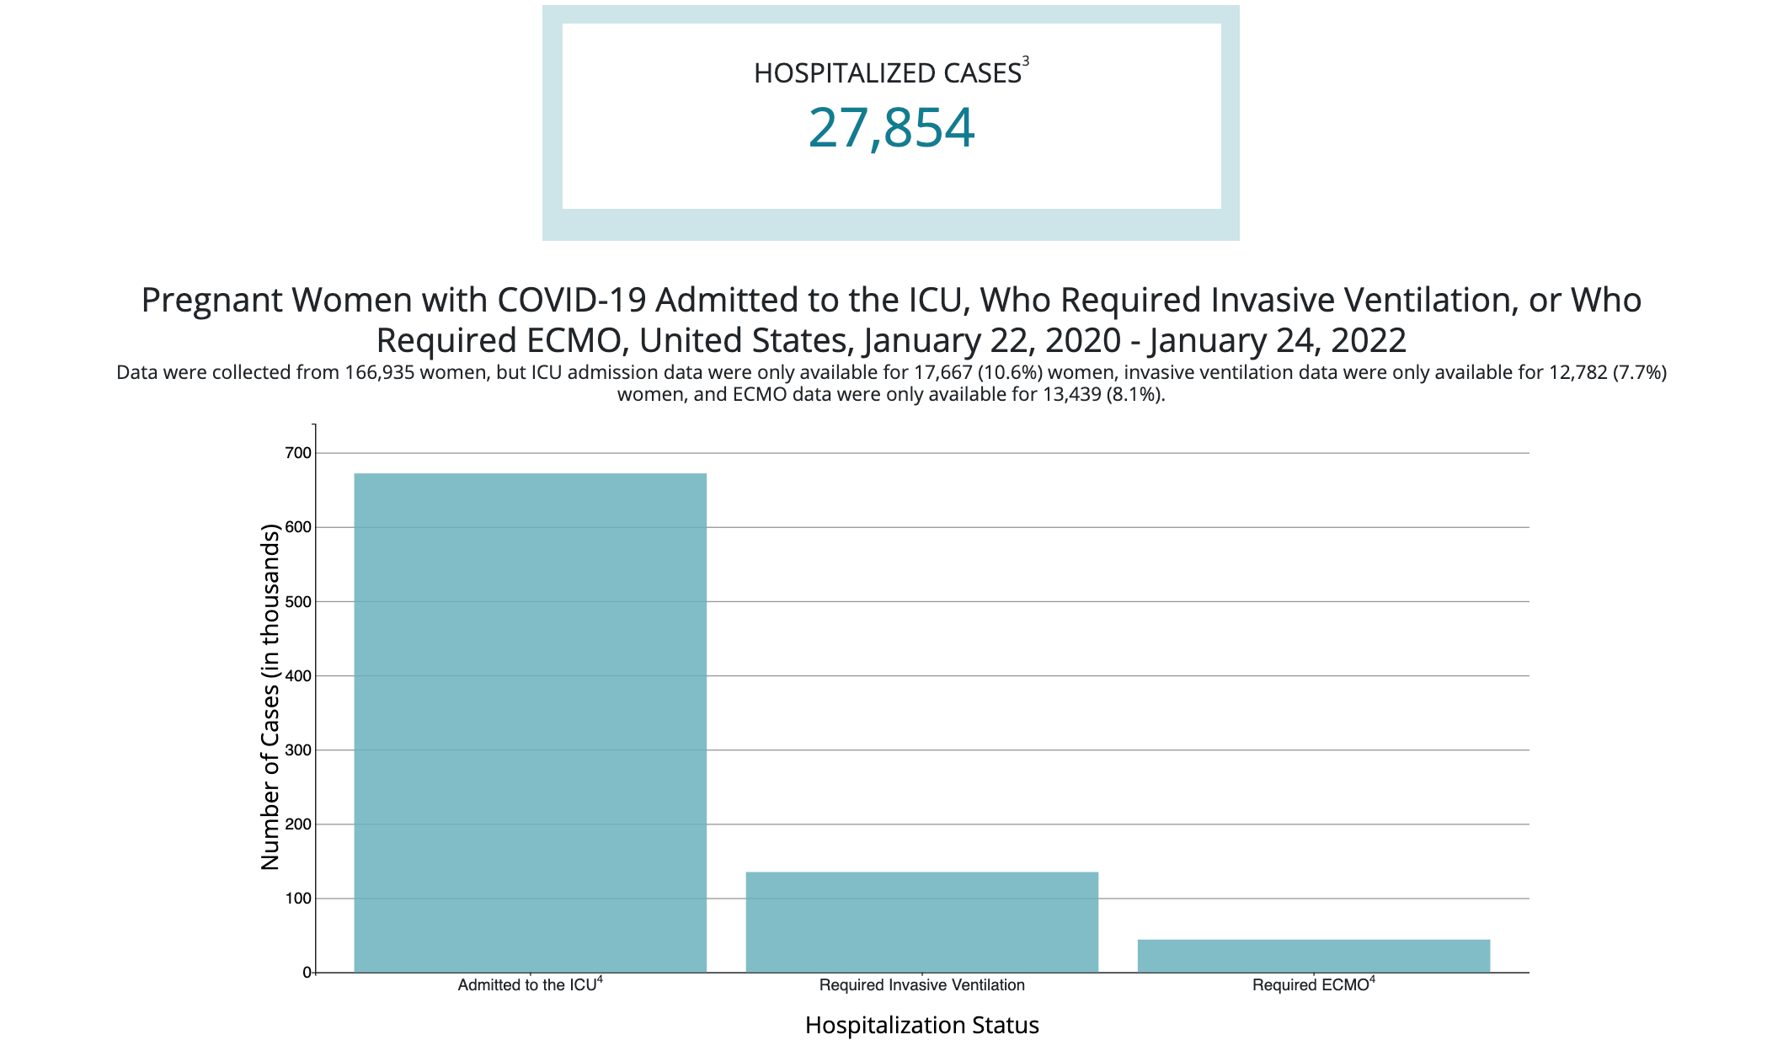
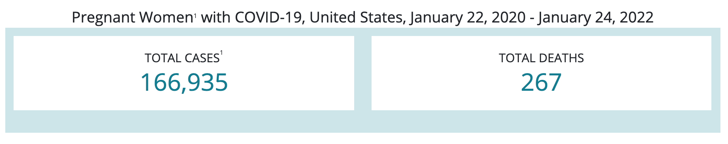
CDC Data: COVID-19 during pregnancy: severity of maternal illness

Slide 17
Dangers of COVID-19 infection during pregnancy
A study of pregnant women in Scotland, published in Jan 2022 in Nature medicine: 77.4% of COVID-19 infections, 91% COVID infections associated with hospitalizations, 98% of COVID infections associated with ICU admission and all baby deaths occurred in pregnant women who were unvaccinated.
Another study published in the Lancet in Jan 2022, COVID-19 infection in pregnancy led to an increased risk of preterm delivery and stillbirth.
Notes:
https://www.nature.com/articles/s41591-021-01666-2. Between the start of a COVID-19 vaccine program in Scotland, on 8 December 2020 and 31 October 2021, 25,917 COVID-19 vaccinations were given to 18,457 pregnant women. Vaccine coverage was substantially lower in pregnant women than in the general female population of 18−44 years; 32.3% of women giving birth in October 2021 had two doses of vaccine compared to 77.4% in all women. The extended perinatal mortality rate for women who gave birth within 28 d of a COVID-19 diagnosis was 22.6 per 1,000 births (95% CI 12.9−38.5; pandemic background rate 5.6 per 1,000 births; 452 out of 80,456; 95% CI 5.1−6.2). Overall, 77.4% (3,833 out of 4,950; 95% CI 76.2−78.6) of SARS-CoV-2 infections, 90.9% (748 out of 823; 95% CI 88.7−92.7) of SARS-CoV-2 associated with hospital admission and 98% (102 out of 104; 95% CI 92.5−99.7) of SARS-CoV-2 associated with critical care admission, as well as all baby deaths, occurred in pregnant women who were unvaccinated at the time of COVID-19 diagnosis. Addressing low vaccine uptake rates in pregnant women is imperative to protect the health of women and babies in the ongoing pandemic.
https://www.thelancet.com/journals/landig/article/PIIS2589-7500(21)00250-8/fulltext#%20
Between March 5, 2020, and July 4, 2021, 73 666 pregnant people delivered, 18 335 of whom had at least one SARS-CoV-2 test during pregnancy before Feb 14, 2021. We observed 882 people infected with SARS-CoV-2 during their pregnancy (first trimester n=85; second trimester n=226; and third trimester n=571) and 19 769 people who have never tested positive for SARS-CoV-2 and received at least one negative SARS-CoV-2 test during their pregnancy. SARS-CoV-2 infection indicated an increased risk of preterm delivery (p<0·05) and stillbirth (p<0·05), accounted for primarily by first and second trimester SARS-CoV-2 infections. Gestational age at SARS-CoV-2 infection was correlated with gestational age at delivery (p<0·01) and had the greatest impact on predicting gestational age at delivery. The people in this study had mild or moderate SARS-CoV-2 infections and acute COVID-19 severity was not correlated with gestational age at delivery (p=0·31).

Slide 18
Post-COVID disease

Slide 19
Reinfections and COVID-19
Reinfection with the virus that causes COVID-19 means a person was infected, recovered, and then later became infected again. After recovering from COVID-19, most individuals will have some protection from repeat infections. However, reinfections do occur after COVID-19. We are still learning more about these reinfections.
Ongoing studies of COVID-19 are helping us understand:
How often reinfections occur
Who is at higher risk of reinfection
How soon reinfections take place after a previous infection
The severity (how serious the infection is) of reinfections compared with initial (the first) infections
The risk of transmission to others after reinfection
Notes:
Source: https://www.cdc.gov/coronavirus/2019-ncov/your-health/reinfection.html

Slide 20
Post-COVID conditions
Post-COVID conditions are a wide range of new, returning, or ongoing health problems people can experience four or more weeks after first being infected with the virus that causes COVID-19
As of July 2021, “long COVID,” also known as post-COVID conditions, can be considered a disability under the Americans with Disabilities Act (ADA). Learn more: Guidance on “Long COVID” as a Disability Under the ADA, Section | HHS.govexternal icon
Notes:
Even people who did not have COVID-19 symptoms in the days or weeks after they were infected can have post-COVID conditions. These conditions can present as different types and combinations of health problems for different lengths of time.

Slide 21
Post-COVID symptoms
Difficulty breathing or shortness of breath
Tiredness or fatigue
Symptoms that get worse after physical or mental activities (also known as post-exertional malaise)
Difficulty thinking or concentrating (sometimes referred to as “brain fog”)
Cough
Chest or stomach pain
Headache
Fast-beating or pounding heart (also known as heart palpitations)
Joint or muscle pain
Pins-and-needles feeling
Diarrhea
Sleep problems
Fever
Dizziness on standing (lightheadedness)
Rash
Mood changes
Change in smell or taste
Changes in menstrual period cycles

Slide 22
Multiorgan effects of COVID-19 (MIS-C and MIS-A)
Multiorgan effects or autoimmune conditions over a longer time with symptoms lasting weeks or months after COVID-19 illness.
Multiorgan effects can affect many, if not all, body systems, including heart, lung, kidney, skin, and brain functions. Autoimmune conditions happen when your immune system attacks healthy cells in your body by mistake, causing inflammation (swelling) or tissue damage in the affected parts of the body.
While it is very rare, some people, mostly children, experience multisystem inflammatory syndrome (MIS) during or immediately after a COVID-19 infection. MIS is a condition where different body parts can become inflamed. MIS can lead to post-COVID conditions if a person continues to experience multiorgan effects or other symptoms.
Notes:
ome people who had severe illness with COVID-19 experience multiorgan effects or autoimmune conditions over a longer time with symptoms lasting weeks or months after COVID-19 illness. Multiorgan effects can affect many, if not all, body systems, including heart, lung, kidney, skin, and brain functions. Autoimmune conditions happen when your immune system attacks healthy cells in your body by mistake, causing inflammation (swelling) or tissue damage in the affected parts of the body.
While it is very rare, some people, mostly children, experience multisystem inflammatory syndrome (MIS) during or immediately after a COVID-19 infection. MIS is a condition where different body parts can become inflamed. MIS can lead to post-COVID conditions if a person continues to experience multiorgan effects or other symptoms.

Slide 23
MIS-C and MIS-A signs and symptoms
Ongoing fever PLUS more than one of the following:
Stomach pain
Bloodshot eyes
Diarrhea
Dizziness or lightheadedness (signs of low blood pressure)
Skin rash
Vomiting
When to seek Emergency Care
Trouble Breathing.
Pain or pressure in the chest that does not go away
Confusion or unusual behavior
Severe abdominal pain
Inability to wake or stay awake
Pale, gray, or blue-colored skin, lips, or nail beds, depending on skin tone
This list does not include all possible symptoms. Please call a medical provider for any other symptoms that are severe or concerning to you.
Call 911 or call ahead to your local emergency facility: Notify the operator that you are seeking care for someone who has or may have COVID-19.

Slide 24
Long COVID resources
CDC pages for public on post-COVID conditions and caring for people with post-COVID conditions
CDC pages for healthcare providers on post-COVID conditions and evaluating and caring for patients with post-COVID conditions
Resolve to Save Lives’ Voices of Long COVID campaign
CHOP video on COVID-19 and MIS-C, MIS-A and long-haulers
Johns Hopkins article on long haulers and long-term effects of COVID-19
US Dept. of Labor resources for workers, employers, youth and policymakers
HHS guidance on long COVID as a disability
Administration for Community Living resources for people with long COVID
Notes:
CDC: https://www.cdc.gov/coronavirus/2019-ncov/long-term-effects/index.html and https://www.cdc.gov/coronavirus/2019-ncov/long-term-effects/care-post-covid.html
CDC healthcare providers: https://www.cdc.gov/coronavirus/2019-ncov/hcp/clinical-care/post-covid-index.html and https://www.cdc.gov/coronavirus/2019-ncov/hcp/clinical-care/post-covid-conditions.html?CDC_AA_refVal=https%3A%2F%2Fwww.cdc.gov%2Fcoronavirus%2F2019-ncov%2Fhcp%2Fclinical-care%2Flate-sequelae.html
CHOP: https://www.chop.edu/centers-programs/vaccine-education-center/video/what-known-about-covid-19-and-mis-c-mis-long-haulers and
Johns Hopkins: https://www.hopkinsmedicine.org/health/conditions-and-diseases/coronavirus/covid-long-haulers-long-term-effects-of-covid19
From US Dept. of Labor: resources for workers, employers, youth and policymakers: https://www.dol.gov/agencies/odep/topics/coronavirus-covid-19-long-covid#Workers
From Administration for Community Living: -list of available resources for people with long COVID: https://acl.gov/covid19/resources-people-experiencing-long-covid
HHS guidance on long COVID as a disability: https://www.hhs.gov/civil-rights/for-providers/civil-rights-covid19/guidance-long-covid-disability/index.html

Slide 25
Protecting yourself from COVID-19 disease

Slide 26
How to protect yourself and others from COVID-19
Get a COVID-19 vaccine as soon as you can. Find a vaccine here. Everyone 12 years and older should get a booster shot when eligible.
Consistently and correctly wear a well-fitting mask that covers your nose and mouth to help protect yourself and others.
Stay 6 feet apart from others.
Avoid crowds and poorly ventilated indoor spaces.
Know when to test to be informed and prevent spread to others.
Wash your hands often with soap and water and dry thoroughly. Use hand sanitizer with at least 60% alcohol if soap and water aren’t available.
Notes:
Source: https://www.cdc.gov/coronavirus/2019-ncov/your-health/reinfection.html

Slide 27
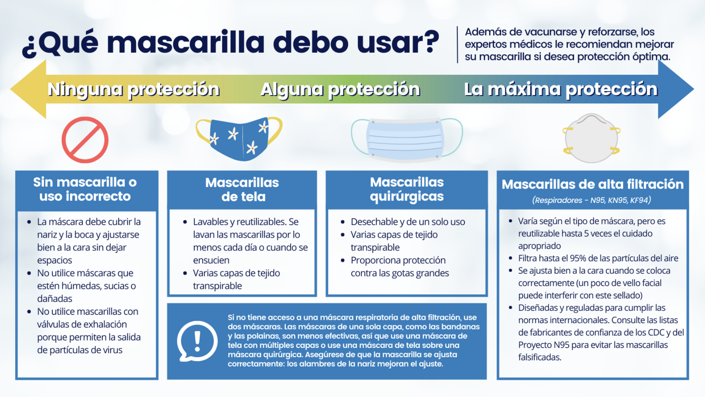
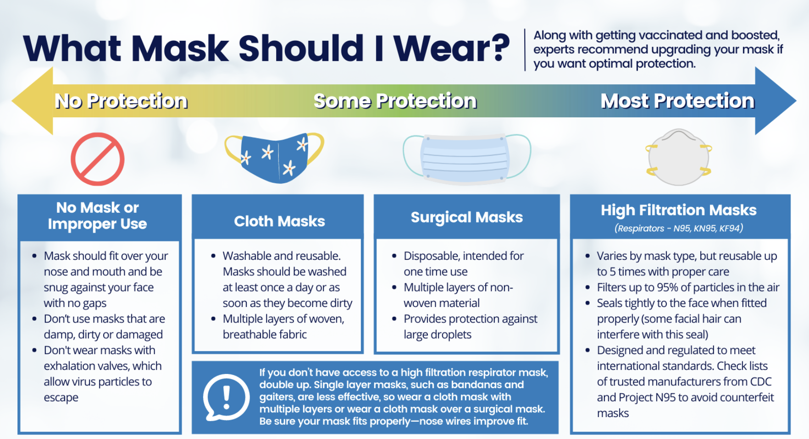
PHCC mask resources- English/Spanish
Notes:
Public Health Communications Collaborative resources: https://publichealthcollaborative.org/resources/shareable-graphic-what-mask-should-i-wear/https://publichealthcollaborative.org/resources/shareable-graphic-what-mask-should-i-wear/

Slide 28
When to wear a mask
Wear a mask with the best fit, protection, and comfort for you.
If you are not up to date with your COVID-19 vaccines and are ages 2 or older, you should wear a mask indoors in public.
In general, people do not need to wear masks when outdoors. In areas of substantial or high transmission, people might choose to wear a mask outdoors when in sustained close contact with other people, particularly if
They or someone they live with has a weakened immune system or is at increased risk for severe disease.
They are not up to date on COVID-19 vaccines or live with someone who is not up to date on COVID-19 vaccines.
Notes:
Source: https://www.cdc.gov/coronavirus/2019-ncov/transmission/index.html

Slide 29
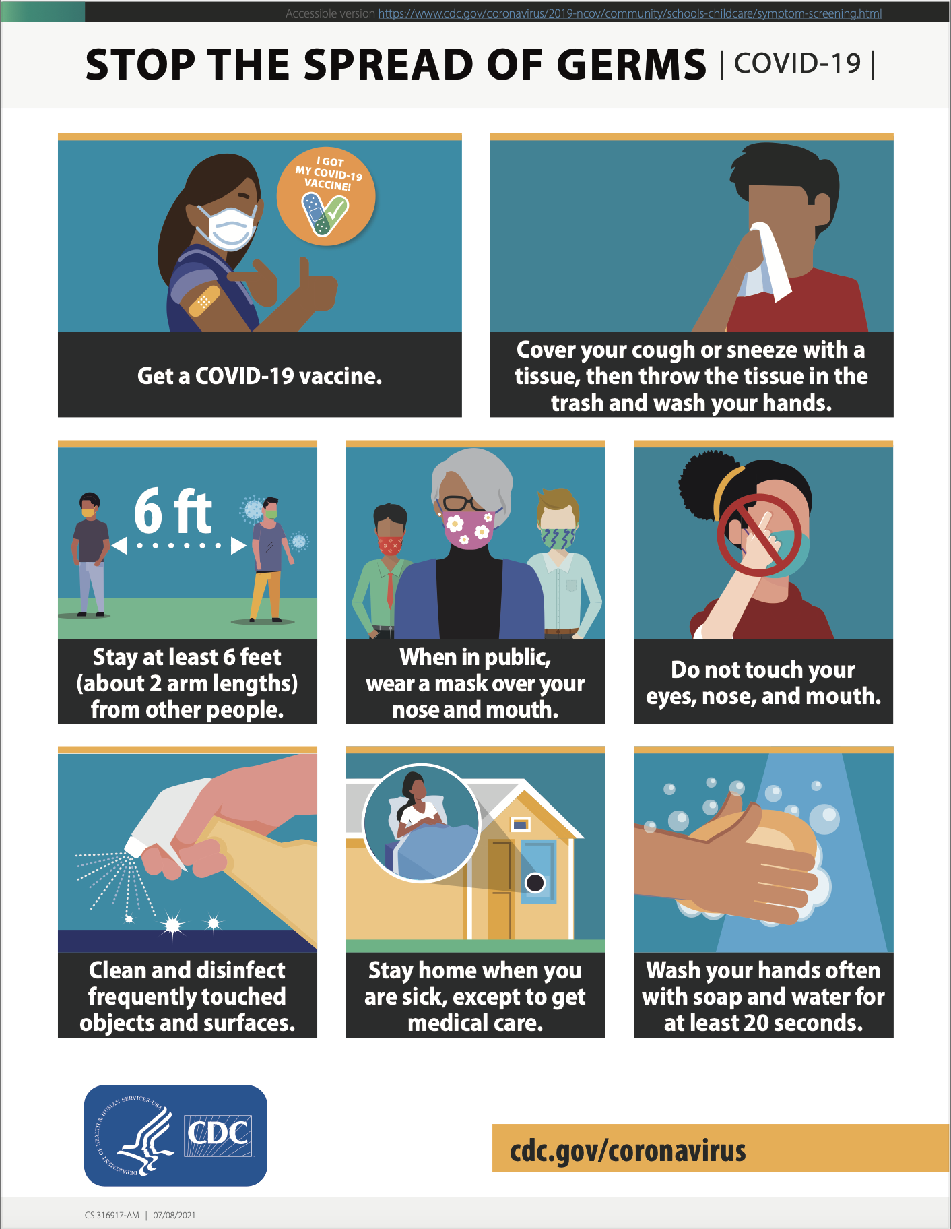
Notes:
Source: https://www.cdc.gov/coronavirus/2019-ncov/images/print-materials/Stop_the_spread_vaccinated_v2.pdf

Slide 30
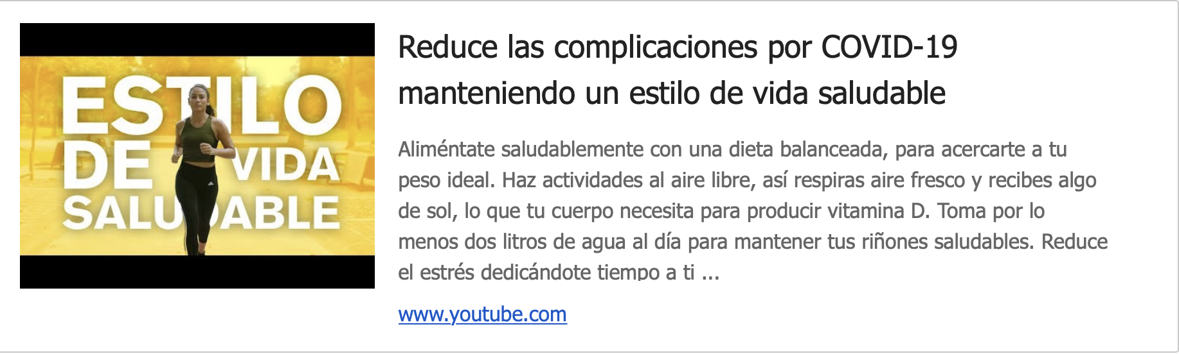
COVID-19 video from El Salvador- Spanish
Video includes messages on maintaining good health to reduce the complications of COVID
Notes:
Video from El Salvador: https://www.youtube.com/watch?v=RpaFcMge9Po

Slide 31
Treatment for COVID-19 disease

Slide 32
Treatment for COVID-19 (1)
If you test positive for COVID-19 and have one or more health conditions that increase your risk of becoming very sick, treatment may be available.
Contact a health professional right away after a positive test to determine if you may be eligible, even if your symptoms are mild right now.
Don’t delay: Treatment must be started within the first few days to be effective.
Notes:
Source: https://www.cdc.gov/coronavirus/2019-ncov/your-health/treatments-for-severe-illness.html

Slide 33
Treatment for COVID-19 (2)
For people at high risk of disease progression, the FDA has issued EUAs for a number of treatments for COVID-19.
Monoclonal antibody treatments could help the immune system recognize and respond more effectively to the virus.
Oral antiviral medications that target specific parts of the SARS-CoV-2 virus can help reduce its multiplication and spread through the patient’s body.
Some of these treatments may not be effective against the Omicron variant. Your healthcare provider will decide which, if any, of these treatments are appropriate to treat your illness.
Notes:
Source: https://www.cdc.gov/coronavirus/2019-ncov/your-health/treatments-for-severe-illness.html

Slide 34
Thank You!!

