Slide 1
COVID-19 Materials and Messaging
June 8, 2021; Updated March 3. 2022
This webinar is supported by the Centers for Disease Control and Prevention of the U.S. Department of Health and Human Services (HHS) as part of a Cooperative Agreement. The contents are those of the author(s) and do not necessarily represent the official views of, nor an endorsement, by CDC/HHS, or the U.S. Government.
Notes:
Welcome

Slide 2
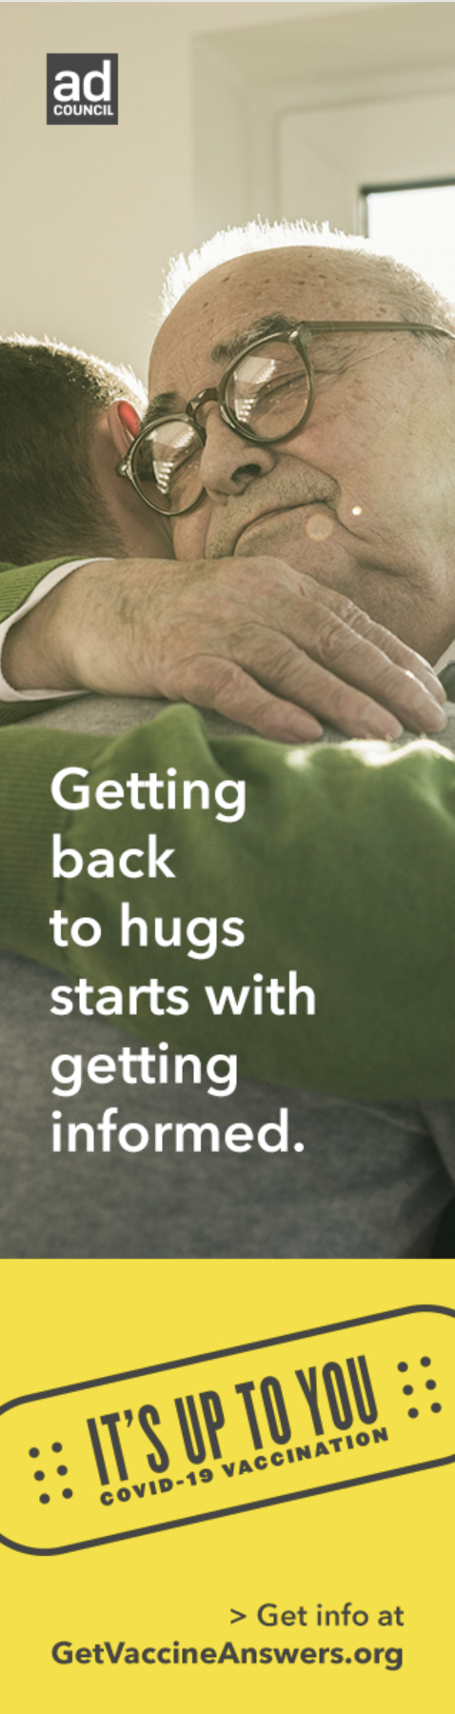
Learning Objectives
Understanding what what communities are thinking about COVID-19 vaccines; identifying potential solutions to increase confidence and uptake.
Describe messaging that can increase vaccine acceptance
Identify communication materials that can increase vaccine acceptance
Notes:
At the end of this presentation, you should be able to describe:
Describe messaging that can increase vaccine acceptance
Provide communication materials that can increase vaccine acceptance

Slide 3
Finding out what the community is saying

Slide 4
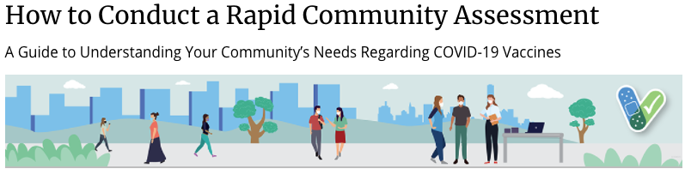
CDC Guide: Understanding your community’s needs regarding COVID-19 vaccines
Objectives:
To identify communities at risk for low COVID-19 vaccine uptake among adults, adolescents, or children.
To understand what communities are thinking about COVID-19 vaccines for adults, adolescents, and children, and plan for potential solutions to increase confidence and uptake.
To identify community leaders, trusted messengers, and other important channels through which you can reach communities.
To identify areas of intervention and prioritize potential intervention strategies to increase COVID-19 vaccine confidence and uptake.
SOURCE: CDC Guide on conducting a RCA
Notes:
Rapid community assessment (RCA) is a process for quickly collecting community insights about a public health issue in order to inform program design. The assessment involves reviewing existing data and conducting community-based interviews, listening sessions, observations, social listening, and surveys.

Slide 5
Vaccine Insights report: State of Vaccine confidence Reports from the CDC
CDC regularly creates reports about the status of COVID-19 vaccine confidence in the United States, emphasizing major themes that influence vaccine confidence and uptake.
The reports include analyses of multiple quantitative and qualitative data sources, ranging from social listening and web metrics to immunization survey data and inquiries to the CDC.
SOURCE: CDC Vaccine Confidence Team, Insights Unit

Slide 6
Ongoing national surveys
Kaiser Family Foundation: COVID-19 Vaccine Monitor
An ongoing research project tracking the public’s attitudes and experiences with COVID-19 vaccinations.
CDC: Trends in Vaccine Confidence
National data updated weekly-monthly. Data represent trends in vaccination status and intent by week and by demographics.
Pew Research Center: National surveys COVID-19

Slide 7

Vaccine Acceptance Strategies & Messaging
de Beaumont, Reagan-Udall, Ad Council, REACH grantees

Slide 8
“Why they decided to get vaccinated”
I had three family members and a neighbor pass away, and a friend that works in ICU in it on the COVID floor who told me how bad it was.
I lost friends and family and saw that people were getting the vaccine and surviving it.
I decided to get the vaccine after talking to some highly credible medical professionals that are family friends, and to first responders who see what’s going on.
I wanted to get some sense of normalcy back like being able to go to a baseball game or being able to travel — you need to have the vaccination to do it.
As time went on, I learned that there weren’t any major effects that people were having from these vaccines. The balance of things I wanted for my family — travelling and getting back to normalcy — those things sort of started to tip the scale. In my decision making, the pros and cons shifted.
I found out that I need it to travel and for work purposes. It was a choice of getting vaccinated or getting tested every day.
I did the odds. I looked at the math, I got the numbers from the CDC. And I said, I’m not likely to get this disease. I’m a little more likely than some folks, but a lot less likely than people more elderly than me. And even if I do get it, I’m probably not going to get very sick from it. But looking at the vaccine, a lot of people have gotten it, it’s very effective, and very few people get side effects from it.
SOURCE: de Beaumont
Notes:
Part of the de Beaumont Foundation’s ongoing research on Americans’ attitudes about COVID-19, the focus group was designed to reveal insights that may help build confidence in the vaccines among people who are currently reluctant to be vaccinated.
“As time went on, the balance of things I wanted for my family started to tip the scale. The pros and cons of getting the vaccine shifted.”
Following are some of the themes they heard:
Their decision to get vaccinated came after their perceived risk of getting COVID-19 outweighed their concerns about the safety of the vaccines.
They were motivated by things they want to be able to do, like travel, go to sporting events, and safely see friends and family.
The most influential source of information about COVID-19 vaccines was a doctor, pharmacist, or other medical professional who they knew and trusted.
They became more comfortable after seeing people they know get vaccinated without major complications. (This was much more important to them than seeing politicians, athletes, or other celebrities get the vaccine.)
When asked about their thoughts about people who still say they won’t get vaccinated, many said they respect that position because everyone has the right to make their own decision, while others said those people are uninformed, misinformed, and “a little selfish.”

Slide 9
“Who they most trust for information about the COVID-19 vaccines”
Doctor
Pharmacist
Other medical professionals
My doctor, because he is the one who knows all of my health issues, who knows all the medications I take.
My medical professional name knows me. He’s well researched. And he shoots straight with me.
I asked my doctor, because he got the vaccine too. and all the medical professionals I know.
My healthcare system, because that’s where all my medical history information is housed. So there’s checks and balances there.
My pharmacist. I’ve had the same pharmacist for over 10 years. She has a lot of knowledge and information, so I can have a conversation with her about medications for me and my family.
My doctor prescribes everything, but the pharmacist is the one who will take the time to let me know about the side effects.
SOURCE: de Beaumont
Notes:
de Beaumont: https://debeaumont.org/changing-the-covid-conversation/focus-group-why-we-got-vaccinated/

Slide 10
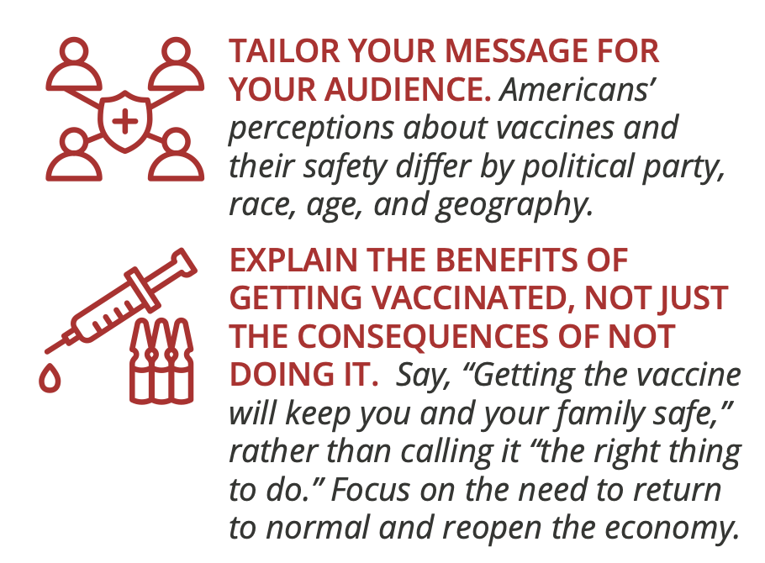
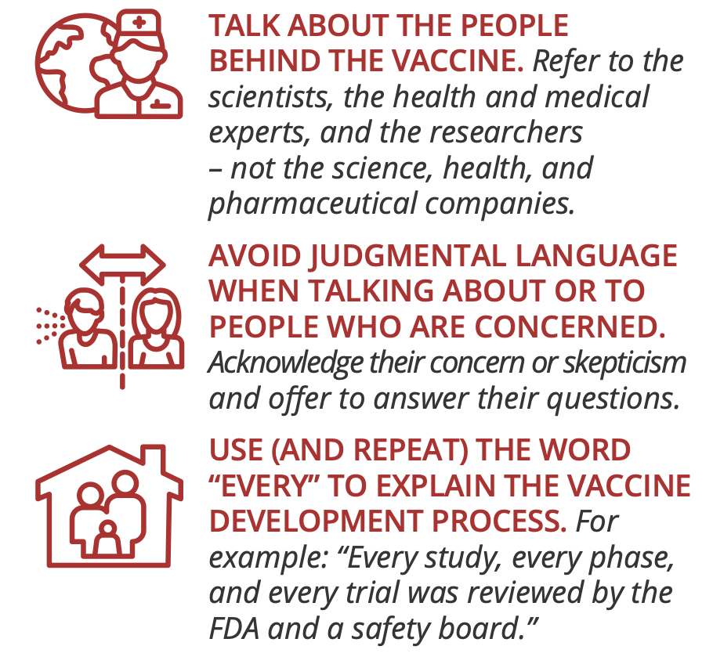
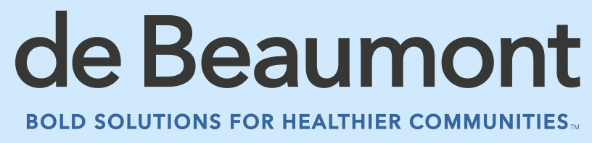
Language that Can Improve Vaccine Acceptance
Source
Notes:
The language we use can improve vaccine acceptance, as shown in this graphic from De Beaumont:
TAILOR YOUR MESSAGE FOR YOUR AUDIENCE
EXPLAIN THE BENEFITS OF GETTING VACCINATED, NOT JUST THE CONSEQUENCES OF NOT DOING IT.
TALK ABOUT THE PEOPLE BEHIND THE VACCINE
AVOID JUDGMENTAL LANGUAGE WHEN TALKING ABOUT OR TO PEOPLE WHO ARE CONCERNED.
USE (AND REPEAT) THE WORD “EVERY” TO EXPLAIN THE VACCINE DEVELOPMENT PROCESS.
https://debeaumont.org/wp-content/uploads/2021/01/VaccineToolkit_1pger.pdf

Slide 11
Language that Can Improve Vaccine Acceptance
Use These Words MORE:
Use These Words LESS:
The benefits of taking it
Getting the vaccine will keep you safe
A return to normal
Your family
Medical experts
Research
Medical researchers
Damage from lockdowns
A transparent, rigorous process
Safety
Pharmaceutical companies
Advanced/ groundbreaking
Vaccination
America’s leading experts
Skeptical/concerned about the vaccine
The consequences of not taking it
Getting the vaccine is the right thing to do
Predictability/certainty
Your community
Scientists/health experts
Discover/create/invent
Drug companies
Inability to travel easily and safely
The dollars spent; number of participants
Security
Drug companies
Historic
Injection/inoculation
The world’s leading experts
Misled/confused about the vaccine
Source
Notes:
And this chart shows how keep messages positive, non-judgmental and focused on family, communities and safety can work to our advantage

Slide 12
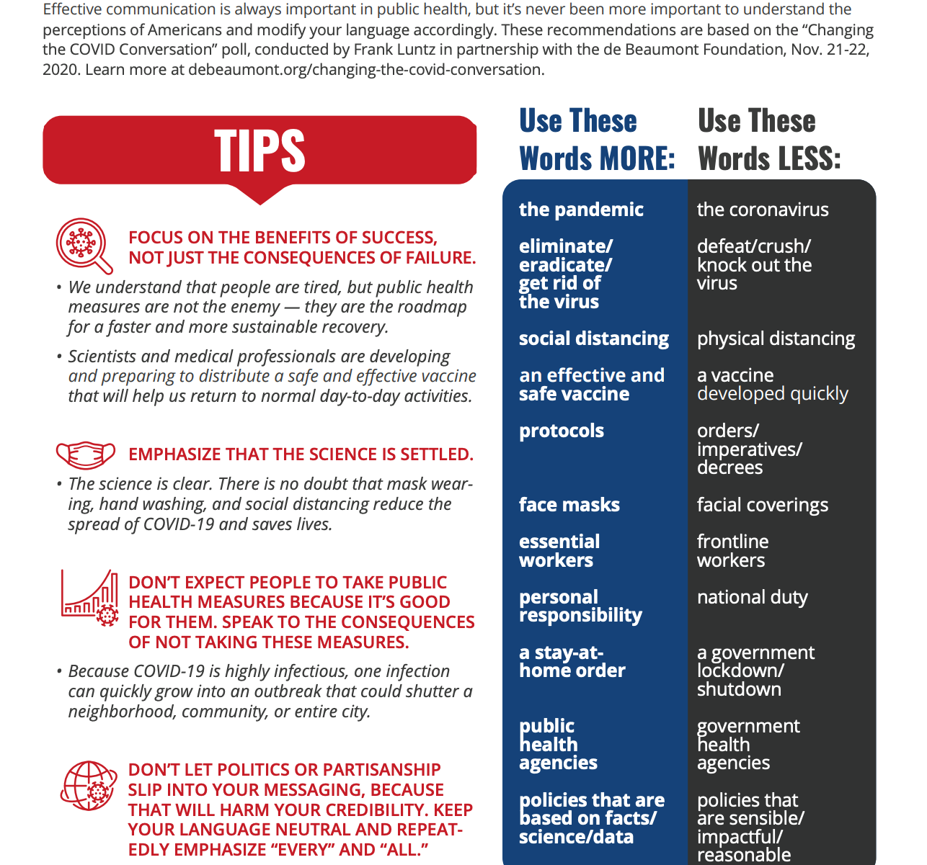
Changing the COVID Conversation: Communications Cheat Sheet
Source
Notes:
And some additional tips from de Beaumont on this communications cheat sheet, which emphasizes:
The need to focus on benefits of success, not consequences of failure
The need to emphasize the science is settled
Don’t let politics get in the way

Slide 13
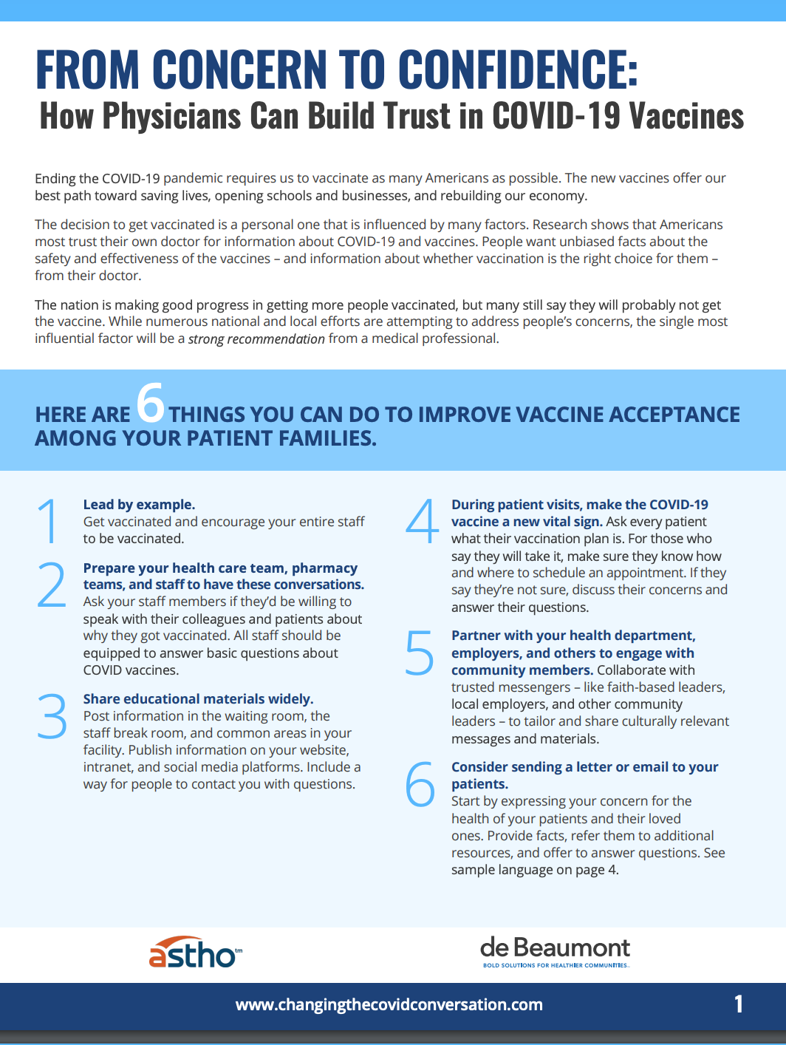
Notes:
Six things medical professionals can do to improve vaccine acceptance.
The de Beaumont Foundation and the Association of State and Territorial Health Officials has released this four-page guide with ideas that doctors, nurses, pharmacists, and other medical professionals can use to build confidence in vaccines among their patients. It incorporates messaging that’s been tested in national polls and focus groups, as well as guidance from the American Medical Association, American Academy of Pediatrics, and the Centers for Disease Control and Prevention.
“Messaging That Works,” with tested language on vaccine safety and effectiveness, side effects, and misinformation.
Recommendations to make conversations with patients as productive as possible.
Sample language for letters, emails, or other communications.

Slide 14
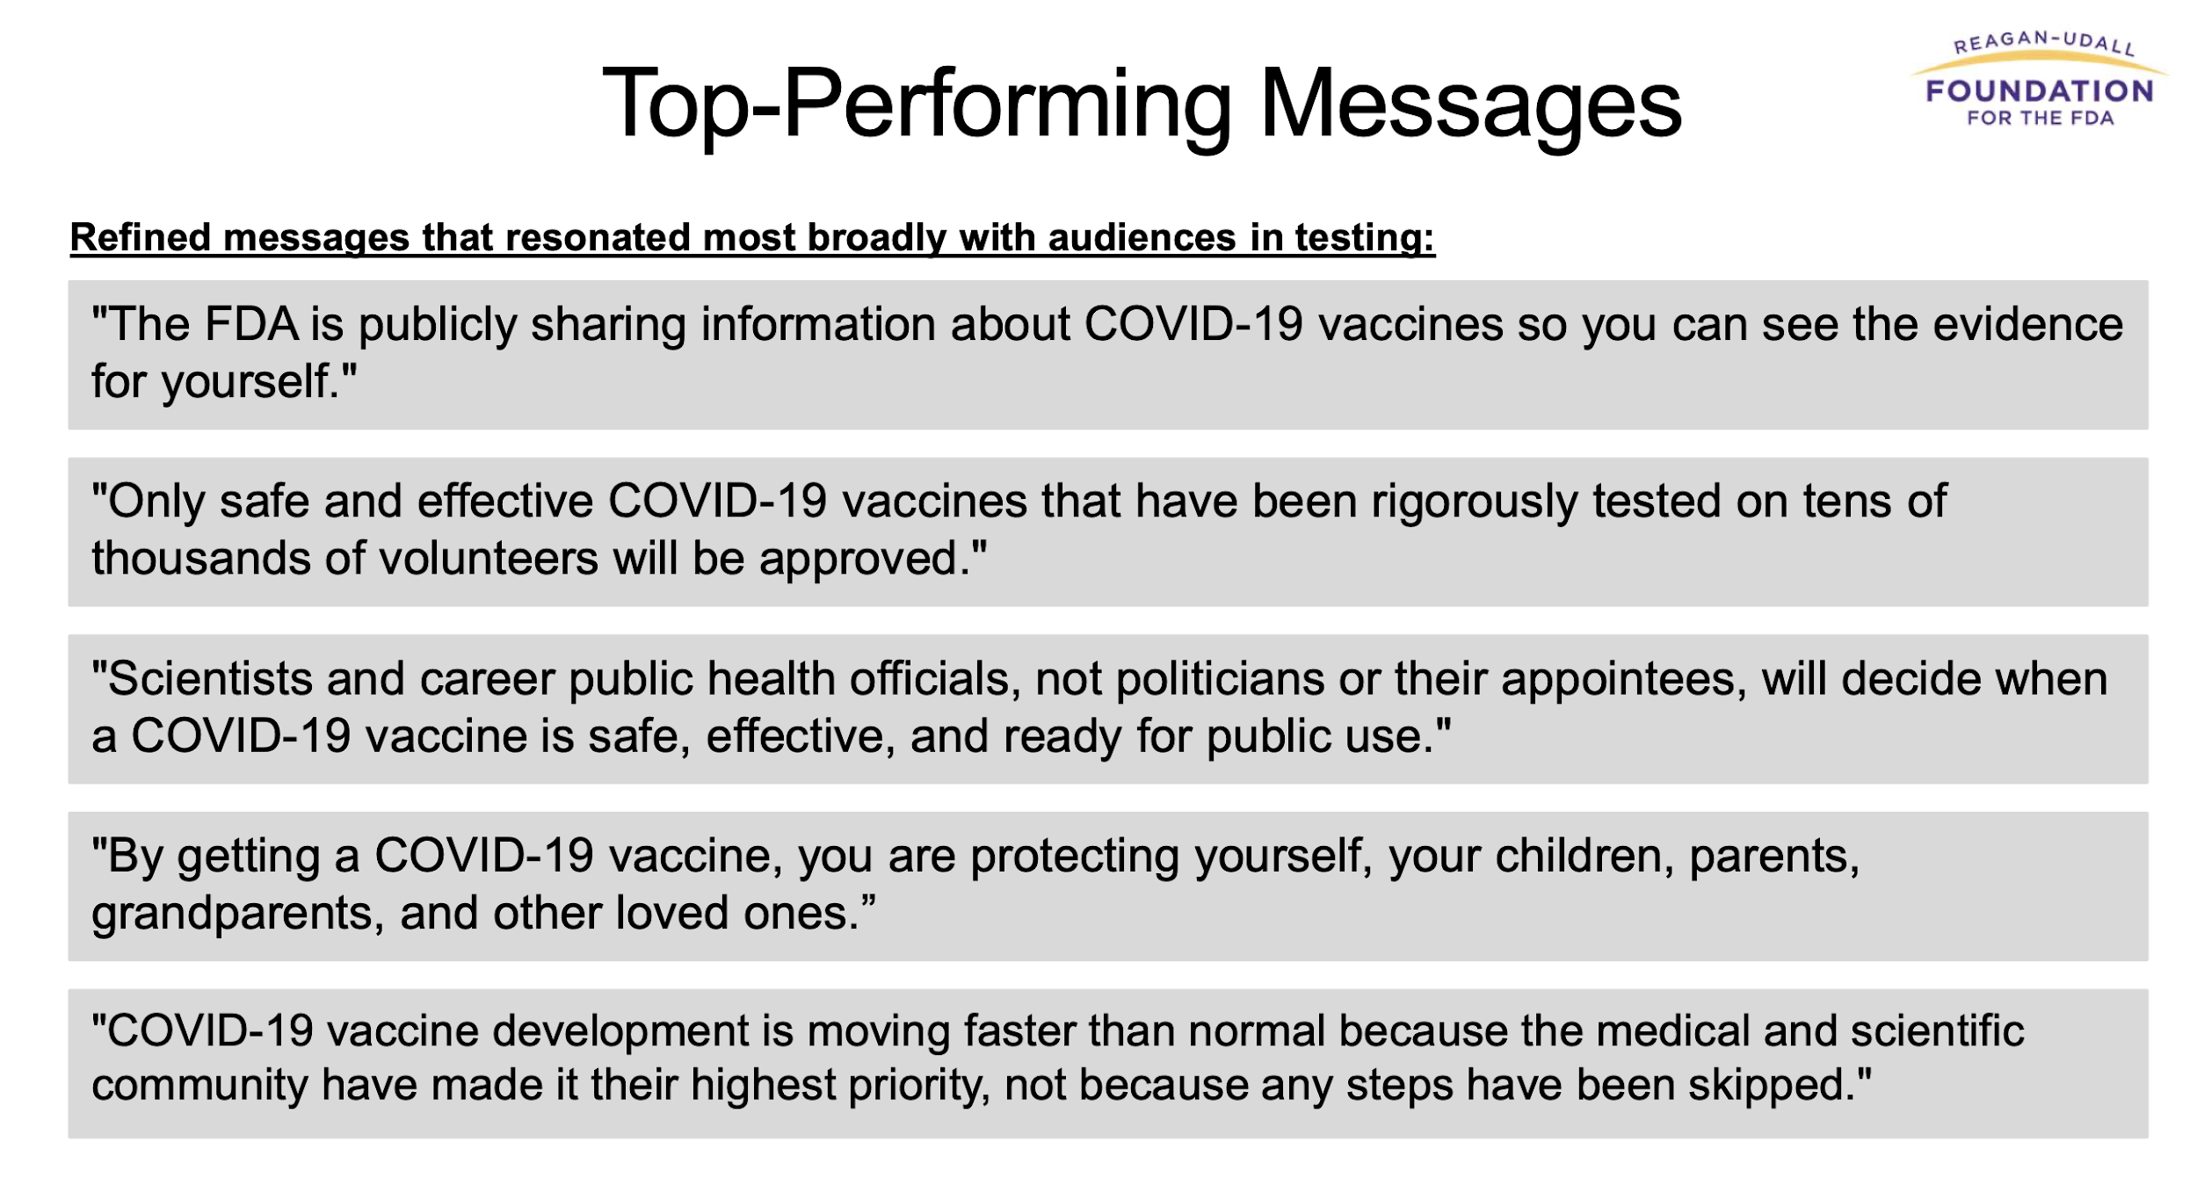
COVID-19 Vaccine Confidence Project: Reagan-Udall Foundation
Notes:
This research from the Reagan-Udall Foundation for the FDA shows the 5 top performing messages when tested
https://reaganudall.org/sites/default/files/2020-12/Vaccine%20Confidence%20Project%20Findings%20for%20Public%20Distribution%20121820.pdf

Slide 15
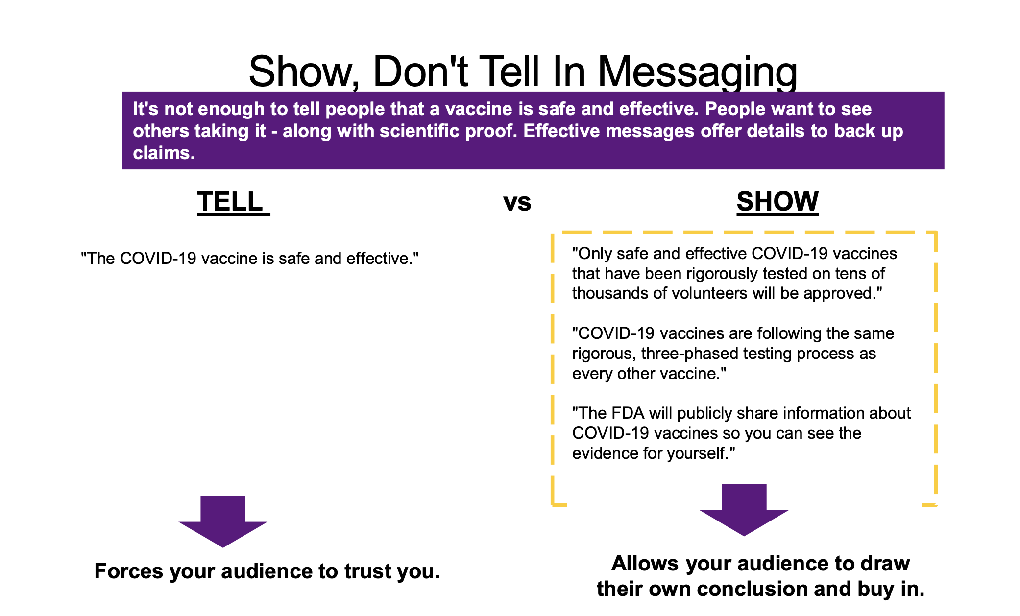

COVID-19 Vaccine Confidence Project: Reagan-Udall Foundation
Notes:
This same report reminds us of effective communication rules.
First, show don’t tell

Slide 16
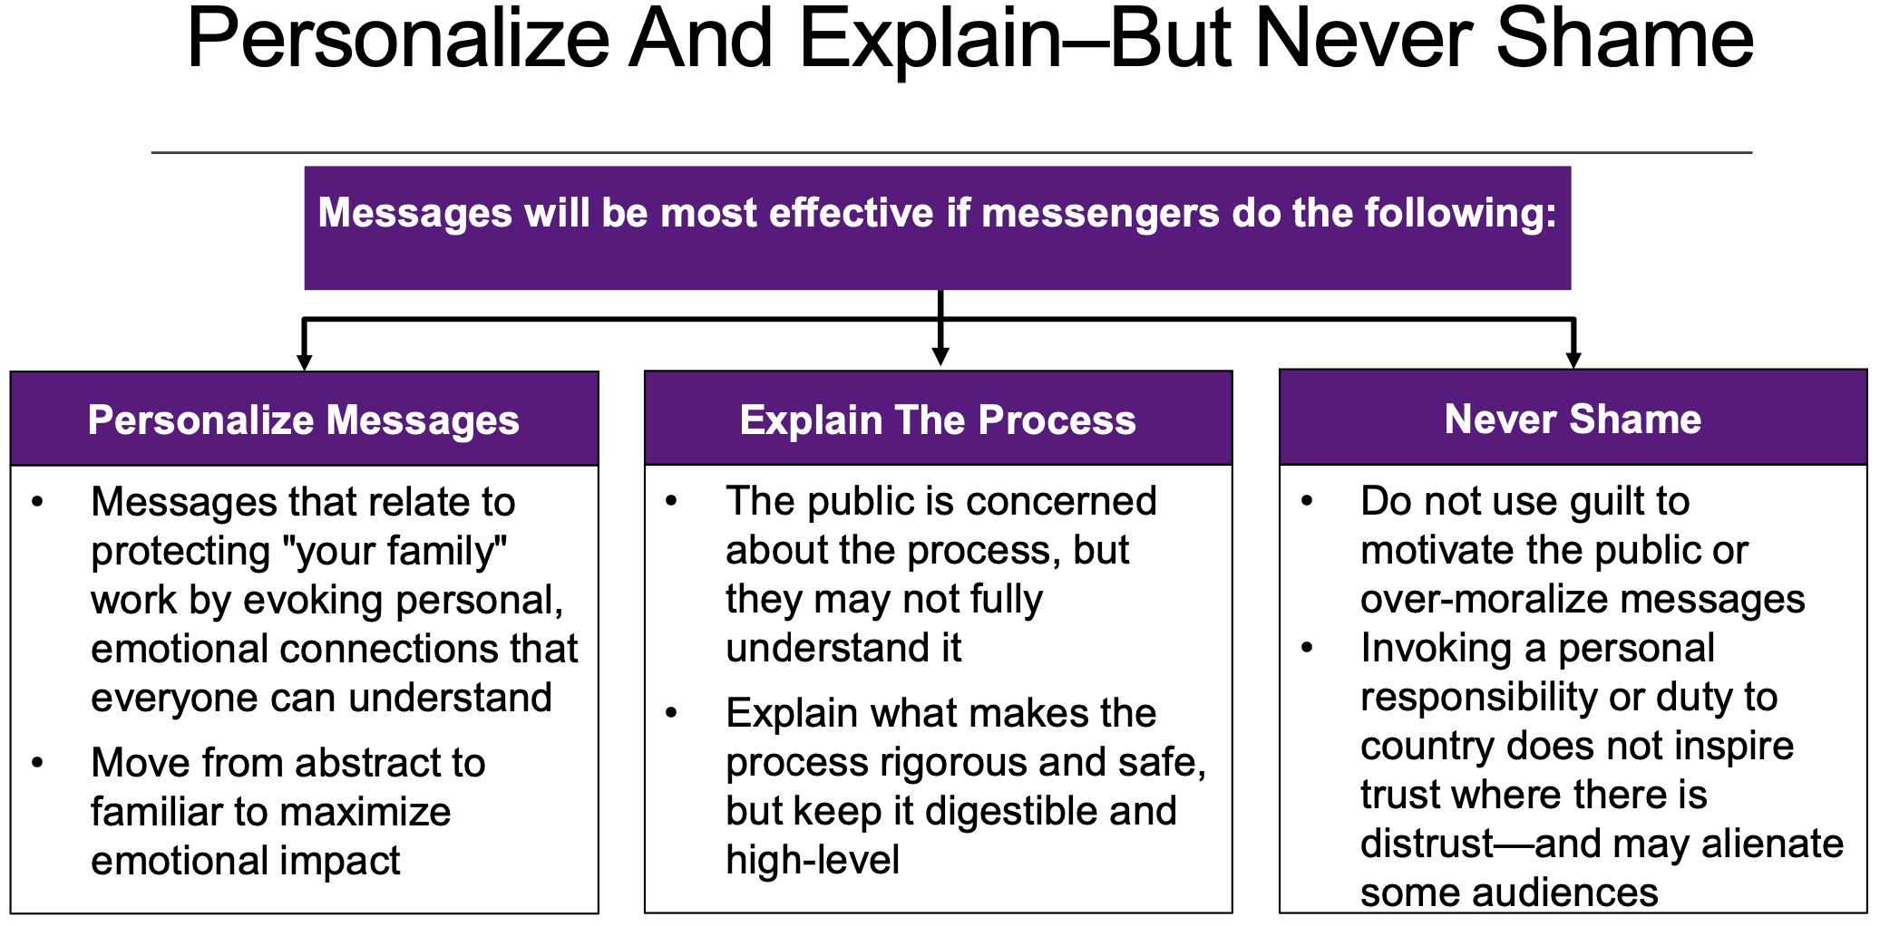
COVID-19 Vaccine Confidence Project: Reagan-Udall Foundation
Notes:
Second, personalize and explain – but never shame

Slide 17
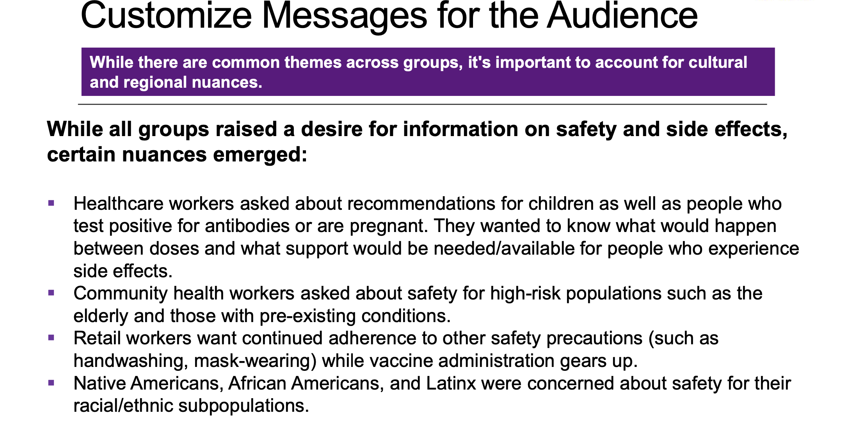
COVID-19 Vaccine Confidence Project: Reagan-Udall Foundation
Notes:
Third, customize messages for each audience

Slide 18
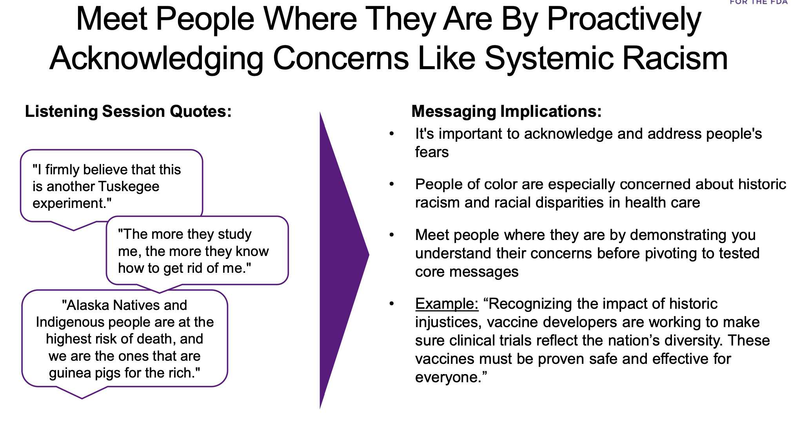
COVID-19 Vaccine Confidence Project: Reagan-Udall Foundation
Notes:
And fourth, meet people where they are – and do this by proactively acknowledging concerns like systemic racsim

Slide 19
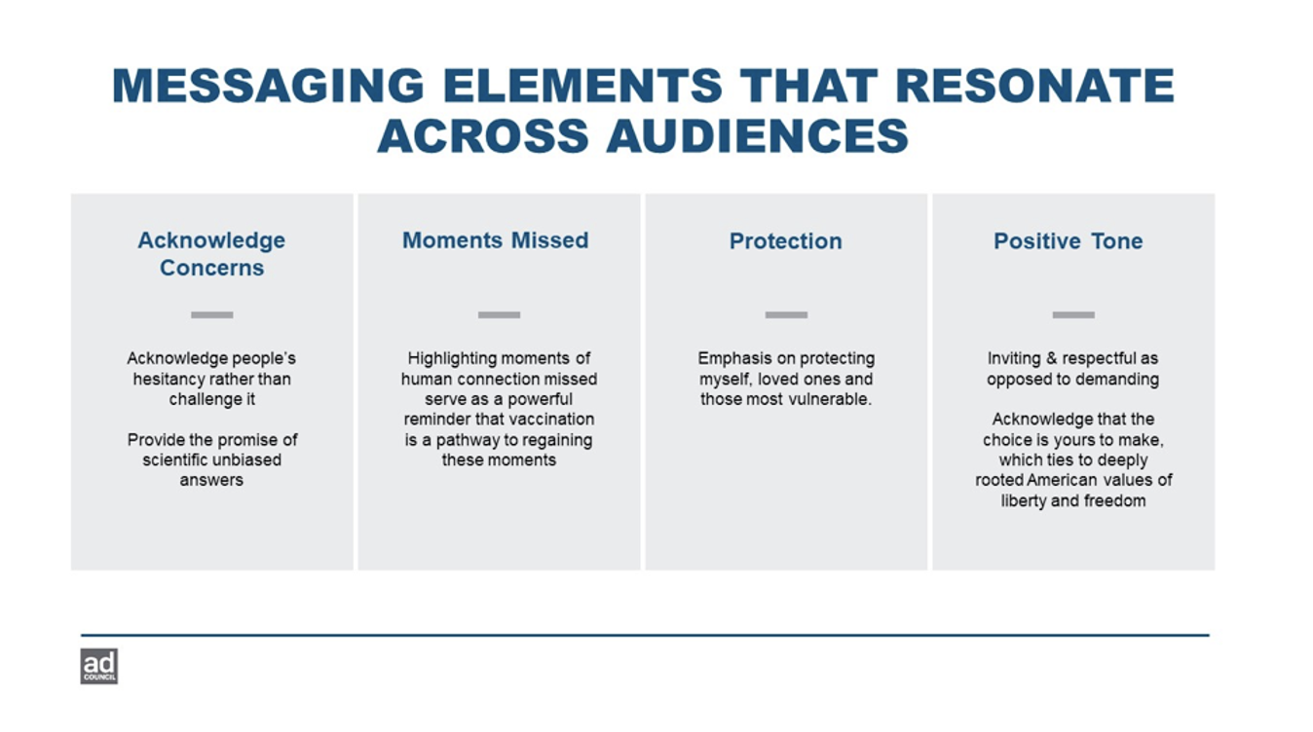
Messaging Elements that Resonate Across Audiences
Notes:
According to the Ad Council, messages that resonate across all audiences include:
Acknowledging people’s hesitancy rather than challenging it
Highlighting moments of human connection that were missed due to a vaccine-preventable disease
Protecting myself, loved ones and those most vulnerable
Using a positive tone that is inviting and respectful – not demanding

Slide 20
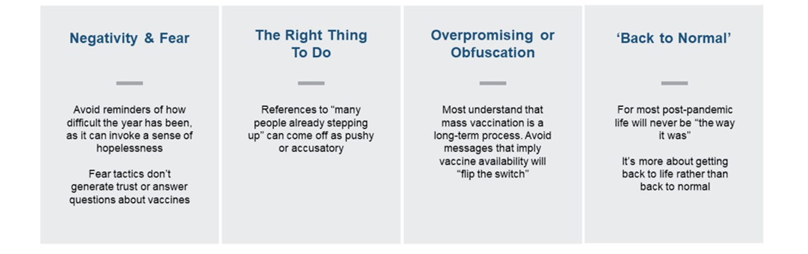
Messaging Elements that Don’t Work
Notes:
On the other hand, there is some messaging that is rejected across all audiences:
Negativity and fear tactics
Telling people it is the “right thing to do”
Overpromising – and ignoring thr fact that it is long-term process
Suggesting we will get back to “normal” or the way life was

Slide 21
Vaccine Acceptance Strategies & Messaging: Lessons From the Flu Vaccine (REACH)
Hispanic/Latino/Latinx
“Protecting your loved ones, communities”
Younger people turn to/listen family elders
Radio/TV ads/Facebook/What’s app – all work
People expect transparency in messaging – side effects
Gather data using focus groups (with community members as facilitators)
Account for dialects, nuances etc. (with community input)
Return to the community with results to facilitate findings
Address food and housing insecurity in communities (e.g., Immigrants not able to access federal resources)
Address concerns about vaccine cost,
Address concerns about immigration status
Partnerships with Mexican Consulate (New Mexico) and other long-standing partners in the community works
Notes:
[Source not identified, unless it is the reference on the previous slide]
Let’s look at what we have learned from vaccine acceptance strategies and messaging used with the flu vaccine in racial/ethnic populations
From the Hispanic/Latino/Latinx:
“Protecting your loved ones, communities”
Younger people turn to/listen family elders, “whatever grandma says…”
Radio/TV ads/Facebook/What’s app – all work
People expect transparency in messaging – side effects
Use focus groups (utilizing community members as facilitators) to gather data
Translate materials carefully to account for dialects, nuances etc. (with input from community)
Go back to the community with results obtained in order to facilitate findings
Address food and housing insecurity in some communities—for example, Immigrants – may not be able to access federal resources
Address concerns about vaccine cost,
Address concern of whether one’s immigration status will be questioned at vaccine sites
Partnerships with Mexican Consulate (New Mexico) and other long-standing partners in the community works

Slide 22
Vaccine Acceptance Strategies & Messaging: Lessons From the Flu Vaccine (2) (REACH)
American Indian
Alaskan Native
Big media buys do not work
Groundwork and grassroots efforts do work
Approach each Pueblo or Tribe separately
Treat as individual communities
Allow trusted messengers to conduct and facilitate listening sessions and then bring information back to sponsor/grantee. Tribal leaders need to be involved in constructing all messaging
Respect the preservation of culture through the elders
Paper (flyers, posters) does not work
Digital stories do work
Each community has its own private social media channel
Message focus: “why you got the flu vaccine”
Notes:
American Indian:
Big media buys do not work
Groundwork and grassroots efforts do work
Approach each Pueblo or Tribe separately
Treat as individual communities
Allow trusted messengers to conduct and facilitate listening sessions and then bring information back to sponsor/grantee. Tribal leaders need to be involved in constructing all messaging
Respect the preservation of culture through the elders
Alaskan Native:
Paper (flyers, posters) does not work
Digital stories do work
Each community has its own private social media channel
Message focus: “why you got the flu vaccine”

Slide 23
Vaccine Acceptance Strategies & Messaging: Lessons From the Flu Vaccine (3)(REACH)
Marshallese
Asian
Acknowledge and respect historical events, like radiation testing on Islands
Trusted messengers from within the community are key
Need to translate messages into all dialects – with community input
Longstanding relationships in the Asian American community are key
Trained messengers in the Asian and Arab communities (E. Michigan)
Notes:
Marshallese:
Acknowledge and respect historical events, like radiation testing on Islands
Trusted messengers from within the community are key
Asian American:
Need to translate messages into all dialects – with community input
Longstanding relationships in the Asian American community are key
Trained messengers in the Asian and Arab communities (E. Michigan)

Slide 24
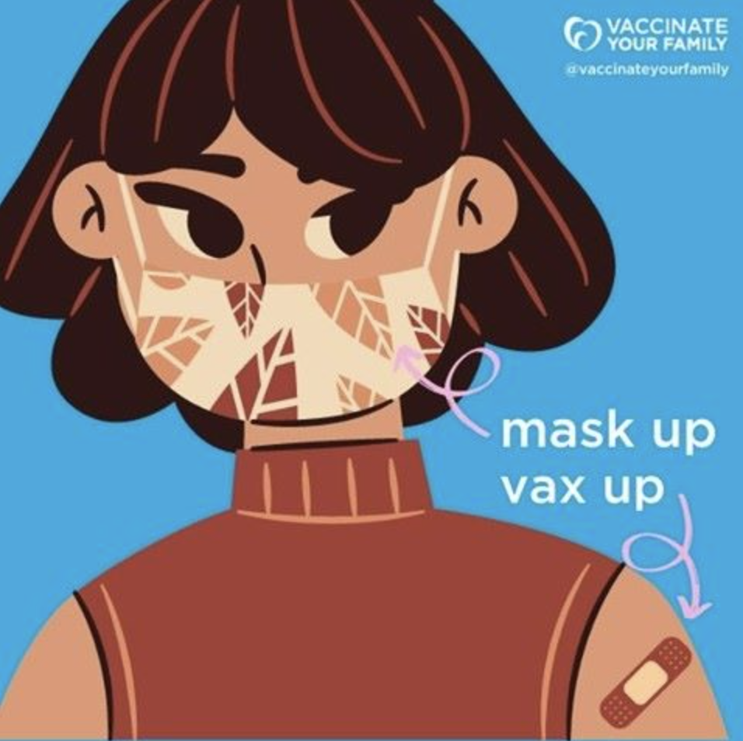
Using Social Media to Increase Vaccine Acceptance
Notes:
Just as anti-vaxxers use their own spaces on social media to spread their message, we can use social media to increase vaccine acceptance

Slide 25

Social Media & Vaccine Acceptance
The more uncertain you are, the more likely you are to turn to social media for answers
That’s why social media platforms can play a strong role in mitigating vaccine misperceptions
Vaccine attitudes can help and inform interventions, assist with audience segmentation and allow you to tailor message to address attitudes
Social media influencers (media organizations, celebrity doctors,, etc.) can sway attitudes
‘Framing’ is key (gain vs. loss): “If you get a vaccine, this is what you will gain vs. if you get a vaccine, this is what you will lose”
Vaccine attitudes are clustered online – educate key influencers to tell your story
Always review comments after a posting
Notes:
According to John Hopkins webinar in February on social media interventions and vaccine hesitancy…
The more uncertain you are, the more likely you are to turn towards social media for answers.
Hence social media platforms can play a strong role in mitigating vaccine misperceptions. Vaccine attitudes can help and inform interventions, assist with audience segmentation. Allows you to tailor message to address attitudes to drive towards vaccine acceptance.
Social media influencers can sway attitudes (e.g. media organizations, celebrity doctors)
‘Framing’ is key (gain vs. loss). “If you get a vaccine, this is what you will gain vs. if you get a vaccine, this is what you will lose”
Vaccine attitudes are clustered on line – an ‘echo-chamber’ – educate key influencers to tell your message
Review comments after a posting
https://www.jhsph.edu/ivac/2021/01/27/webinar-social-media-interventions-and-vaccine-hesitancy/

Slide 26
Communication Resources
Notes:
In this next section of the webinar, I would like to talk about some strategies to deal with vaccine hesitancy and increase immunization rates.

Slide 27
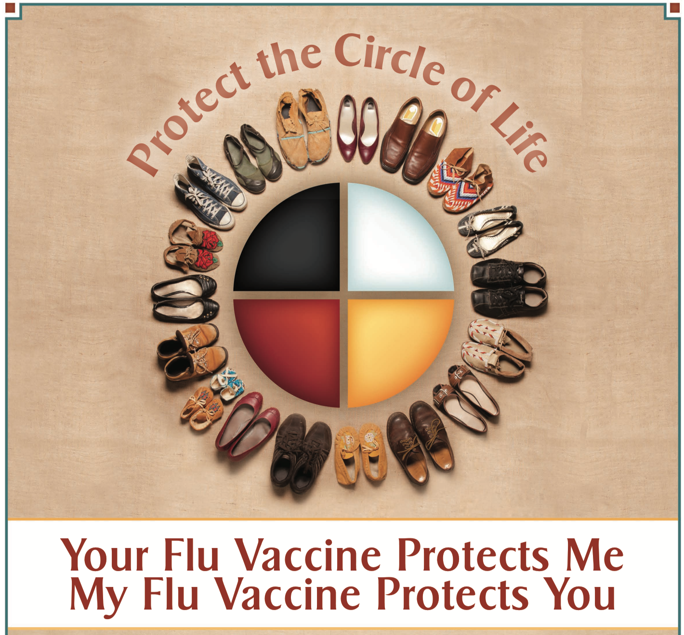
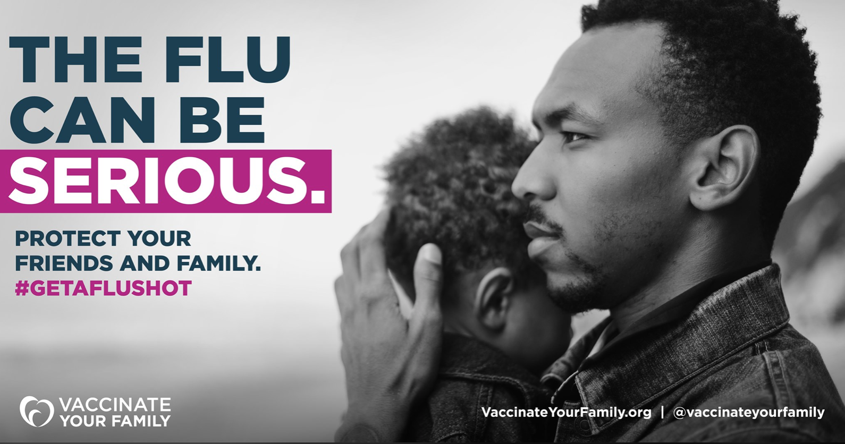

Use Culturally Appropriate Materials
Vaccinate Your Family
CDC
NRC-RIM
Notes:
You may need to adapt or create new materials that are appropriate for your target population.
CDC: https://www.cdc.gov/flu/pdf/freeresources/native/protect_circle_life_poster_8.5x11.pdf
VYF: https://www.facebook.com/VaccinateYourFamily/photos/10160244093359112
NRC-RIM: https://nrcrim.org/vaccines/campaigns/vaccination-campaign

Slide 28


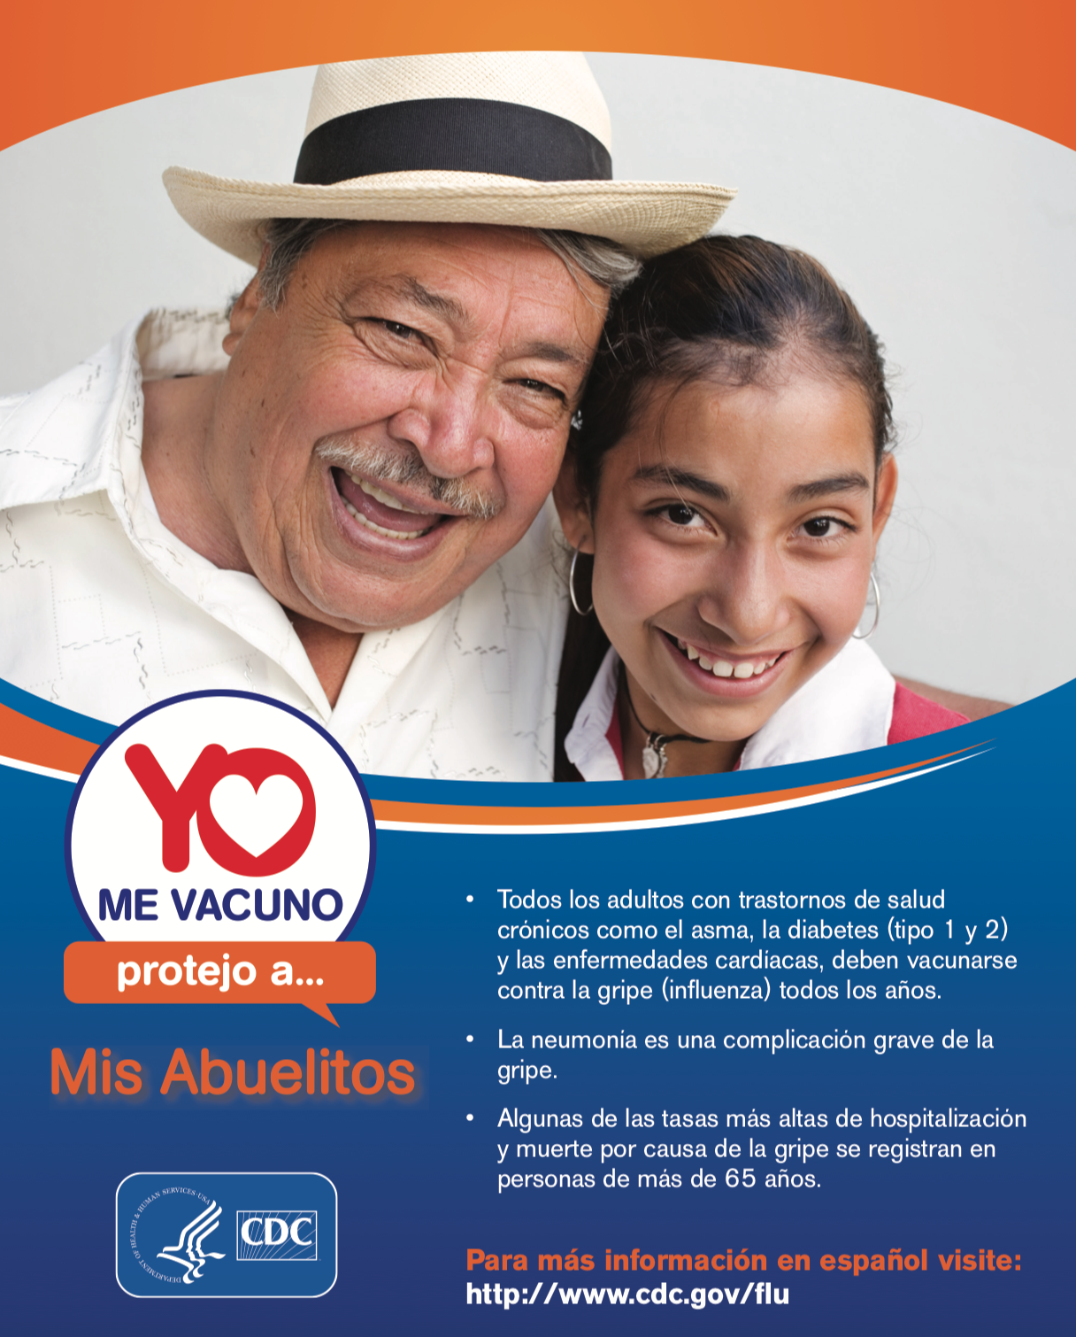
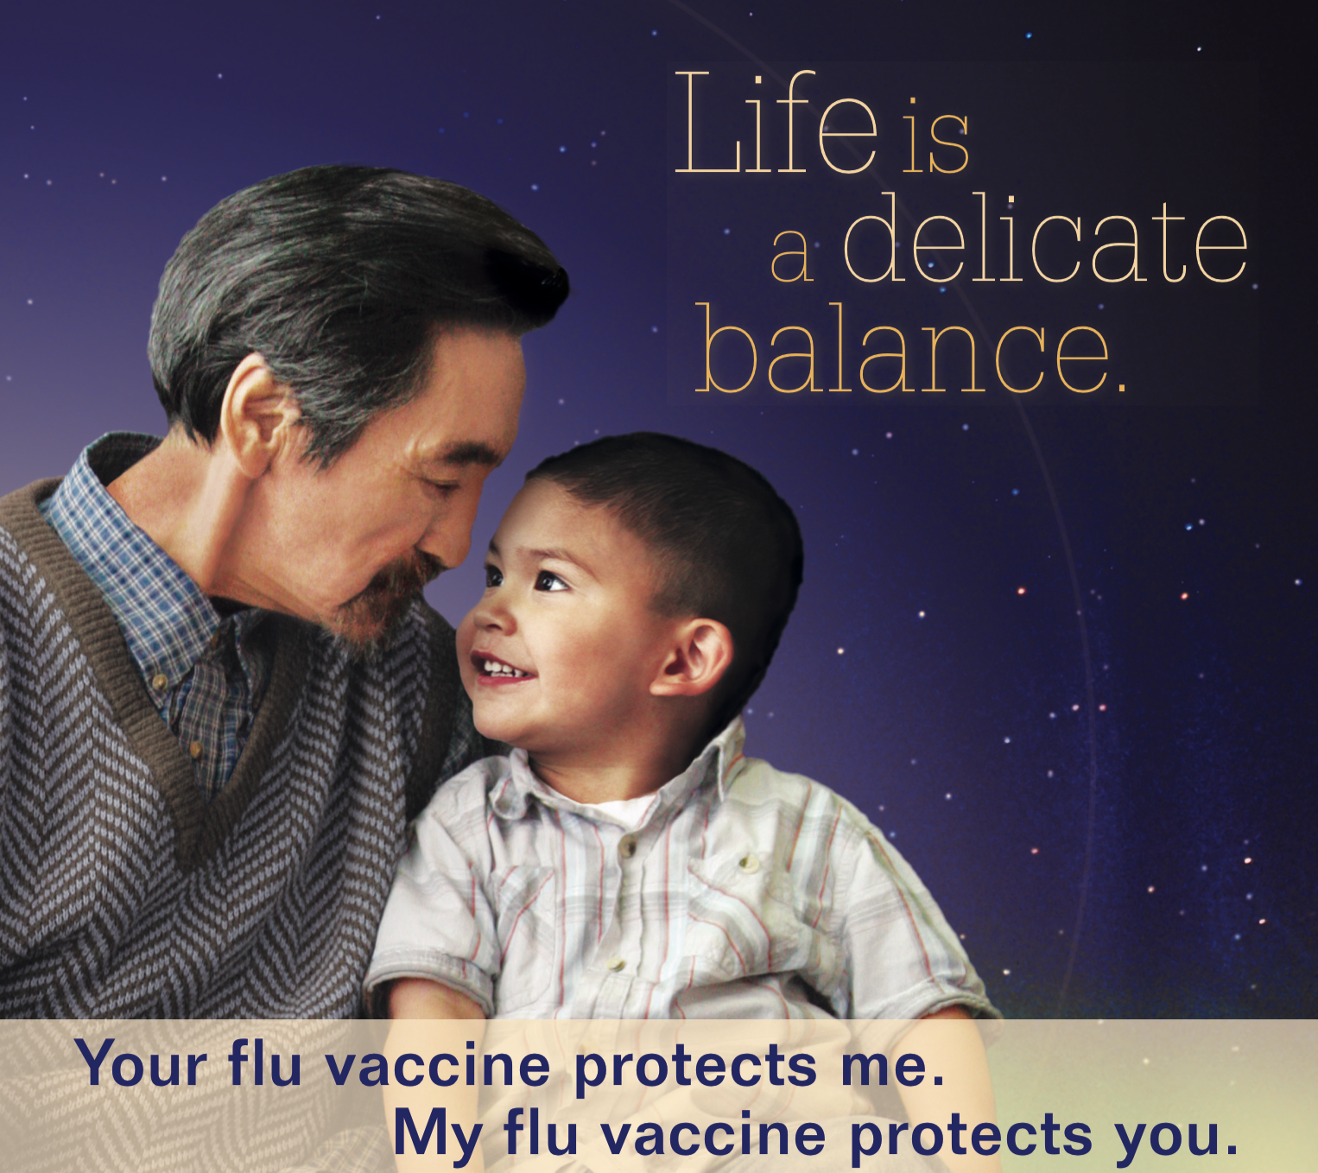
Multigenerational Resources
CDC
CDC
Ad Council
Vaccinate Your Family/
Good Health WINs
Notes:
Here are some examples of multi-generational resources on flu vaccination that might be effective with different groups. I tried to include a hyperlink to the source of each resource so you can find these resources later if you like them.
Ad Council: https://www.adcouncil.org/campaign/vaccine-educationgood
CDC: https://www.cdc.gov/flu/pdf/freeresources/native/f_an_print.pdf
Good Health WINs: https://goodhealthwins.org

Slide 29
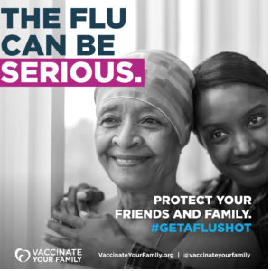
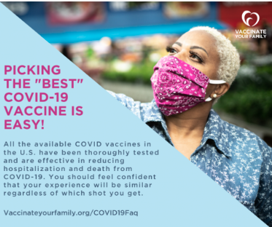
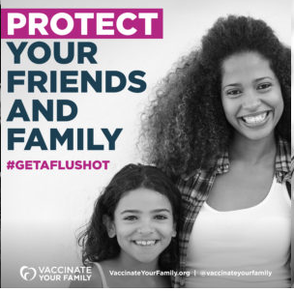
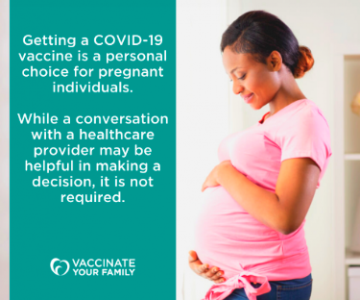
Vaccinate Your Family Resources
Social media graphics promoting flu vaccine in minorities here
Social media graphics on vaccine safety/confidence here
Please tag Vaccinate Your Family when using these graphics on social media
Notes:
Vaccinate Your Family is a non-profit organization that advocates for immunizations in the United States. They have a lot of high-quality social media graphics that are targeting flu vaccination in minority groups. They have also developed a lot of resources that speak to vaccine safety and confidence. I hope you will take a look at the two websites linked to in this slide. Please tag Vaccinate Your Family if you use their graphics on social media platforms
https://www.vaccinateyourfamily.org/vyf-flu-graphics-and-videos/
https://vaccinateyourfamily.org/vyf-vaccinegraphics/

Slide 30
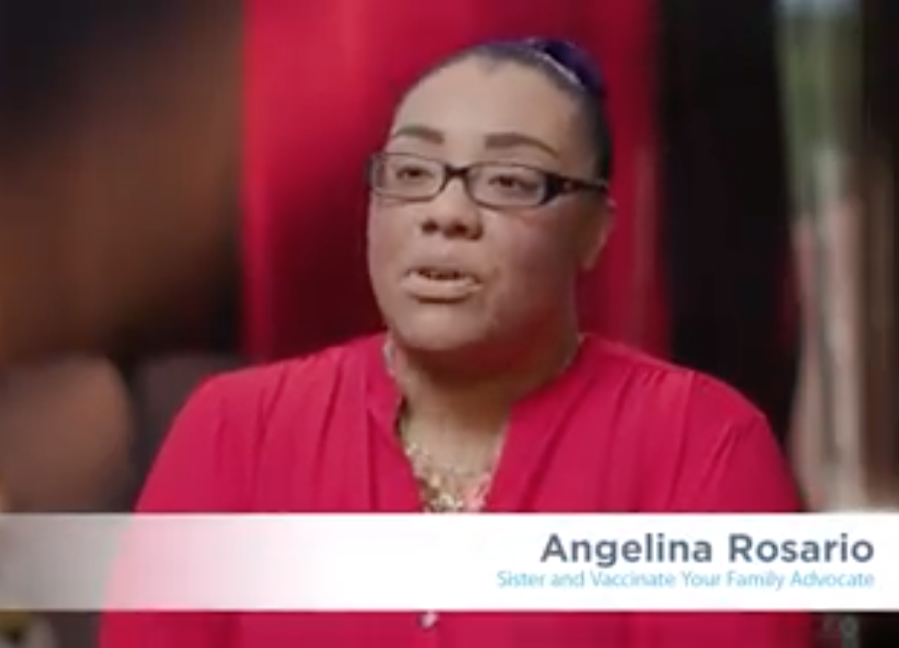
Use Personal Stories
Notes:
Another effective method to convey the importance of vaccination is through personal stories.
Please play the video
https://www.facebook.com/28164899111/videos/34016562732204

Slide 31
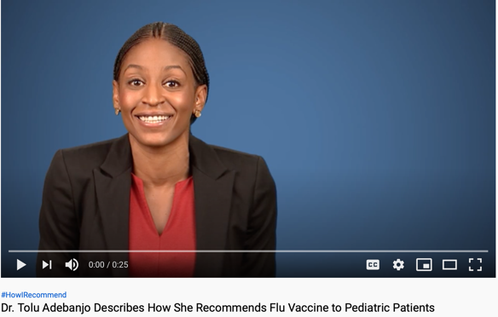
CDC’s #HowIRecommend Vaccine Series
Notes:
This video shows how this provider makes flu recommendations to her patients. CDC has a series of videos from healthcare providers talking about how they recommend vaccines.
https://www.youtube.com/watch?v=tiFGgfPohos
Please play the video

Slide 32
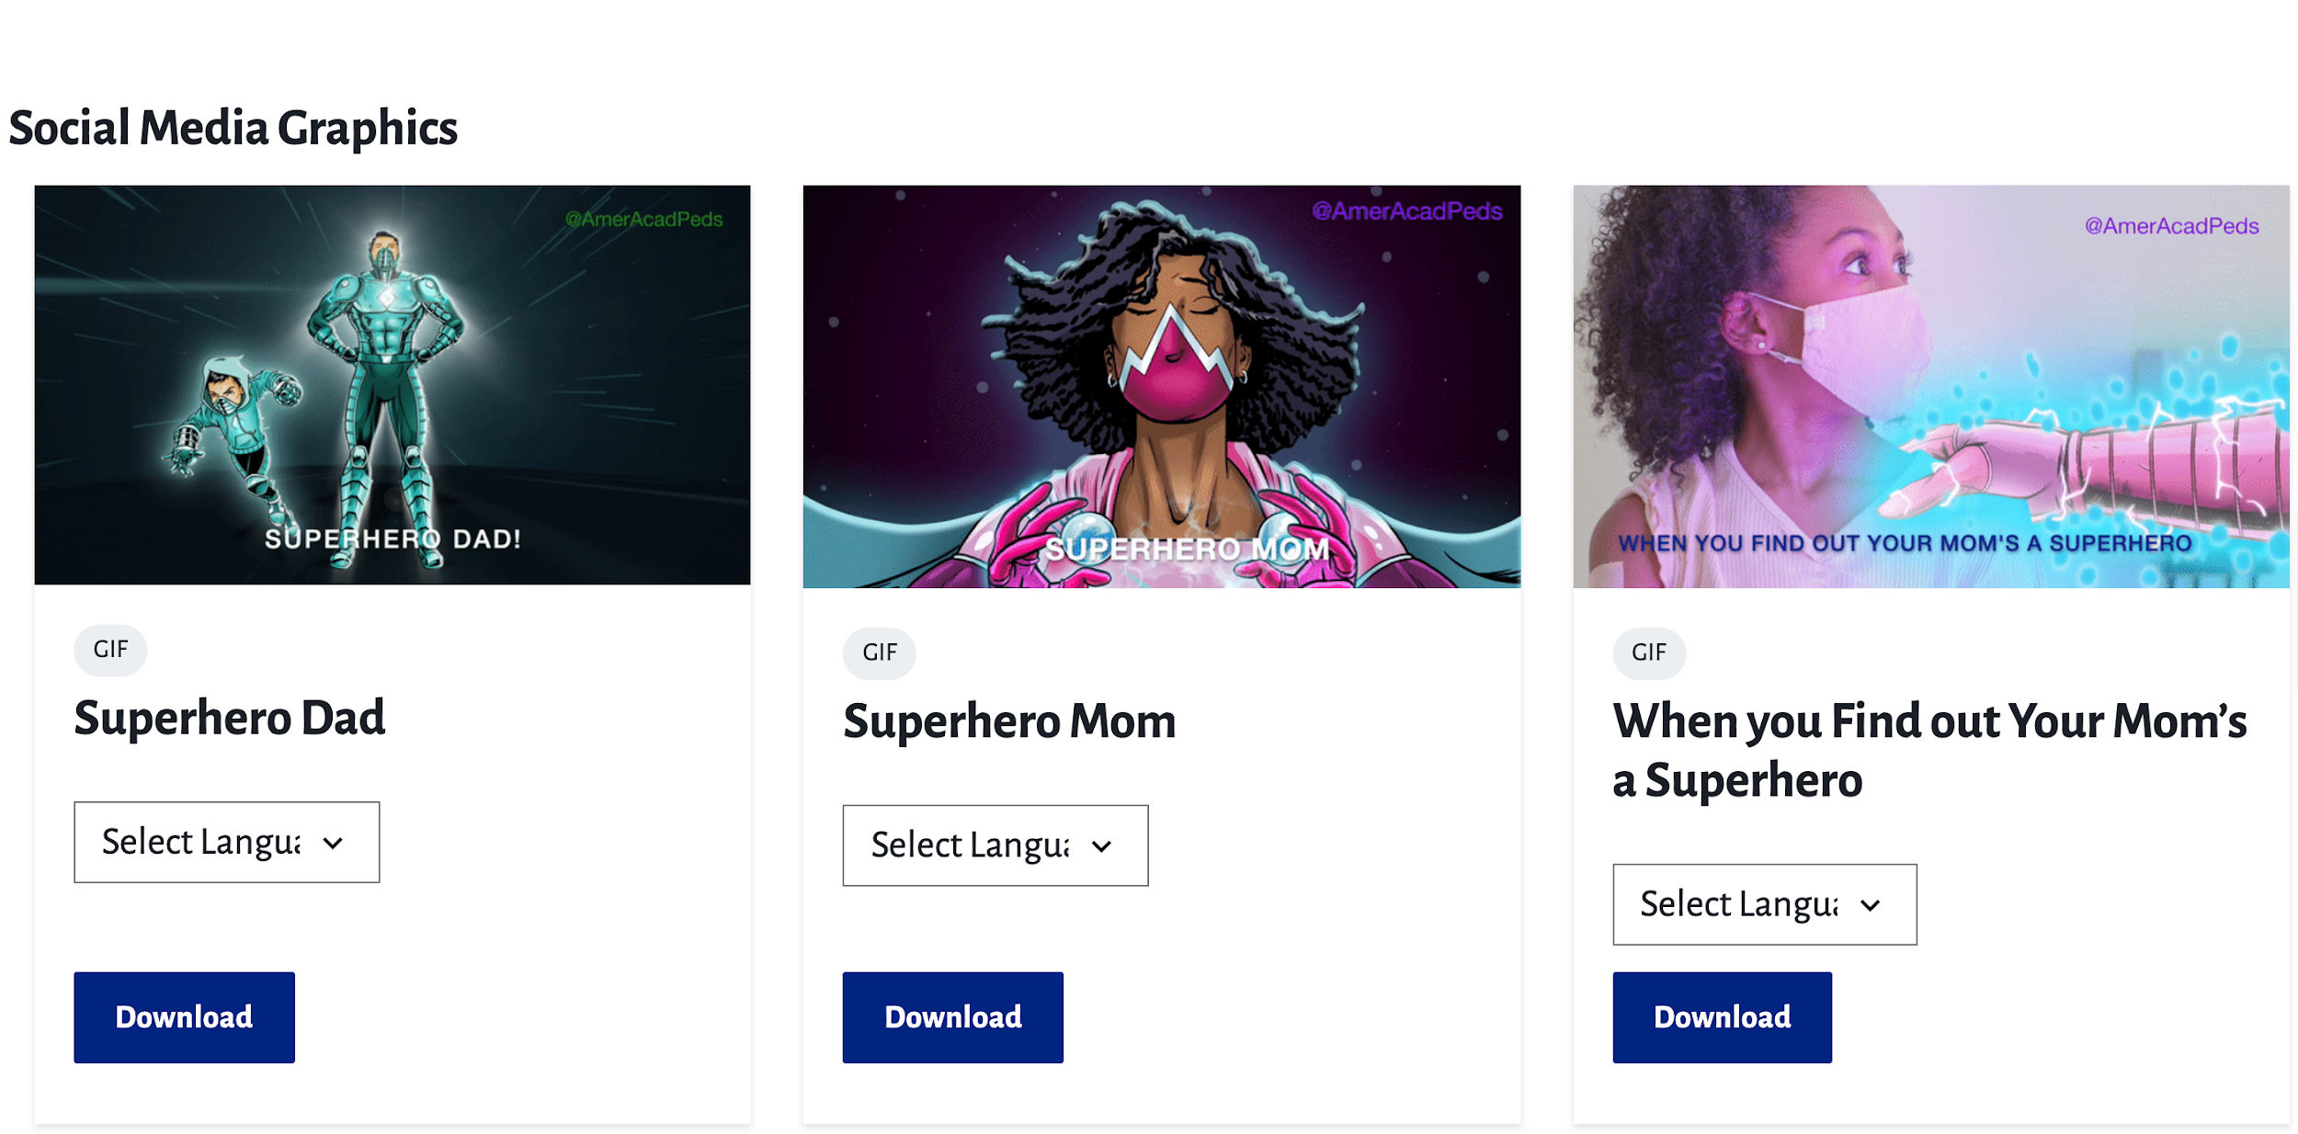
#Call your pediatrician - AAP
Notes:
From the American Academy of Pediatrics: https://services.aap.org/en/news-room/campaigns-and-toolkits/call-your-pediatrician/
Using humor and real-world conversations, we have launched the #CallYourPediatrician campaign, which aims to reach parents with timely reminders that going to the pediatrician, even during COVID-19,is important and safe.
videos,
Social media graphics, messaging

Slide 33
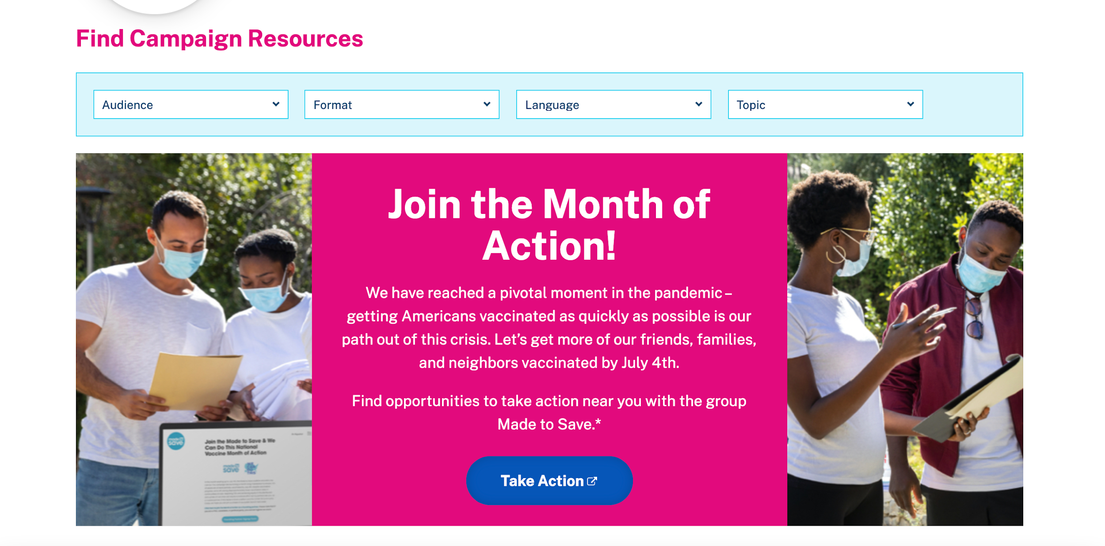
Notes:
Link: https://wecandothis.hhs.gov

Slide 34
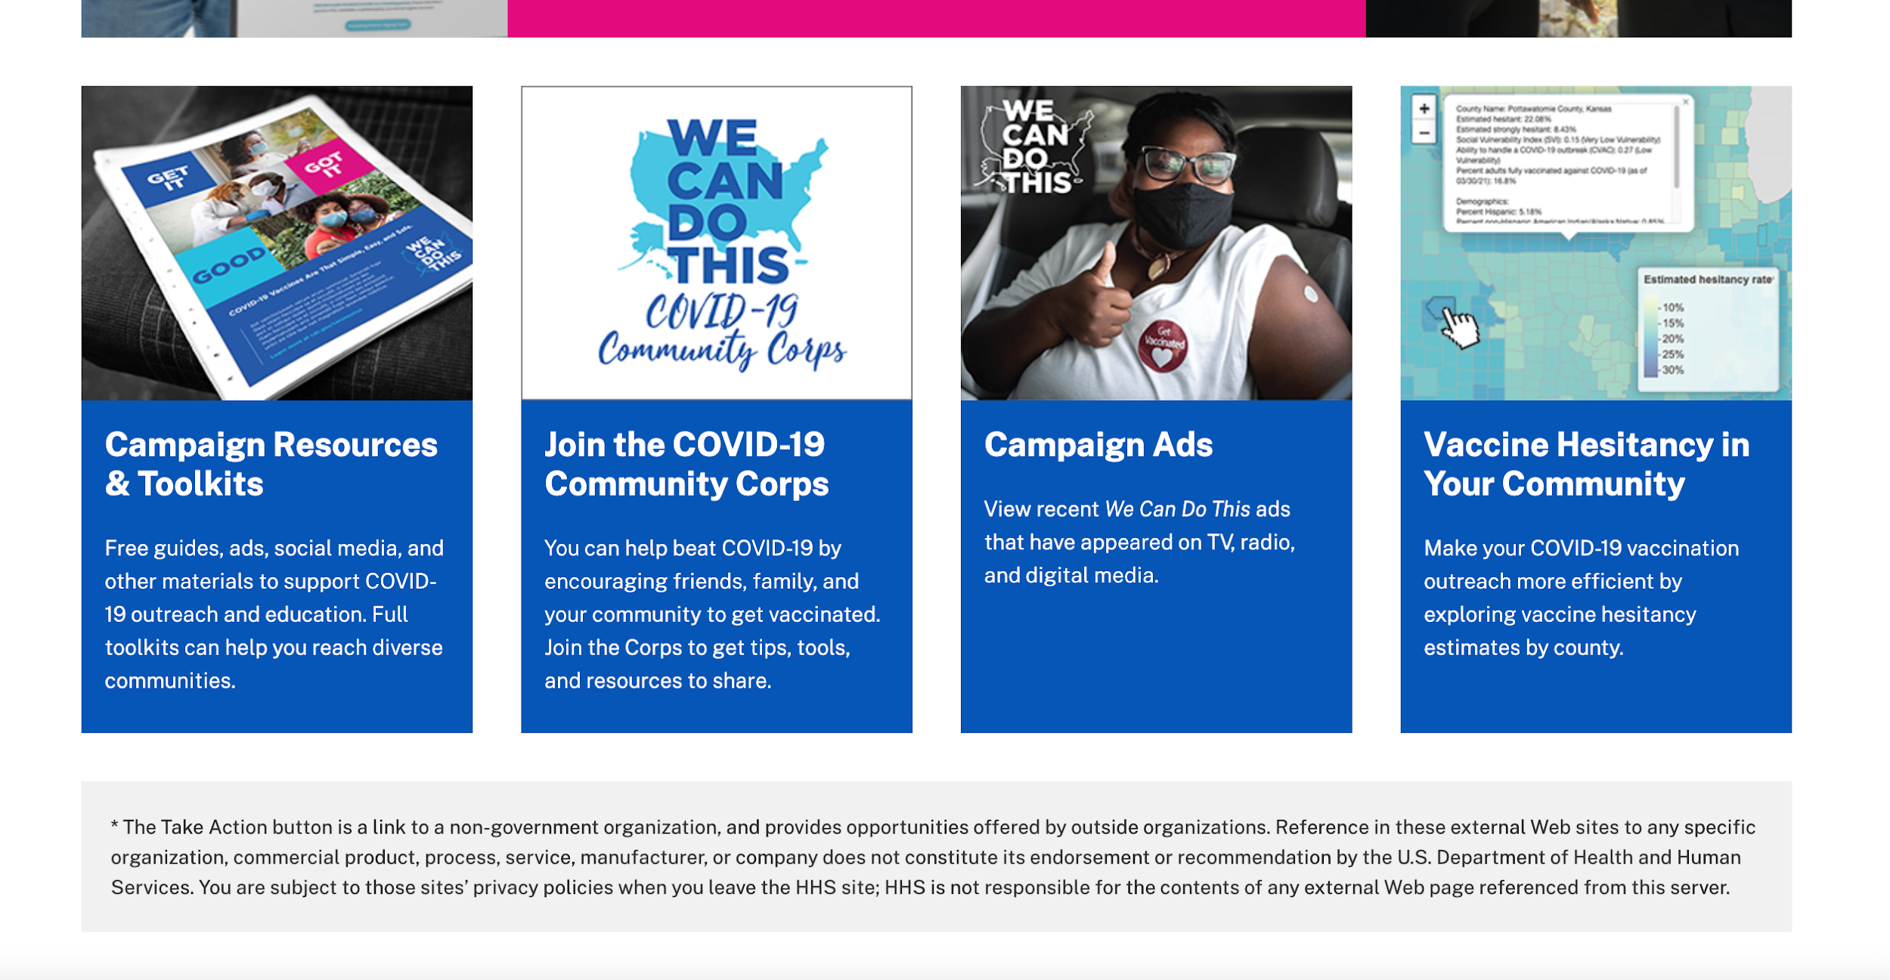
Notes:
Link: https://wecandothis.hhs.gov

Slide 35
Additional Information/Resources

Slide 36
Additional Resources
Our Vaccine. My Decision. website developed by the National Minority Quality Forum: www.our-vaccine.org
It’s Up to You campaign from the Ad Council: https://www.adcouncil.org/campaign/vaccine-education
Changing the COVID Conversation from de Beaumont: https://debeaumont.org/changing-the-covid-conversation/
Power & Immunity Guide from the American Lung Association: https://www.lung.org/getmedia/ec3ef385-7239-44d2-94af-c09051dfdae1/americanlungassociation_vaccineeducationtoolkit.pdf
Vaccine Confidence Toolkit by AIM: https://www.immunizationmanagers.org/general/custom.asp?page=vaccineconfidenceguide

Slide 37
Additional Resources
The Conversation: Between Us, About Us Toolkit: https://www.greaterthancovid.org/theconversation/toolkit/
We Can Do This campaign from HHS: https://wecandothis.hhs.gov
Made to Save resource library: https://madetosave.org/covid-resources/
Families Against COVID-19 by Kimberly Coffey Foundation and Emily Stillman Foundation: https://www.familiesagainstcovid19.org
Vaccine Equity Toolkit by Kaiser Permanente: https://about.kaiserpermanente.org/content/dam/kp/mykp/documents/instructions/covid-19-vaccine-equity-toolkit-external.pdf
National Resource Center for Refugees, Immigrants, and Migrants (NRC-RIM): https://nrcrim.org

Slide 38
Resources for American Indian and Alaskan Native Populations
Northwest Portland Area Indian Health Board’s COVID-19 page
COVID-19 weekly ECHO programs
Video on COVID-19 vaccine questions
Results from a national COVID-19 vaccination survey by the Urban Indian Health Institute
National Indian Health Board’s National Tribal COVID-19 Response
Notes:
These are links to some resources aimed at American Indian and Alaskan Native populations including resources from the Northwest Portland Area Indian Health Board, the Urban Indian Health Institute and the National Indian Health Board

