Slide 1
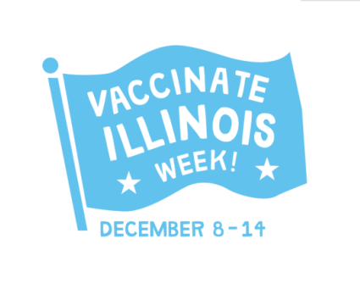
Sustainable Adult Immunization Activities
Julie Morita, M.D.
Medical Director, Immunization Program
Chicago Department of Public Health

Slide 2
Chicago
Total population: 2.7 million*
  NH-White: 45%
  NH-Black: 33%
  Hispanic: 29%
Area of Chicago: 229 square miles
* 2010 US Census

Slide 3
Prevention and Public Health Fund
Adult Initiative, CDC
July 1, 2012-December 31, 2013
  Required projects
    Pharmacies
    Workplace
  Optional projects
    Community Health Centers
Funding: $740,000

Slide 4
Sustainable Activities
Vaccinate Illinois Week
  Localized celebration of National Influenza Vaccination Week
Community Health Center (CHC) Initiative
  Quality improvement interventions
  Vaccine provision – 317, local funds
Notes:
CHC – 265,000
Public information campaign VIW – 30,000

Slide 5
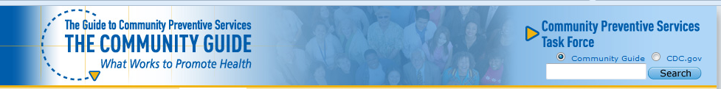
Community Based Interventions Implemented in Combination
Increase community demand for vaccinations
  Mass and small media
  Outreach and tracking of clients
Enhance access to vaccination services
Include interventions directed at providers
  Educational activities
Notes:
Independent, nonfederal, unpaid group appointed by Centers for Disease Control and Prevention (CDC)
Members represent research, practice, and policy expertise in community preventive services, public health, health promotion, and disease prevention

Slide 6

Vaccinate Illinois Week
Local observance of National Influenza Vaccination Week, December 8 - 14, 2013
Partners
  State and local health departments
  Professional organizations (ACP, AAP, AAFP, ACOG)
  Blue Cross Blue Shield of Illinois
  Pharmacies (Walgreens, CVS, Osco)
  Immunization coalition
  Medicare QIO

Slide 7
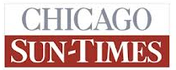



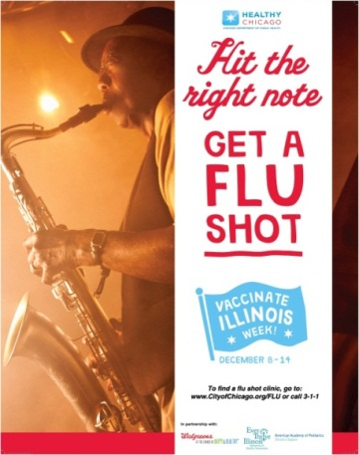

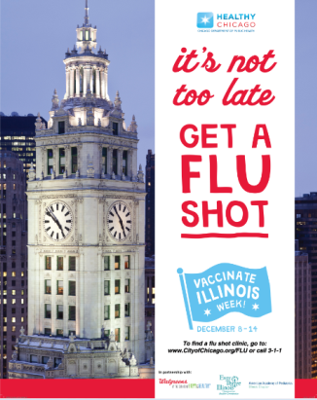


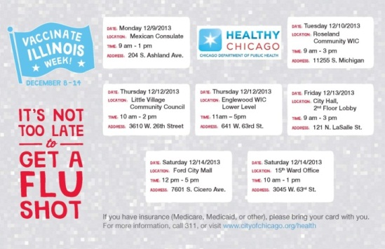


Print and Outdoor Ads
Radio
Community Outreach
Social Media
Flyer distribution (electronically, in-person)

Slide 8

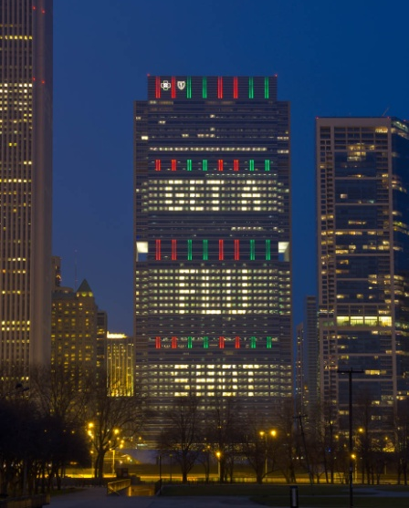

Slide 9




Increasing Access to Vaccines
CDPH clinics
Universities of Chicago and Illinois sites
IDPH clinics
Walgreens
Notes:
Flu vaccine voucher: 28,000 Chicago area

Slide 10
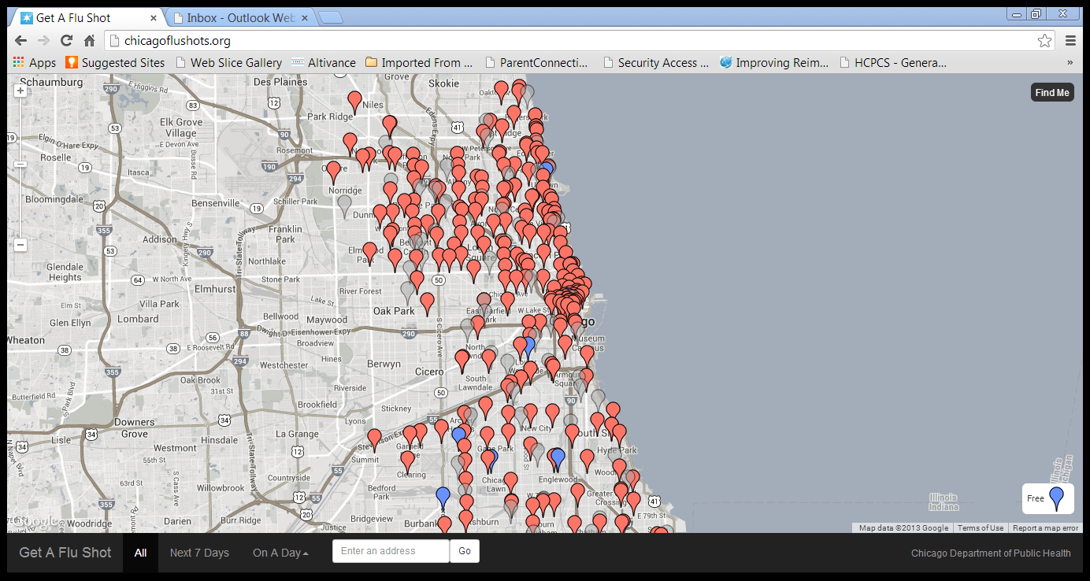
Chicago Flu Clinic Locator
CDPH clinics, retail pharmacies including CVS, Dominicks, Osco and Walgreens
www.chicagoflushots.org
Notes:
More than 2,500 visits and more than 10,000 clicks on sites.

Slide 11





Provider Interventions
Disease and Vaccine Updates
  Newsletter articles
    Professional organizations
    Vaccines for Children Program
    Blue Cross Blue Shield of Illinois
  Influenza Disease Update – Webinar
    CDC and Families Fighting Flu speaker

Slide 12
Summary
Public Health can bring together partners from many sectors
Partners bring resources
Coordinated and consistent messaging facilitates communication
Expansion to early and late season, 2014-2015

Slide 13
Community Health Center (CHC) Initiative
Monthly, CDPH convened CHC staff to guide interventions and provide technical assistance
  Alliance of Chicago Community Health Services
    Network of CHCs (7) with 15 sites
  Beloved Community Family Wellness Center
    1 site
  Near North Health Services Corporation
    6 sites
Notes:
Alliance- vision to promote thoughtful use of health information technology in the Safety Net to promote access, improve quality and efficiency – 100K ~ 50 locations
Near North Health Services – 8 locations – 80K
Beloved Community Family Wellness Center – 1 location 85K

Slide 14
Interventions
Quality improvement initiatives that incorporated electronic health record (EHR) modifications
  Coverage levels using EHR data
  Standing orders, patient and/or provider reminders
  Interface with immunization information system (IIS)
CDPH provided Tdap, pneumococcal, influenza hepatitis B and zoster vaccines
  317 and local funds
Notes:
CDPH used local and 317 funds to purchase Tdap, influenza and hep A/B vaccines for participating CHCs –

Slide 15
Agency | Sites | Coverage levels | Vaccines | Interventions | Interface
Alliance (7 CHCs) | 15 | Pre and post intervention coverage levels determined | Tdap Influenza PPV23 Hep B Zoster | Educational materials EHR huddle reports* Order sets* Patient reminders Provider reminders* Training | Centricity – ICARE in production
Beloved | 1 | Coverage levels determined monthly | Tdap Influenza PPV23 Hep B Zoster | Patient reminders Provider reminders* (huddle reports, color chart flags) Standing orders* Training | Next Gen – ICARE *
Near North | 6 | Pre and post intervention coverage levels determined | Tdap Influenza PPV23 Hep B Zoster | Educational materials Patient reminders Provider reminders* Standing orders* Training | Centricity – ICARE in production
* Public Health Node – state funded program to assist with development of interface
Notes:
10 FQHCS with 48 sites participating
CDPH provided guidance for coverage level determinations
FQHCs struggled with doing this
CDPH evaluated CoCasa as potential tool for adult immunization coverage levels – influenza, pneumococcal vaccines not included
CDPH created programs to determine adult immunization coverage levels – will determine baseline coverage levels for clinics while they are creating own programs for their EHRs

Slide 16
Vaccine Distribution
Agency Name | Hep B | Tdap | Zoster | Pneumo | Influenza
Alliance | 705 | 1,530 | 1,340 | 1,595 | 6,600
Beloved | 0 | 250 | 60 | 230 | 150
Near North | 520 | 1,055 | 565 | 1,305 | 1,900

Slide 17
Summary
CHCs reluctant to invest in adult vaccine systems because vaccine supply inconsistent
CDPH provided vaccine
  Addressed vaccine insecurity
  Vaccine linked to technical assistance
CDPH will make adult vaccine available to CHCs through an application process
Notes:
1. Alliance is a lead IT agency for 11 FQHCs – high level of EHR support, low level of engagement of staff at individual FQHCs
Beloved is a small FQHC with low level EHR support and high level of engagement of staff
2. 2/3 contracts issued
3. CoCasa to be updated. Interim solution is CDPH program.

Slide 18
Discussion

