Slide 1
Creating Messages that Work:
Quick Guide to Adult Vaccine Messaging
Amy Callis, MPH
Senior Health Communication Specialist
Carter Consulting for NCIRD Health Communication Science Office

Slide 2
overview
Overview: Patient Education Work Group Quick Guide
Application: Using the Quick Guide to update products
Exercise: Creating a plan to help partners support NIAM
Notes:
Take a minute to quickly introduce my other workgroup co-chairs – Laurel and Erin. Our fourth co-chair Erica DeWald could not be here but I did want to single her out as the guide was led by her.

Slide 3
Using the guide
Updating current materials: To help you think through when updating your materials
Creating new materials: Considerations for developing new materials
Resources: Comprehensive list of additional resources if you want to take a “deep dive”
If your organization doesn’t have its own materials, we provide some options on materials you can use.
http://www.izsummitpartners.org/wp-content/uploads/2014/05/AdultVaccineMessaging2.pdf
Notes:
We know that many of you have a suite of adult focused immunization products – this guide is intended to help you focus you efforts when updating and creating new materials. For those who do not have their own suite of products, we also have a number of products from CDC and NPHIC based on these principles. We also encourage you all to share your products with fellow workgroup members.

Slide 4
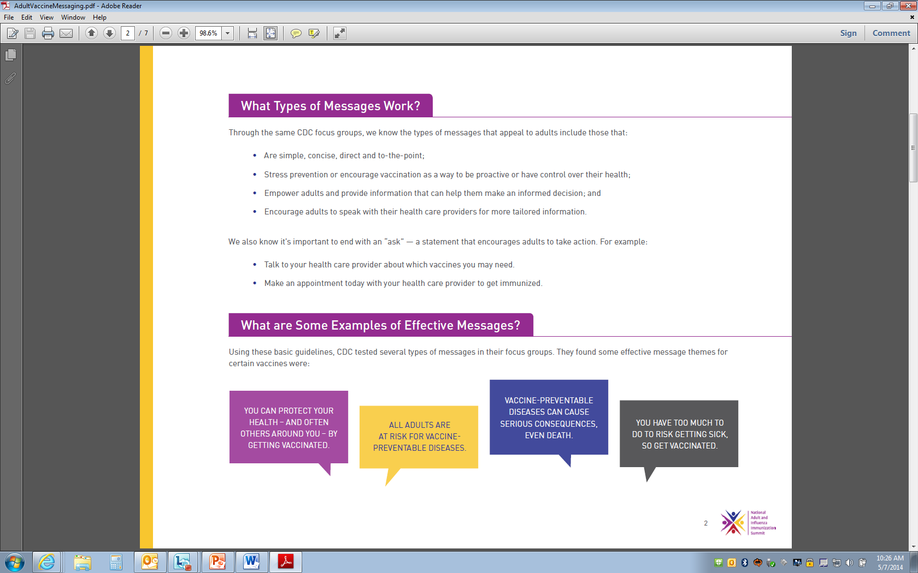
Quick guide to adult vaccine messaging
Motivation
  Protection from serious disease
  Remember, adults need to believe they are susceptible before a “protection” message will resonate with them so consider tying the two together.
  Protecting others
  Talk to your healthcare professional
  Biggest predictor is a HCP recommendation so drive your audience to talk with their HCP
Notes:
Wanted to spend just a little time with a high level overview of some of the key points in the guide. We’ll actually be presenting the guide more in-depth to the entire summit during tomorrow’s Patient Education presentation.
For the break out’s purposes we’ll be focusing on three components of messaging: motivation, types of messages and tailoring messages.

Slide 5
Quick guide to adult vaccine messaging
Types of Messages
  Simple, concise
  Prevention, proactive
  Empowering to make informed decision
  Call to Action – talk with your HCP!
Adapting Messaging – TAILOR your messages!
  Age
  Minority populations
  Newly insured
  Chronic conditions

Slide 6
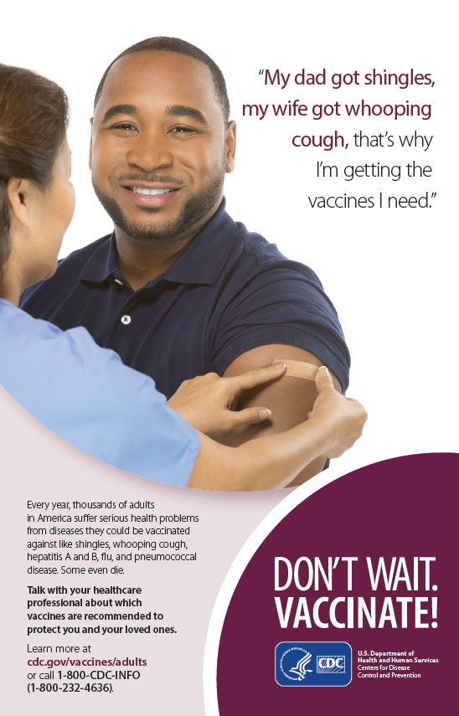
Applying the principles
  Motivation:
  Protection from serious disease. Part of motivating adults in thinking about protection is helping them to recognize they are susceptible.
  Visuals:
  Simple but engaging by looking at directly at the camera.
  Illustrating a positive experience with the desired action (getting vaccinated)
  Keep in mind many people have a fear of needles so try not to use images of people actually getting a shot.
  CTA: Don’t Wait. Vaccinate! Talk with your HCP

Slide 7
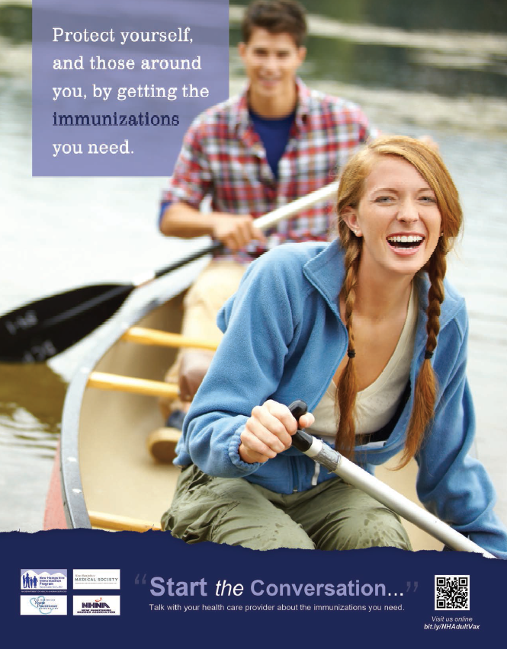
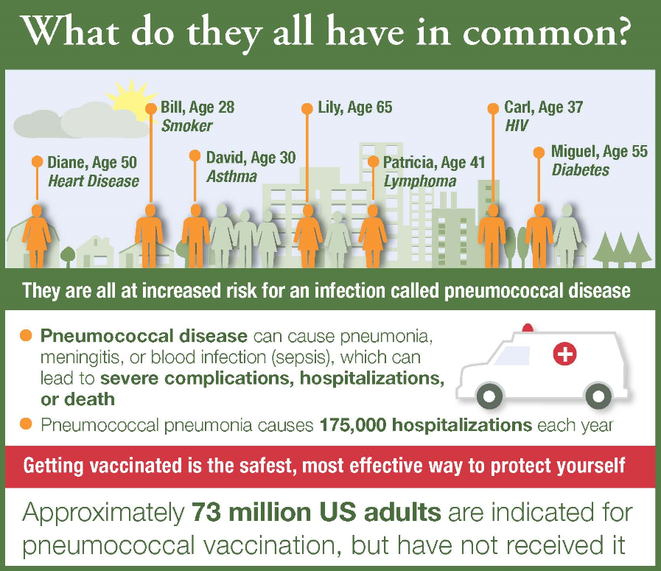
Applying the principles
Notes:
Left: New Hampshire IZ Program – note the simple and concise messaging that is both protection and proactive. The active, positive imagery lends itself to the empowering message that is so effective. There is a great CTA – Start the conversations. And the smart phone barcode is a great touch for folks that want more information.
Right: NFID infographic. Note the nice tailoring – providing a “snap shot” way of showing all the folks at risk and allowing the reader to self-identify as well as show the depth and breadth of individuals at risk by highlighting different ages and health conditions.

Slide 8

Creating a plan for niam
National Immunization Awareness Month (August):
  Adult Week: Aug 24 – 30
  Sponsored by National Public Health Information Coalition
  One of the few national opportunities for Adult Vaccination!
Opportunities:
  Build relationships with key audience organizations to help disseminate messages
  Give presentations
  Encourage non-traditional partnerships
  Update your materials and/or use CDC and NIAM materials during NIAM:
    Place matte articles in local papers, newsletters, etc.
    Update website (including web features)
    Tweet and post on social media
    Place print ads and radio PSAs
    Share factsheets with your constituents

Slide 9
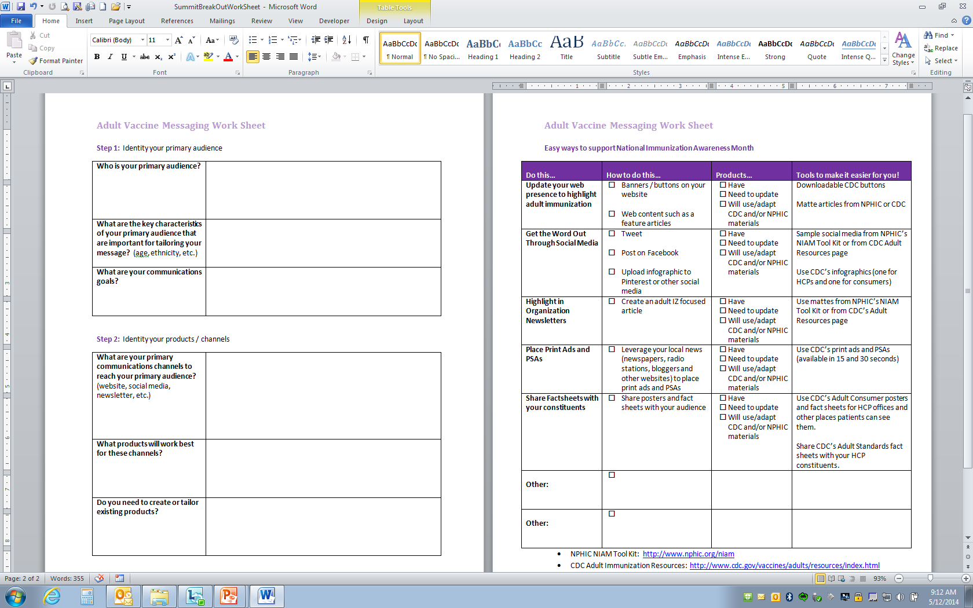
Creating a plan for niam

Slide 10
Creating a plan for NIAM
Showcase your materials and get the word out!
Resources to help:
  CDC (http://www.cdc.gov/vaccines/hcp/patient-ed/adults/for-patients/adults-all.html)
    Posters/Flyers
    Print Ads
    Web Buttons/Banners
    Matte Articles
    Social Media Tweets/Posts
    Web Features
    Radio PSAs
  NPHIC (http://www.nphic.org/niam/)
    Toolkit with matte articles, key messages, ideas for promotion and more!

Slide 11
Creating a plan for NIAM:
Feedback
Who are you key audiences for NIAM?
What are the channels you will use?
What products are going to be most useful?
How many of you have products you will:
  Use for NIAM
  Will you update them?
  Will you use CDC and NPHIC products?
How can you collaborate with others to amplify the message?
Any different ideas for NIAM?

